Slide 1

Advanced SkillsUSA Advisor Teaching Tools: Welcome Pathful
Tuesday October 14, 2025

Slide 2


Slide 3
Session Goals
Explore how Pathful supports classroom career connections.
Learn practical ways to integrate Pathful with SkillsUSA activities.
Understand advisor tools and student experiences.
Share best practices for bringing industry to your students.

Slide 4
What is Pathful?
Pathful is SkillsUSA’s new all-in-one career readiness platform, replacing Absorb.
Designed for students and advisors.
Connects classroom learning to real careers.
Houses all SkillsUSA member benefits: Framework e-learning, Technical Standards, and professional development.

Slide 5
Why Pathful Matters
Career-connected learning at your fingertips.
Digital guest speakers through Pathful Live events.
Exploration and engagement: Students meet real industry pros.
Equity and access: Every student can explore every career cluster.

Slide 6
Member Benefits
Professional Member
Student Member
Easy-to-use teaching tools aligned with SkillsUSA Framework.
Access to Framework Integration Toolkit, Essential Element Modules, and Program of Work ideas.
Built-in tracking and reporting for student participation.
Career videos, virtual job shadows, and mentor connections.
Helps students build professional confidence and identify goals.
Supports employability, workplace, and technical skill growth.

Slide 7
Pathful in Action: Classroom Ideas You Can Use Tomorrow
Quick Bell-Ringer or Sub Plan Activities:
“Career Clip of the Day” – Play a short Pathful video; have students identify which SkillsUSA Framework skills they notice.
“Guess the Skill” – Mute a Pathful Live replay and ask students to infer which Framework element is being demonstrated.
“Rapid Reflection” – One-sentence journal: “How does this career connect to what we’re learning today?”

Slide 8
Pathful in Action: Classroom Ideas You Can Use Tomorrow
Classroom Integration:
Framework Fridays – Use an Essential Element Module in Pathful once a week, paired with a class discussion.
Career Connection Corners – Assign each student a different career video and have them present a ‘one-minute career commercial.’
Program Tie-In – Auto students watch an automotive tech interview; photography students watch a creative industry video; health students shadow a nurse—then all share how their field practices professionalism.

Slide 9
Pathful in Action: Classroom Ideas You Can Use Tomorrow
Project or Competition Integration:
Career Exploration Research Project – Students pick a Pathful career and build a short slideshow connecting it to their SkillsUSA competition area.
Pathful Live + Reflection – Watch a Pathful Live event together, then use a Framework reflection sheet (Personal, Workplace, Technical Skills).
Mock Interview Prep – Use Pathful’s interview videos to spark conversation about common employer expectations.

Slide 10
Pathful in Action: Classroom Ideas You Can Use Tomorrow
Reflection and Assessment Ideas
Add a short Pathful reflection to portfolios or journals:
“What did you learn about this career that surprised you?”
“Which Framework skill do you think is most important in this job?”
“What’s one next step you could take toward this path?”
Use responses for SEL or employability rubric grades.

Slide 11
Advisor & Student Access
Credentials sent to registered SkillsUSA emails.
Advisors can toggle between student/advisor view.
Pathful Support: customercare@skillsusa.org | (844) 875-4557

Slide 12
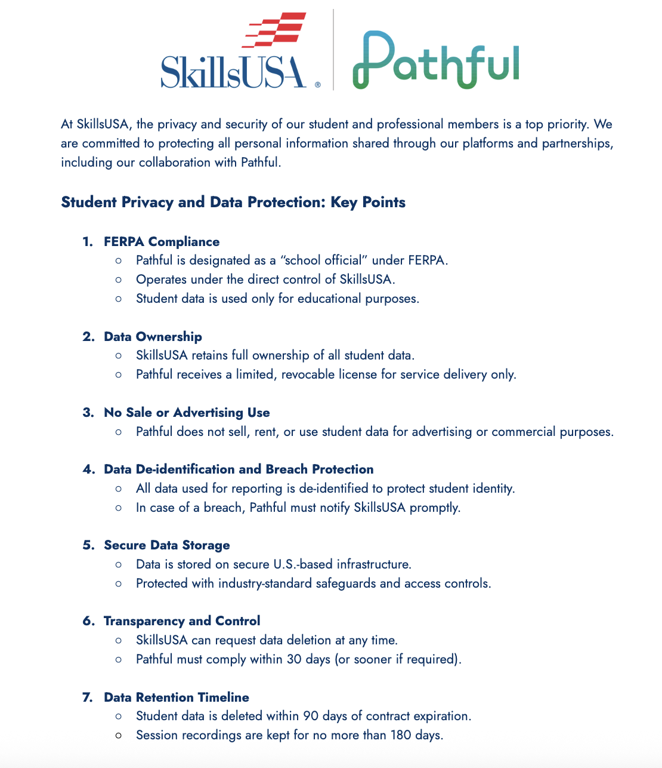
Data Privacy
FERPA & COPPA compliant.
No student data used for advertising.
SkillsUSA retains ownership of student data.

Slide 13
Try It Out!
Choose one way to use Pathful with your students this month.
Share your idea in the chat OR Share the Pathful tool you are most excited to try out

Slide 14
Resources & Support
📎 SkillsUSA WA Advisor Resources
📧 customercare@skillsusa.org
📞 (844) 875-4557

