Slide 1

SkillsUSA Washington Basics
A New Adviser’s Guide to SkillsUSA, from Introduction to Integration

Slide 2

Workshop Sign In Link:
Clock Hour Registration Link:
Google Drive Link:

Slide 3

Karmen Warner
  Title: State Director
  Email: director@skillsusawashington.org
Courtney Burger
  Title: Associate Director
  Email: Courtney@skillsusawashington.org
Adam Scroggins
  Instructor: Pierce County Skills Center
  Email: pugetsoundsouth@skillsusawashington.org

Slide 4
Agenda
State Director Update
SkillsUSA as an organization
SkillsUSA Washington structure
Costs
Essential Dates
Starting Strong
Resources
Integrating Curriculum
Funding
Contact Information

Slide 5
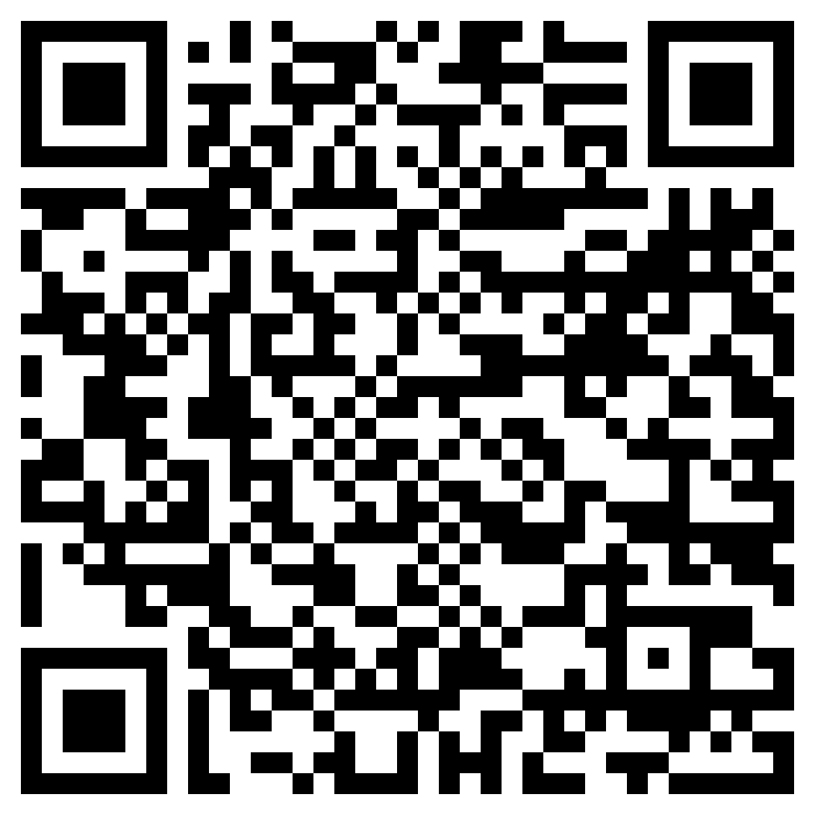
How to Stay in the know
Join the Mailing List
Click to join

Slide 6
A word from the
State Office

Slide 7
Workshop Expectations

Slide 8
About SkillsUSA
https://www.skillsusa.org/
https://Skillsusawashington.org
Founded 1965, as Vocational Industrial Clubs of America (VICA)
Changed to SkillsUSA in 2004
SkillsUSA includes more than 130 different technical, occupational, and leadership competitions.
Partnership of businesses, industry, and educational
Provides scholarships, job opportunities, and advanced training
Over 400,000 members - Middle schools, High schools, and Postsecondary

Slide 9




SkillsUSA Mission Statement

Slide 10








National Partners (600+)
https://www.skillsusa.org/who-we-are/leaders-and-partners/official-partners/
Diamond Level
Platinum Level
Gold Level
Silver Level
Bronze Level

Slide 11















State Partners (50+)
https://skillsusawashington.org/who-we-are/partners/

Slide 12
State Divisions
SkillsUSA Washington is divided into three Divisions
Middle School
High School
Post Secondary
  Technical College
  State College
  University

Slide 13
Costs
https://skillsusawashington.org/events/month/
Student - $20
Professional - $ 50 Regional Dues – defined by region ($5 to $10 regional contest fee typ.)
Registration must be paid to receive:
  Access to Pathful
  Educational resources – Lesson Plans, Activities, Worksheets
  Technical Standards for competitions
  Connect to other instructors in your Career Clusters
  Ability to register for competitions (Region, State and Nationals)

Slide 14
Key Dates and Events
https://skillsusawashington.org/events/month/
Fall Leadership Camp Registration - September 3 - October 8
Fall Leadership Camp - October 23 - October 25
Regional Contest Host Deadline - October 31
Regional Conference Registration - November 11 - December 10
All Regional Contests Concluded - February 14, 2026
SLSC Draft - February 26, 2026 @ 11:00 am - 12:00 pm
SLSC Registration - February 26, 2026 - March 11, 2026
State Leadership & Skills Conference 2026 - April 16, 2026 - April 18, 2026
National Leadership & Skills Conference 2026 - June 1, 2026 - June 5, 2026

Slide 15
Key Training Dates
https://skillsusawashington.org/events/month/
NEW Regional Conference Best Practices: Advisor Training October 2 @ 4:00 pm - 6:00 pm
Crosswalk SkillsUSA into Your Framework - October 7 @ 4:00 pm - 6:00 pm
Elevate - October 8 @ 8:00 am - 1:30 pm
Taking it to the Next Level! Plugging in with Industry: Advisor Training - October 9 @ 4:00 pm - 6:00 pm
Advanced SkillsUSA Advisor Teaching Tools, Welcome Pathful: Advisor Training October 14 @ 4:00 pm - 6:00 pm

Slide 16
Career Cluster Meetings
https://skillsusawashington.org/events/month/
All meetings are virtual from 4:00pm – 5:00pm
Architecture & Construction – 10/16
Health Science – 10/21
A/V Technology & Communications – 10/23 Information Technology - October 23
Manufacturing & STEM – 10/28
Transportation Distribution and Logistics – 10/30

Slide 17
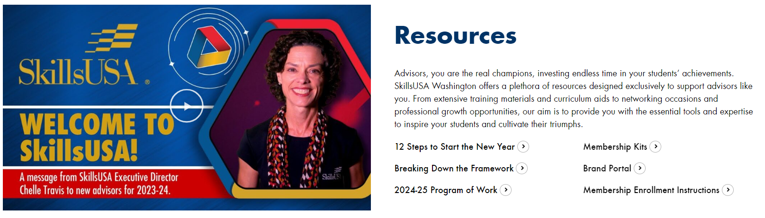
Steps to Start Strong - Resources
https://skillsusawashington.org/resources/advisors/
  Advisor Resources located at https://skillsusawashington.org/resources/advisors/
  Familiarize yourself with SkillsUSA’s
  Secure Support from Administration and other Advisors
  Register: Contact the State office to file Chapter Paperwork
  Build Leadership Team
    Elect Chapter Officers
    Advisor Training – State and National Option
  Create a Program of Work
  Promote and Recruit
  Hold Chapter Meetings
  Engage in Activities
    Competitions and Events
    Extended Learning Activities

Slide 18
Steps to Start Strong
Tips for early success:
Understand this shouldn’t be more work, rather a redirection of what you are already doing only with resources
Contact your regional coordinator
Start small with focus
Identify contests you can support
Identify students who have an interest in leadership and competition
Build your core\legacy students (returning next year)
Volunteer to judge contests
Utilize your Regional Coordinator and State Office

Slide 19
Highlighting SkillsUSA Benefits to Students
Academic and career benefits
  Enhanced Career Readiness
  Improved Academic Performance
  Networking and Career Opportunities
Personal and professional growth opportunities
  Leadership Development
  Professionalism and Ethics
  Confidence and Public Speaking
Success stories and testimonials
  Watch on Youtube

Slide 20
SkillsUSA
Framework
&
Curriculum

Slide 21
Integrating SkillsUSA Curriculum
What am I already doing
  Can I identify the activity as SkillsUSA
  Is what I am doing better than SkillsUSA
  Is what I am doing aligned to local industry
  Am I already providing SkillsUSA without knowing it
Should I re-invent the wheel

Slide 22

SkillsUSA Framework
https://www.skillsusa.org/about/skillsusa-framework/
Computer and Technology Literacy
Job-Specific Skills
Safety and Health
Service Orientation
Professional Development
Integrity
Work Ethic
Professionalism
Responsibility
Adaptability /Flexibility
Self-Motivation
Communication
Decision Making
Teamwork
Multicultural Sensitivity and Awareness
Planning, Organizing and Management
Leadership

Slide 23
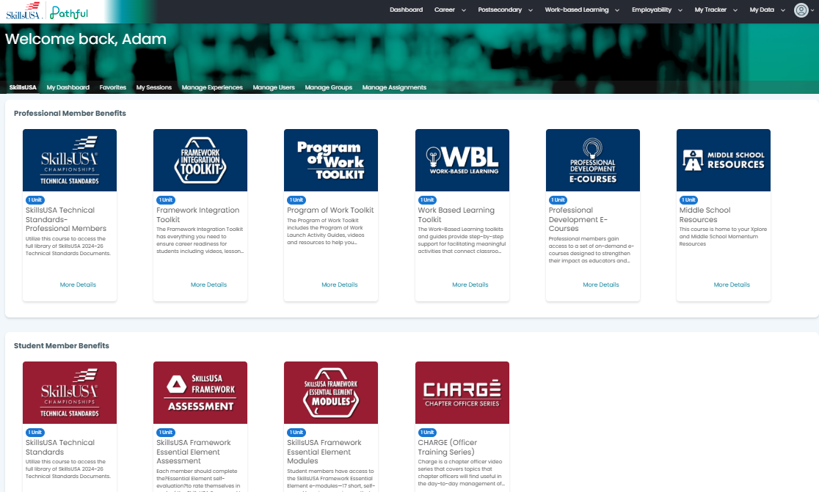
Pathful
https://app.pathful.com/dashboard/skillsusa

Slide 24
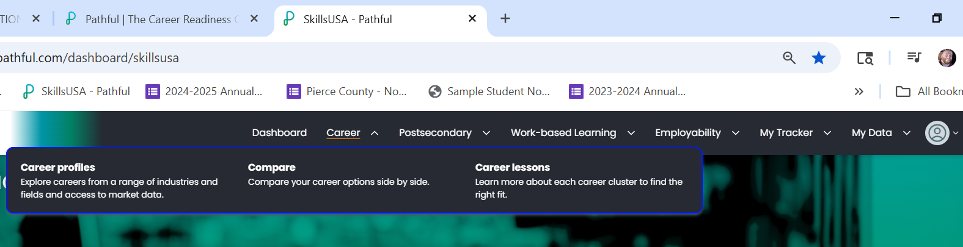


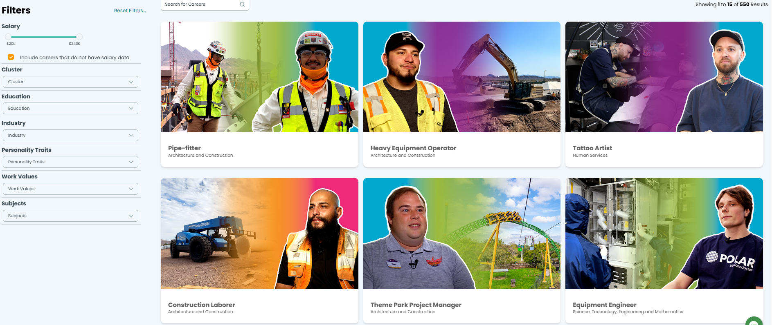
Pathful
https://app.pathful.com/dashboard/skillsusa

Slide 25
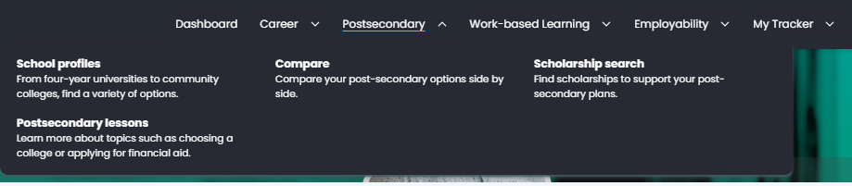
Pathful
https://app.pathful.com/dashboard/skillsusa

Slide 26
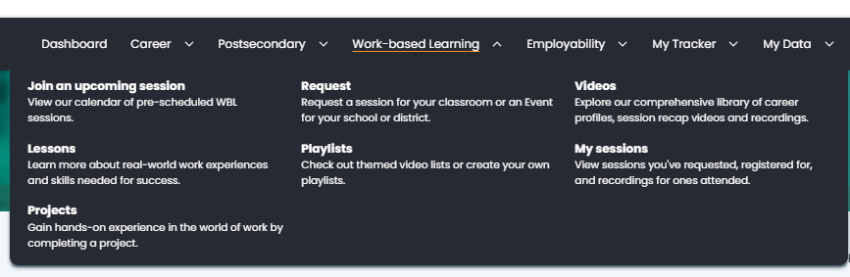
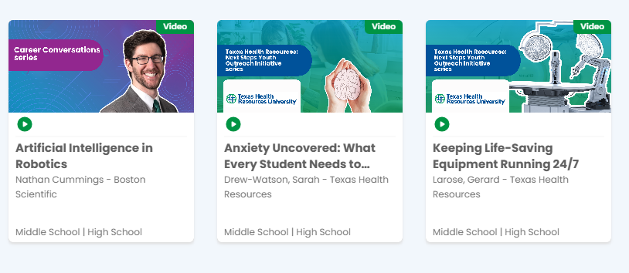
Pathful
https://app.pathful.com/dashboard/skillsusa

Slide 27
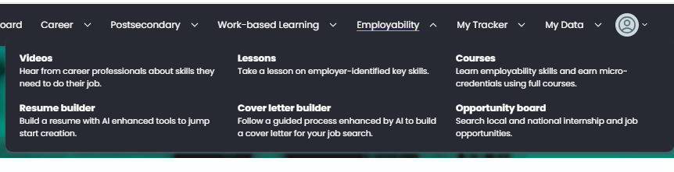
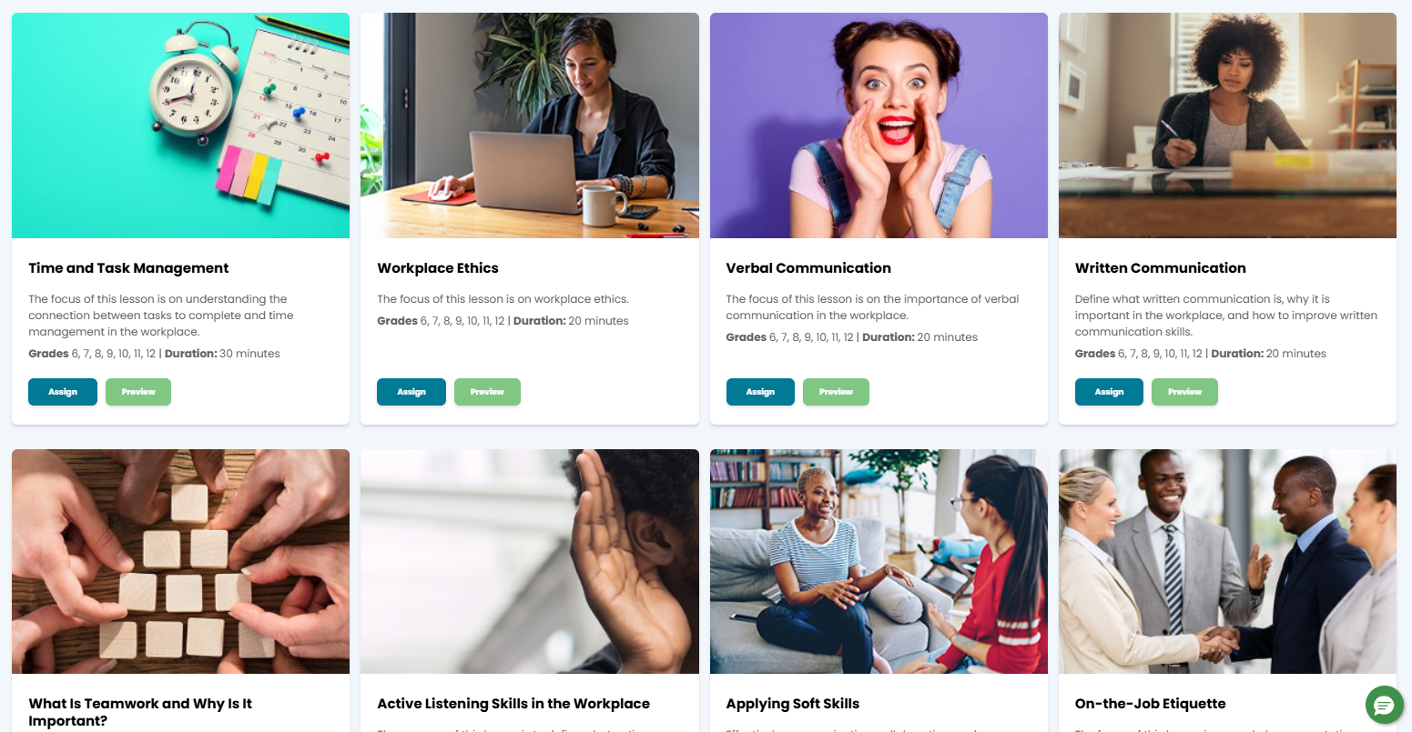
Pathful
https://app.pathful.com/dashboard/skillsusa

Slide 28
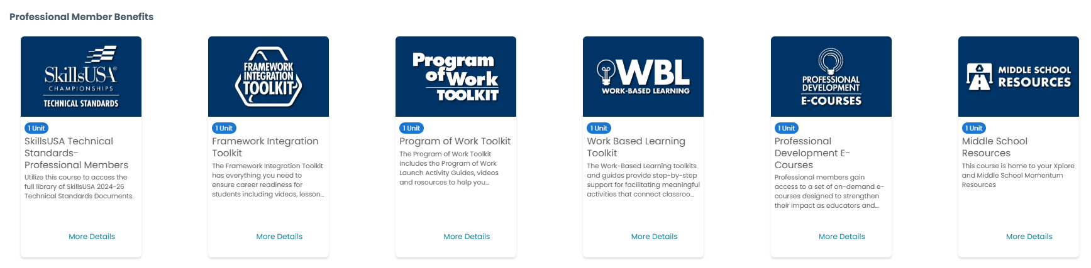
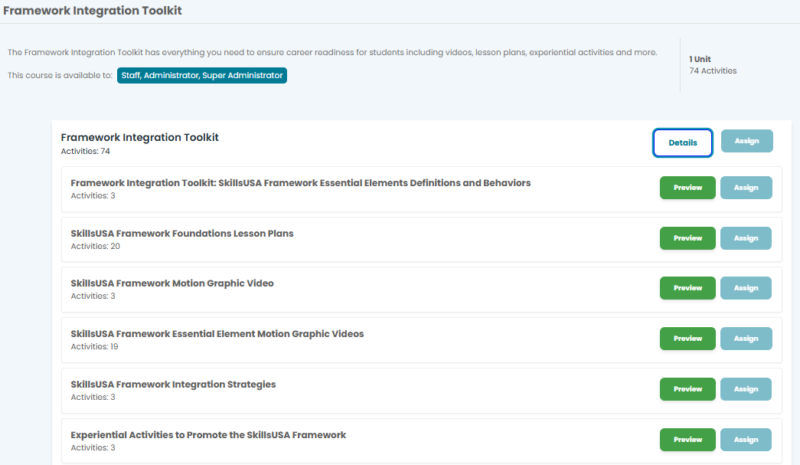
Pathful
https://app.pathful.com/dashboard/skillsusa

Slide 29
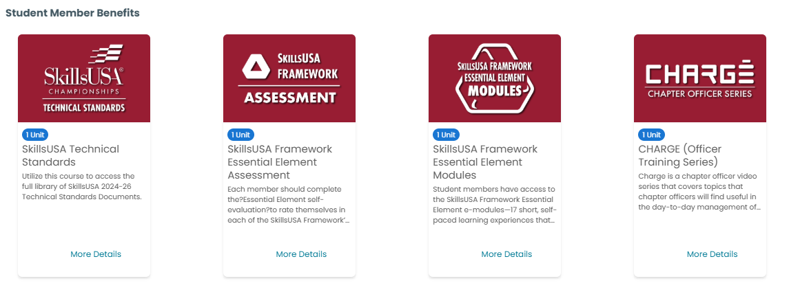
Pathful
https://app.pathful.com/dashboard/skillsusa

Slide 30
Technical Standards
Over 100 Technical, Leadership and Occupational contests
Comprehensive guidelines and criteria for competitions
Detailed descriptions of the competencies and skills required for each competition area
Ensure that students understand both the challenges of the competitions and the demands of their future careers
Aligned to Industry Certifications and Standards
Can be used to align to your course framework
Contest Descriptions can be found here (Link)

Slide 31
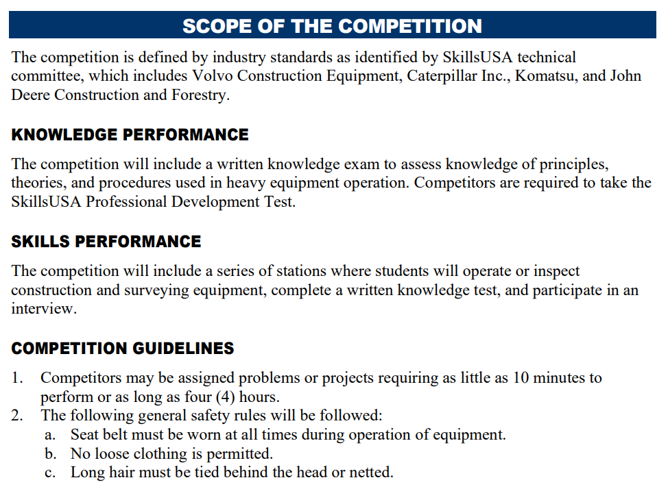
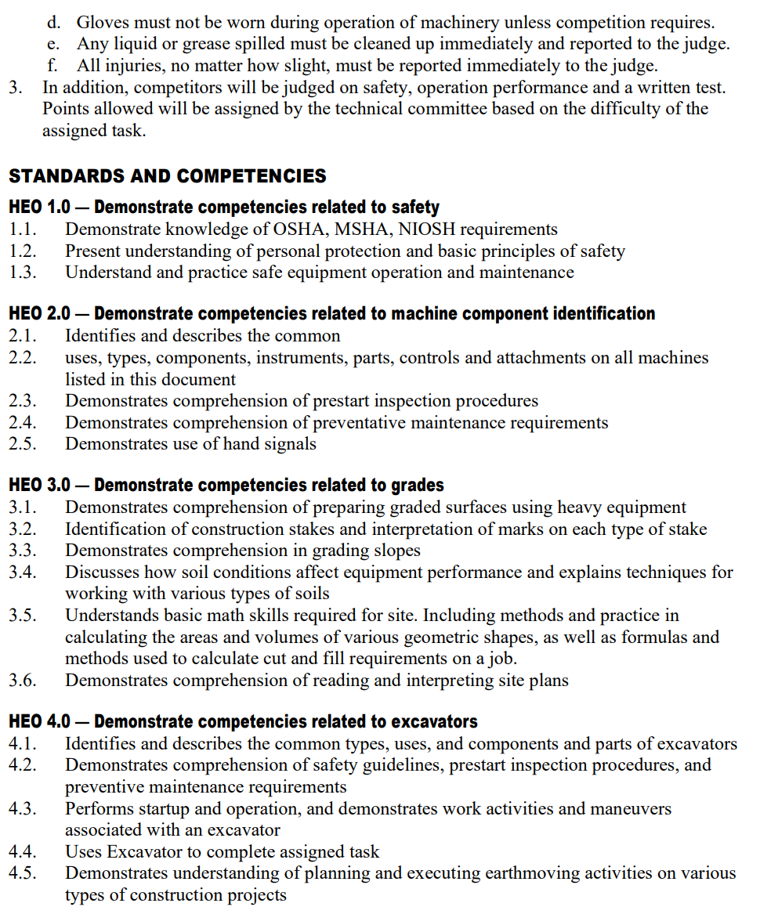
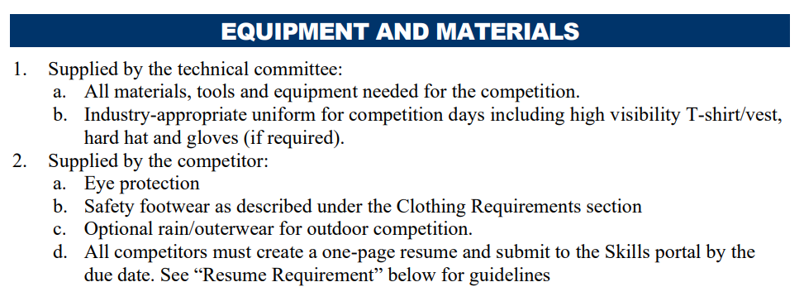
Technical Standards – what's included
CLOTHING REQUIREMENT
ELIGIBILITY
EQUIPMENT AND MATERIALS
  Supplied by host
  Supplied by contestant
SCOPE OF THE CONTEST
  Knowledge Performance
  Skill Performance
  Contest Guidelines
  Standards and Competencies

Slide 32
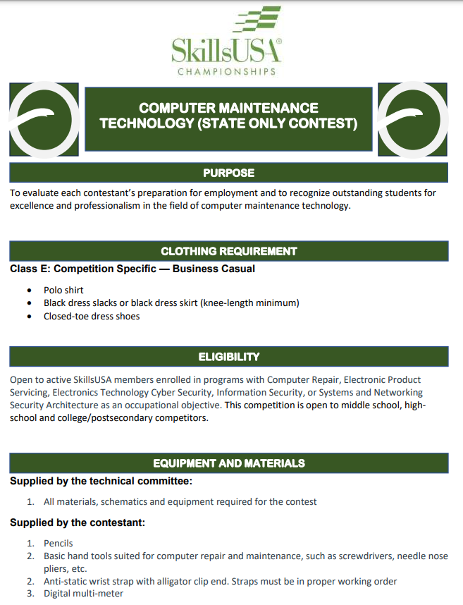
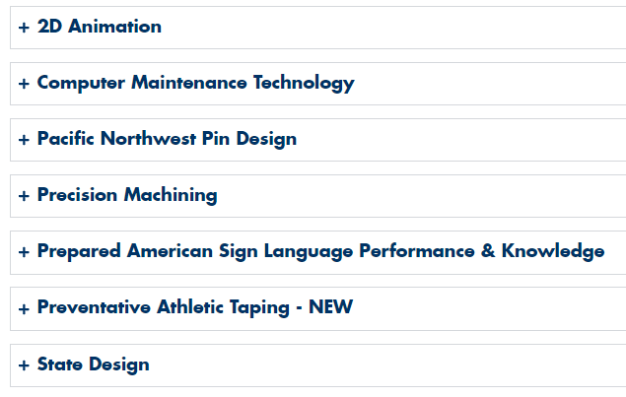
State Only Tech Standards
https://skillsusawashington.org/competitions/state-only/
Contests that are only offered in Washington State
There is no opportunity to compete at a National Level
Designed with the help of local industry and advisory
Can only be found on the SkillsUSA Washington website

Slide 33





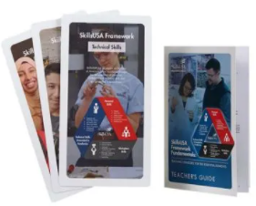




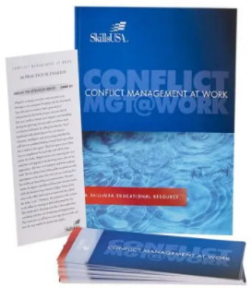


Additional Curriculum
https://www.skillsusa.org/shop/
Team Building
Bellringers
Ice Breakers
Group Activities
Decision Making
SkillsUSA Framework
Communication
Conflict
Leadership
Critical Thinking
Presentations
Meetings
Parliamentary Procedure

Slide 34
Integrating Curriculum

Slide 35
Integrating Curriculum
Identify what you are already doing - label it SkillsUSA
Identify one or two pieces of curriculum to increase effectiveness of your program
Identify what contests you are willing\able to support
Empower students to explore SkillsUSA
Utilize contests as assessments in your classroom
Empower your Advisory Committees to take part in SkillsUSA activities and provide resources

Slide 36
Evaluate Your Program
Evaluate areas you could use additional support
Identify resources that can help your program
Don’t reinvent the wheel
Work with your Regional Coordinators, State Office and State Trainers to find what works best in your program

Slide 37
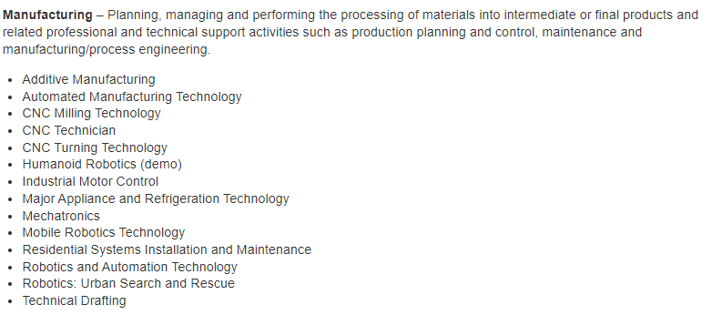






Competitions
127 Nationally recognized competitions
16 Career Clusters
Each Career Cluster has multiple competitions

Slide 38
Contests in Curriculum Example
Contests Supported by an IT class that are incorporated into the class curriculum
Occupational
Technical
Leadership
Career Pathways Showcase
Computer Maintenance
Extemporaneous Speaking
Related Technical Math
Community Service
Cybersecurity
Job Interview
T-Shirt Design
Customer Service
Information Technology Services
Job Skills Demo A
Other
Occupational Health and Safety
Internet of Things
Pin Design
CareerSafe Video
Telecommunications Cabling
Prepared Speech
National Pin & T-Shirt Design
Quiz Bowl
Sate Pin & T-Shirt Design
* No Student has competed but is supported

Slide 39
Integrating Curriculum
Skills Competition as Assessments:
  Framework Standards for Industry are built into the Technical Standards
  Grade sheet \ assessments are already built
  Supporting documents \ assessments for modules have been completed
  Look at non-course contests
    Job Skills Demo A
    Job Interview
    Audio Video Production
  Create a PLC
    Expand assessments

Slide 40

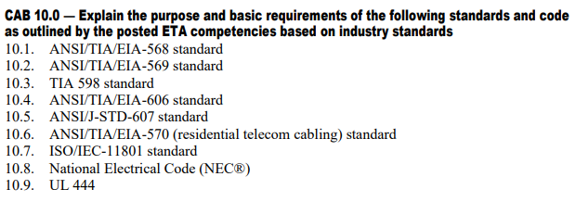
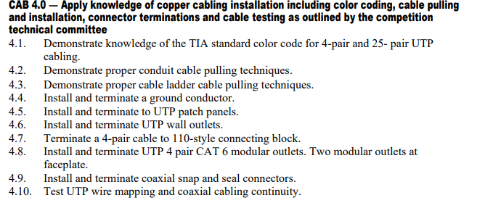
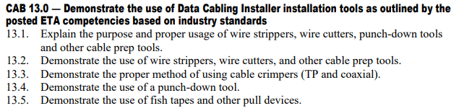
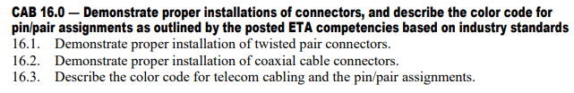
Add to Program Framework
Integrating Curriculum
Formative Assessments
  Define hardware labels
  Make Jumper Cables
  Make Coaxial Cable
  Punch down Assessment
Summative Assessments
  Install serviceable connections between walls
  Room Rewiring Project

Slide 41
Integrating Curriculum
October
Fall Advisor Meetings
Start of identification of regional contests
Advisors announce interest for regional competitions
Host for regionals identified
Registration must be paid to compete in regionals
Regional competitions held
Must compete in regionals to qualify for State
November
December
January – 1st week of February

Slide 42
Securing Funding and Resources

Slide 43
Securing Funding & Resources
Administrative Funding
  Budget Allocation
  Professional Development Funds
  CTE Grants
External Grants and Scholarships
  Non Profits: SkillsUSA National and State, Perkins Grant, Gates Foundation, or local educational foundations
  Corporate Grants: corporations that have educational outreach programs
  Local Businesses: Sponsorships and Donations
  Industry Partners: They may provide financial support, equipment donations, or mentorship opportunities

Slide 44
Securing Funding & Resources
Fundraising Activities
  School Based: Organize Events related to your Industry focus
  Sales: Make products to sell
  Online: Solicit donations online, leverage social media to promote fundraising and share Student success stories
Resource and Donations
  Equipment and Supplies: Equipment, tools, and supplies
  Professional Services: Guest lectures, workshops, or mentorship

Slide 45
Securing Funding & Resources
Community and Alumni Support
  PTA/PTO Grants
  Alumni Donations
  Alumni Events
Advocacy and promotion
  Showcase Success: Present Achievements
  Showcase Success: Student Testimonials
Engage Stakeholders
  School Board Presentations: Gain their support and potentially secure additional funding
  Community Outreach: Social Media, presentations, newsletters, and open houses

Slide 46
Integrating Curriculum
September
Identify areas of curriculum need
Connect with Regional Coordinator
Identification of contests your class can support
Attend the Fall Advisor Meetings
Recruit SkillsUSA members
Hold a Class\School SkillsUSA Leadership event
Have students identify contests of interest
Advisors announce interest for regional competitions
Host for regionals identified
Contest Preparation for students
Fundraising Activities to offset costs of Regional and State Events
Registration must be paid to compete in regionals
Regional competitions held
Must compete in regionals to qualify for State
October
November
December
January – February

Slide 47
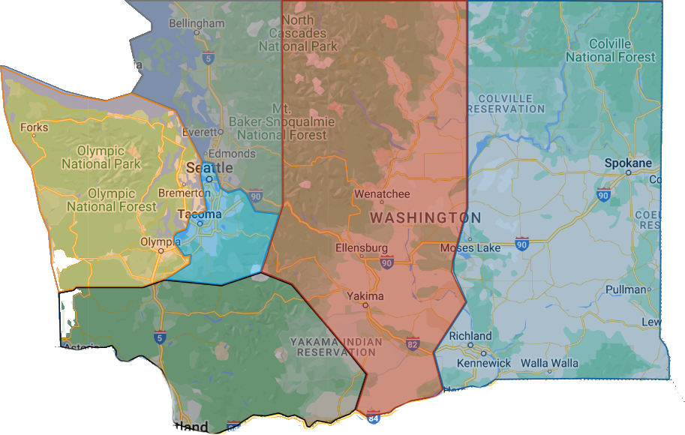
Region Contacts
Link to Regional Map
Southwest
Olympic
Puget Sound South
Central
Eastern
Puget Sound North
6
4
2
5
3
1
Email: “Region name”@Skillsusawashington.org
e.g. Pugetsoundsouth@skillsusawashington.org

Slide 48
Resources and Contacts
Contacts:
Karmen Warner: director@skillsusawashington.org
Courtney Burger: courtney@skillsusawashington.org
Central Region: Central@skillsusawashington.org
Eastern Region: Eastern@skillsusawashington.org
Olympic Region: Olympic@skillsusawashington.org
Southwest Region: Southwest@skillsusawashington.org
PS North Region: Pugetsoundnorth@skillsusawashington.org
PS South Region: Pugetsoundsouth@skillsusawashington.org
Nationals Customer Care: customercare@skillsusa.org
Documents:
Resources: https://skillsusawashington.org/resources/advisors/
12 Steps to Start the Year
Breaking down the Framework
2024-25 Program of Work
Membership Kit
Brand Portal
Membership Enrollment
Mailing List:
Sign up now
Social Media:
Social Media Links: https://linktr.ee/skillsusawashington
Instagram: skillsusawa
Linkedin: https://www.linkedin.com/company/skillsusa-washington/
Facebook: https://www.facebook.com/skillsusawa/
Scholarships:
https://skillsusawashington.org/resources/students/

Slide 49
What Questions
do you have?

Slide 50
Closing
Don’t Reinvent the wheel
  Understand this shouldn’t be more work, rather a redirection of what you are already doing only with resources
Identify what you are already doing well and label it SkillsUSA
  Start small with focus: Identify one or two pieces of curriculum to increase effectiveness of your program
  Utilize contests as assessments in your classroom
Identify what contests you are willing\able to support
Empower students to explore SkillsUSA
  Identify students who have an interest in leadership and competition
  Build your core\legacy students (returning next year)
Volunteer to judge contests
  Utilize your Regional Coordinator and State Office
Empower your Advisory Committees to take part in SkillsUSA activities and provide resources

Slide 51
Thank you for all you do for your students
Join the Mailing List

