Slide 1
NEW Regional Conference Best practices
Introducing New regional programming and procedures
September 22nd 2025

Slide 2
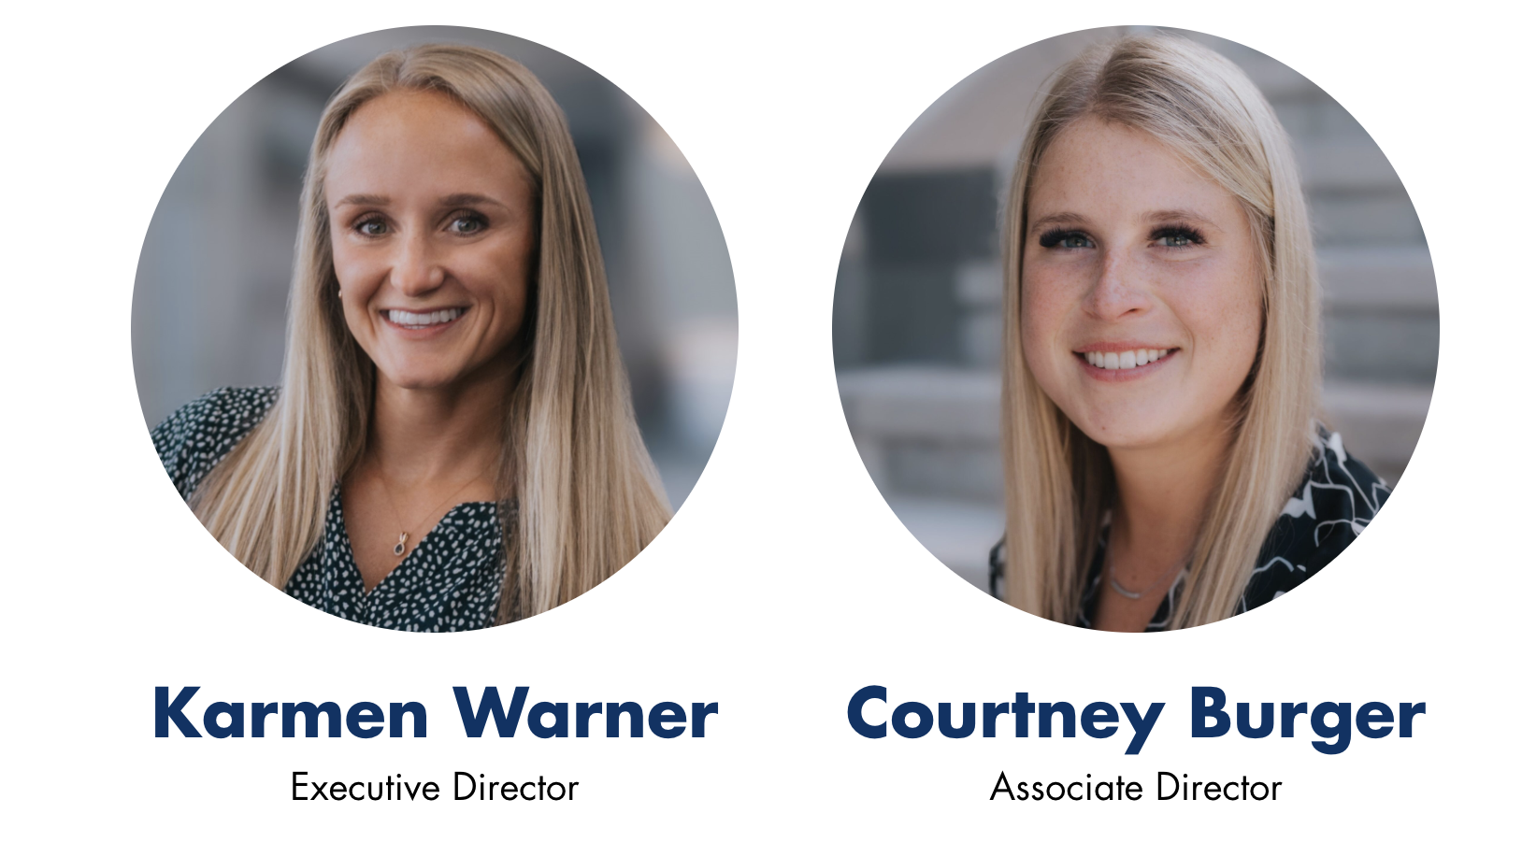
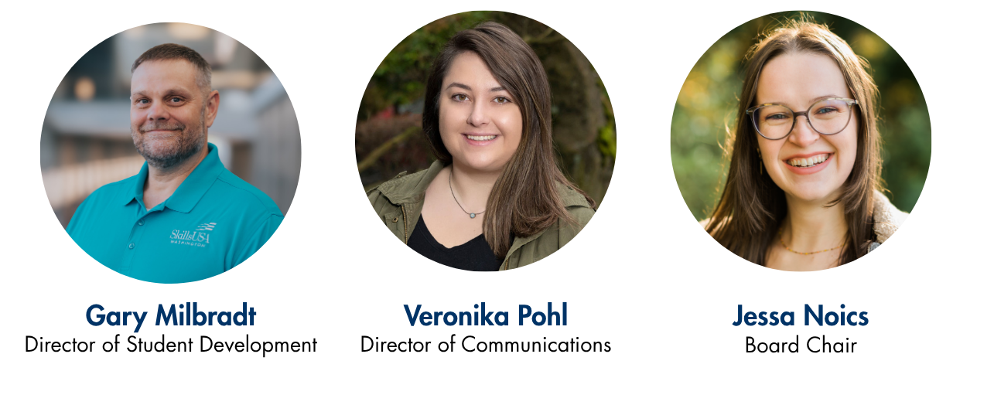
Meet your State Staff

Slide 3
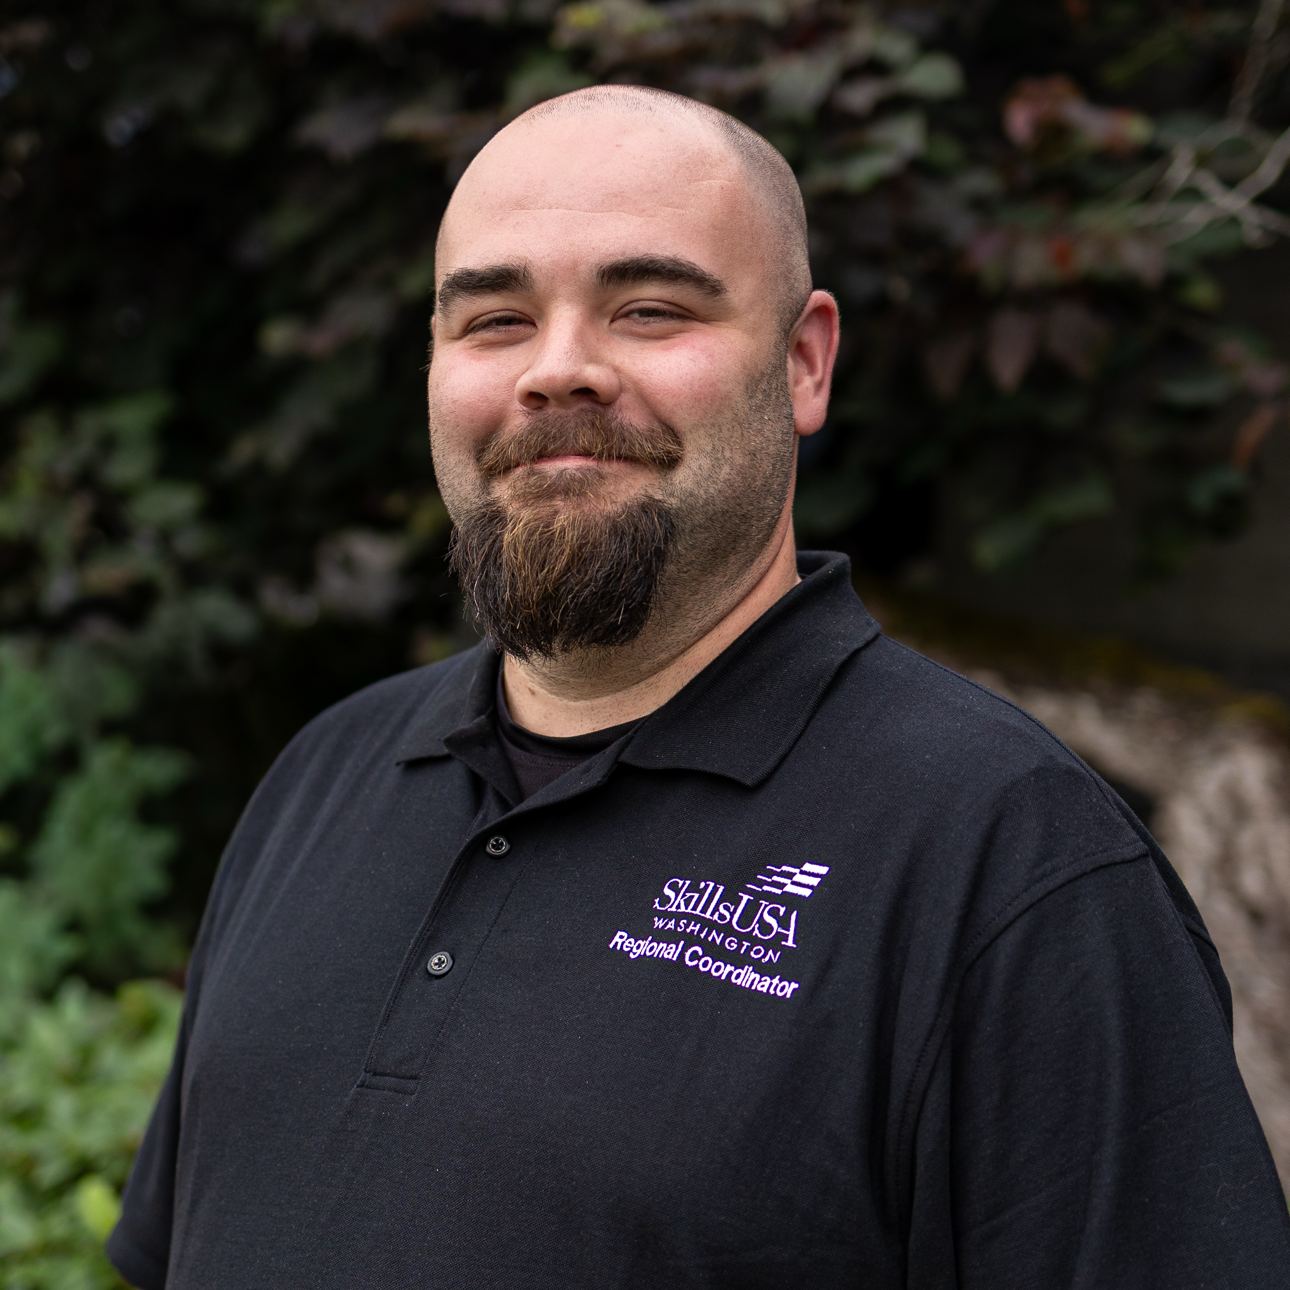
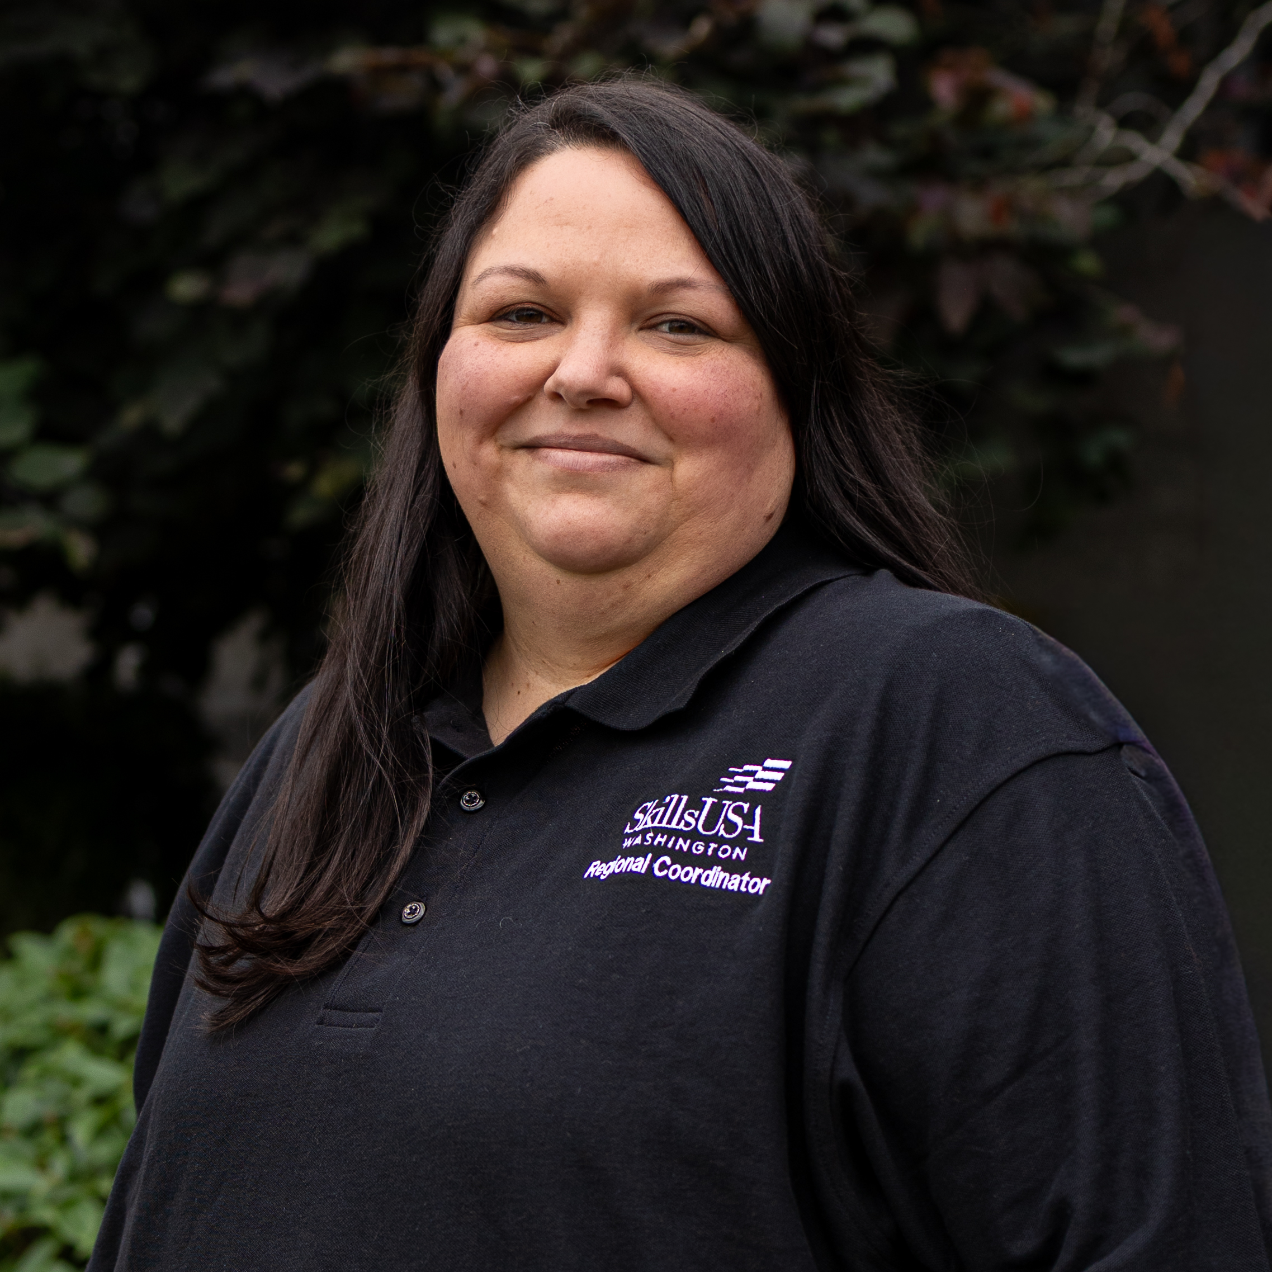
Southwest Regional Coordinators
Nathan Younger
Breanna Nofsinger

Slide 4
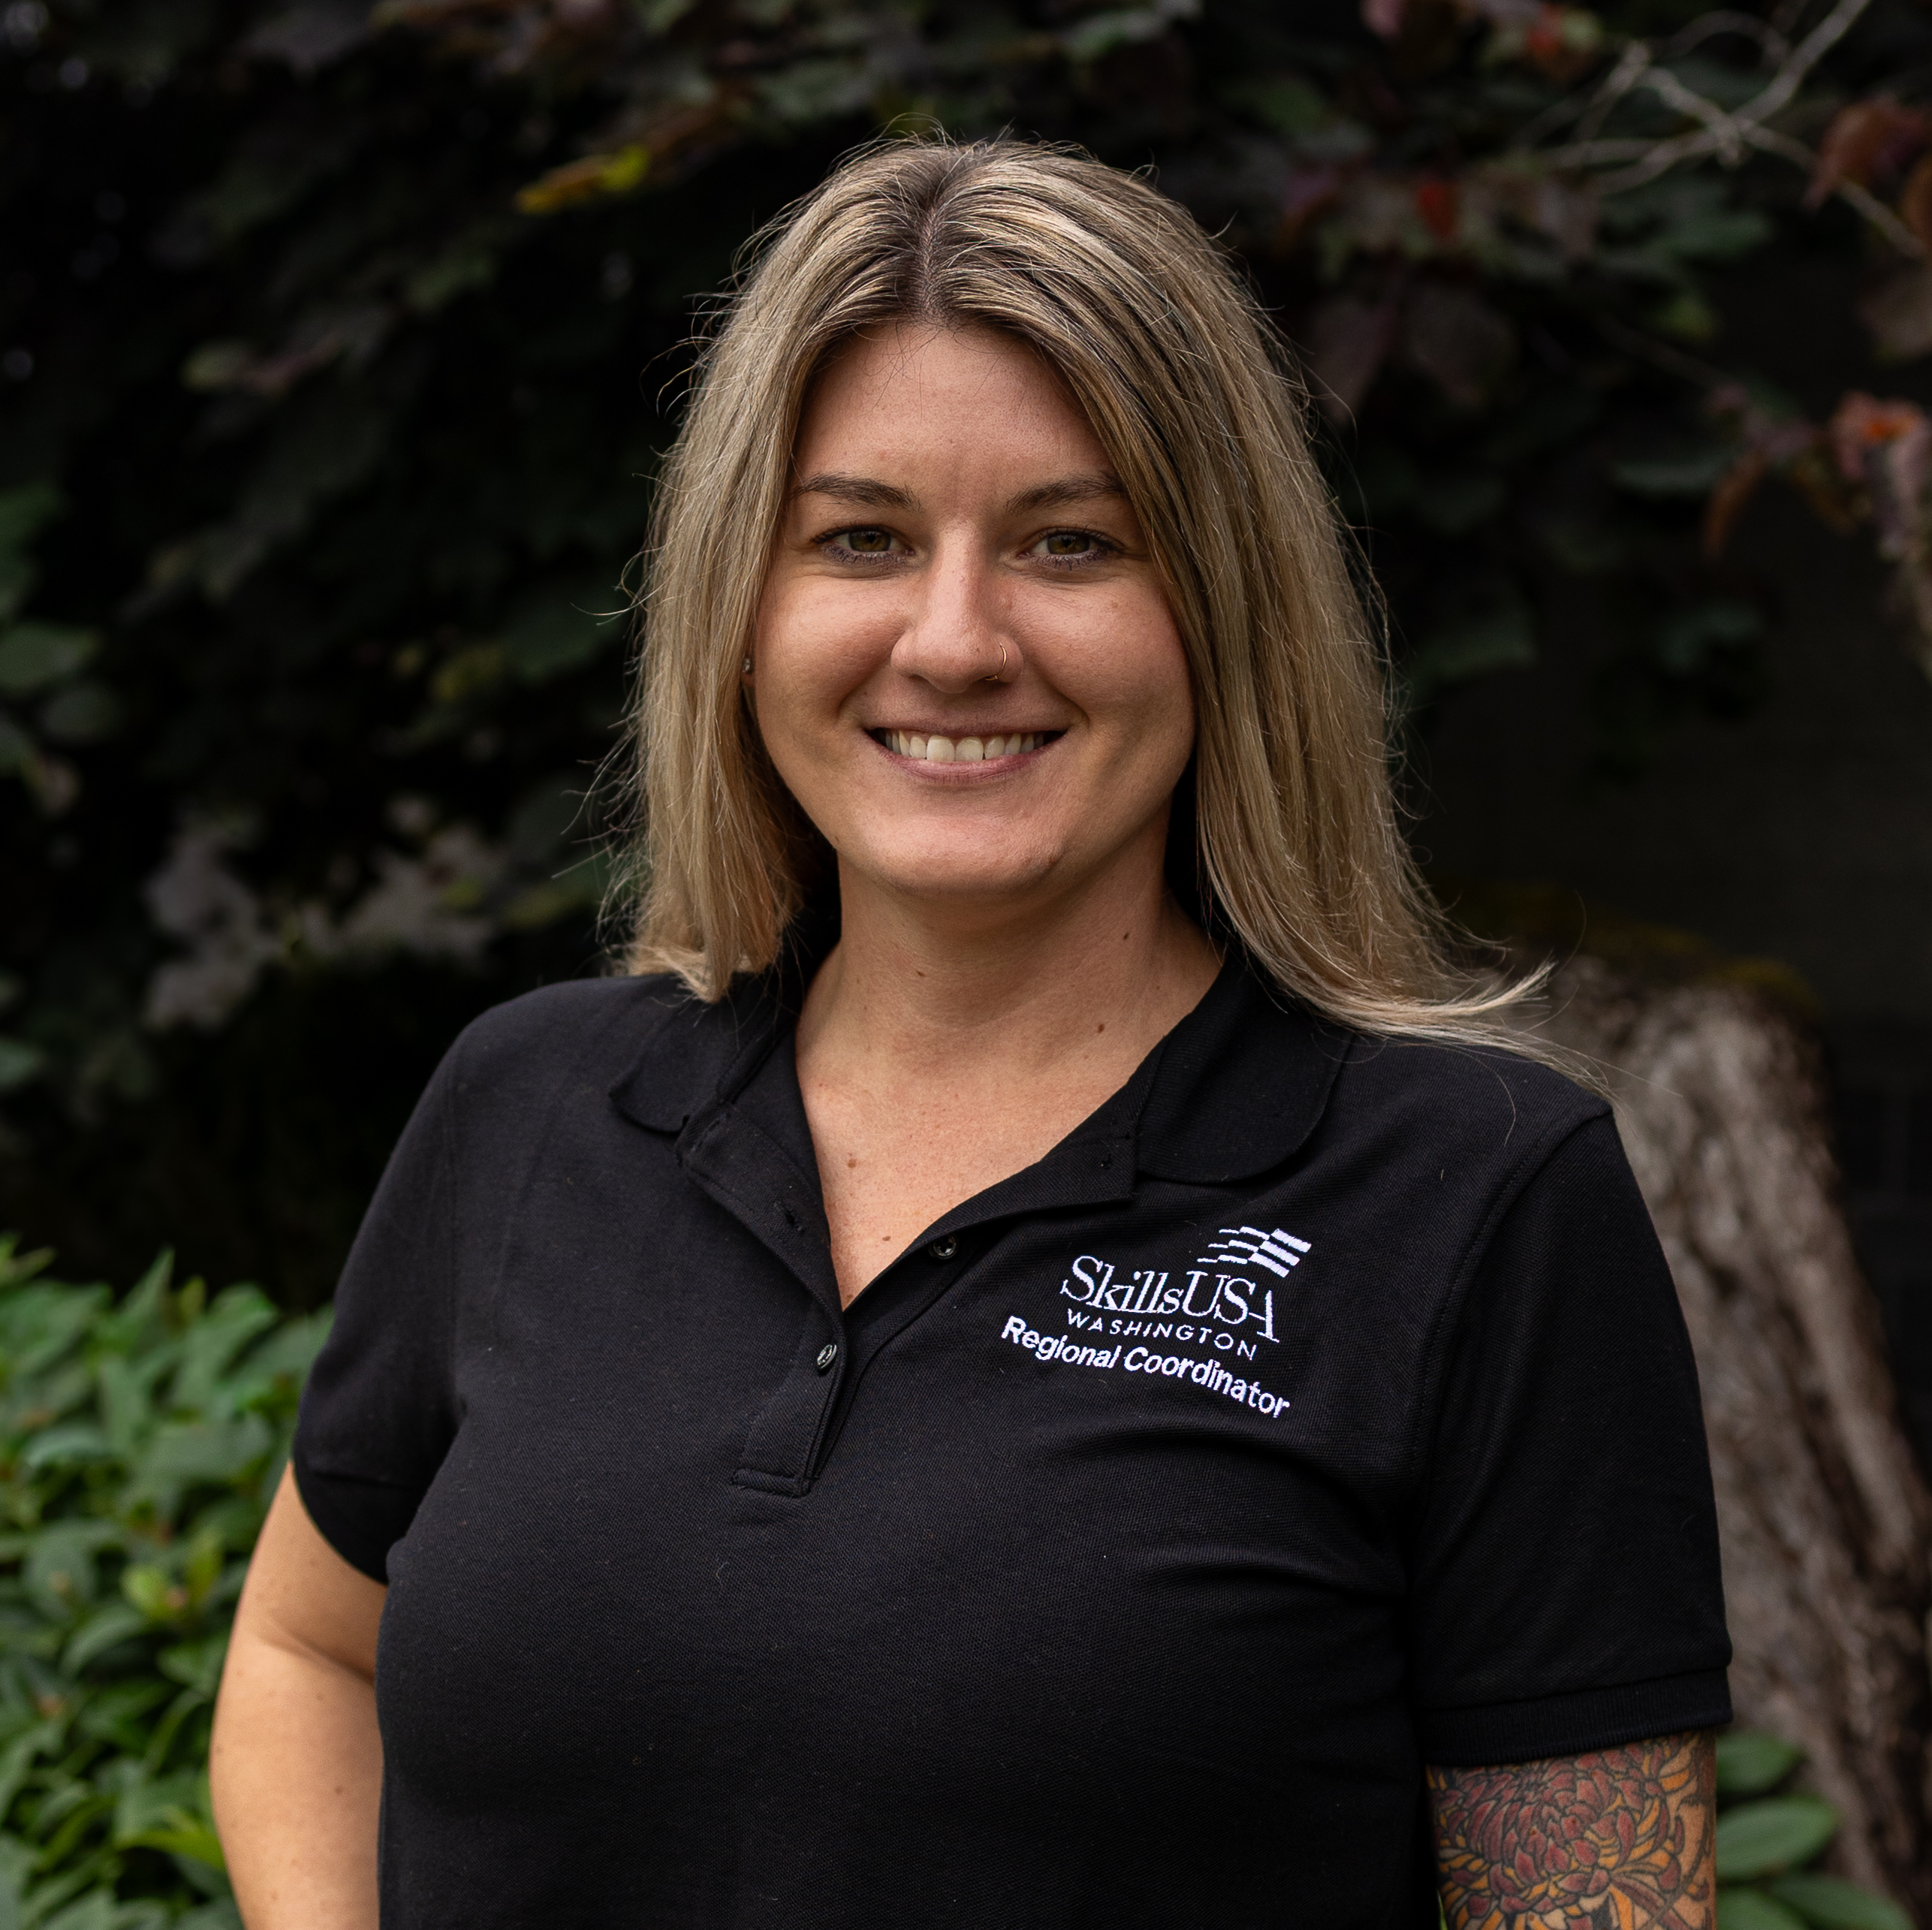
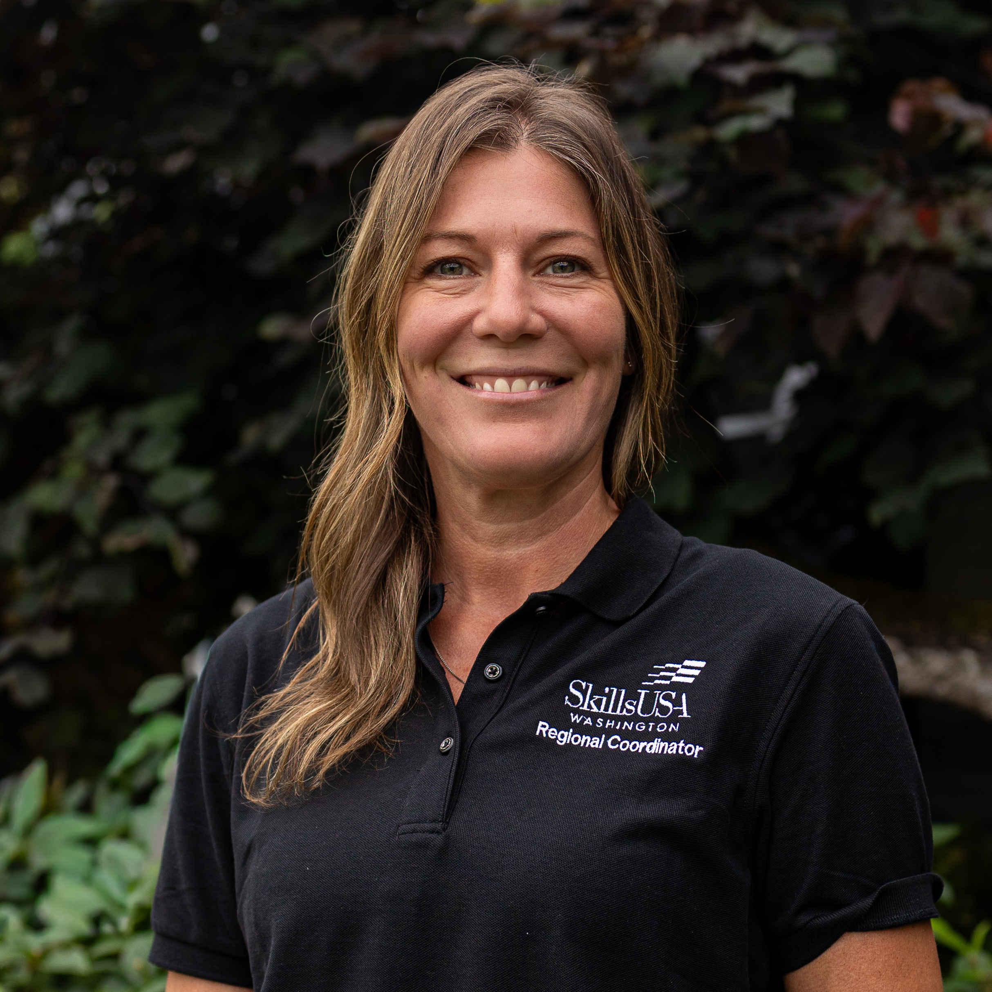
Olympic Regional Coordinators
Megan Ritchie
Jaimee Dobson

Slide 5
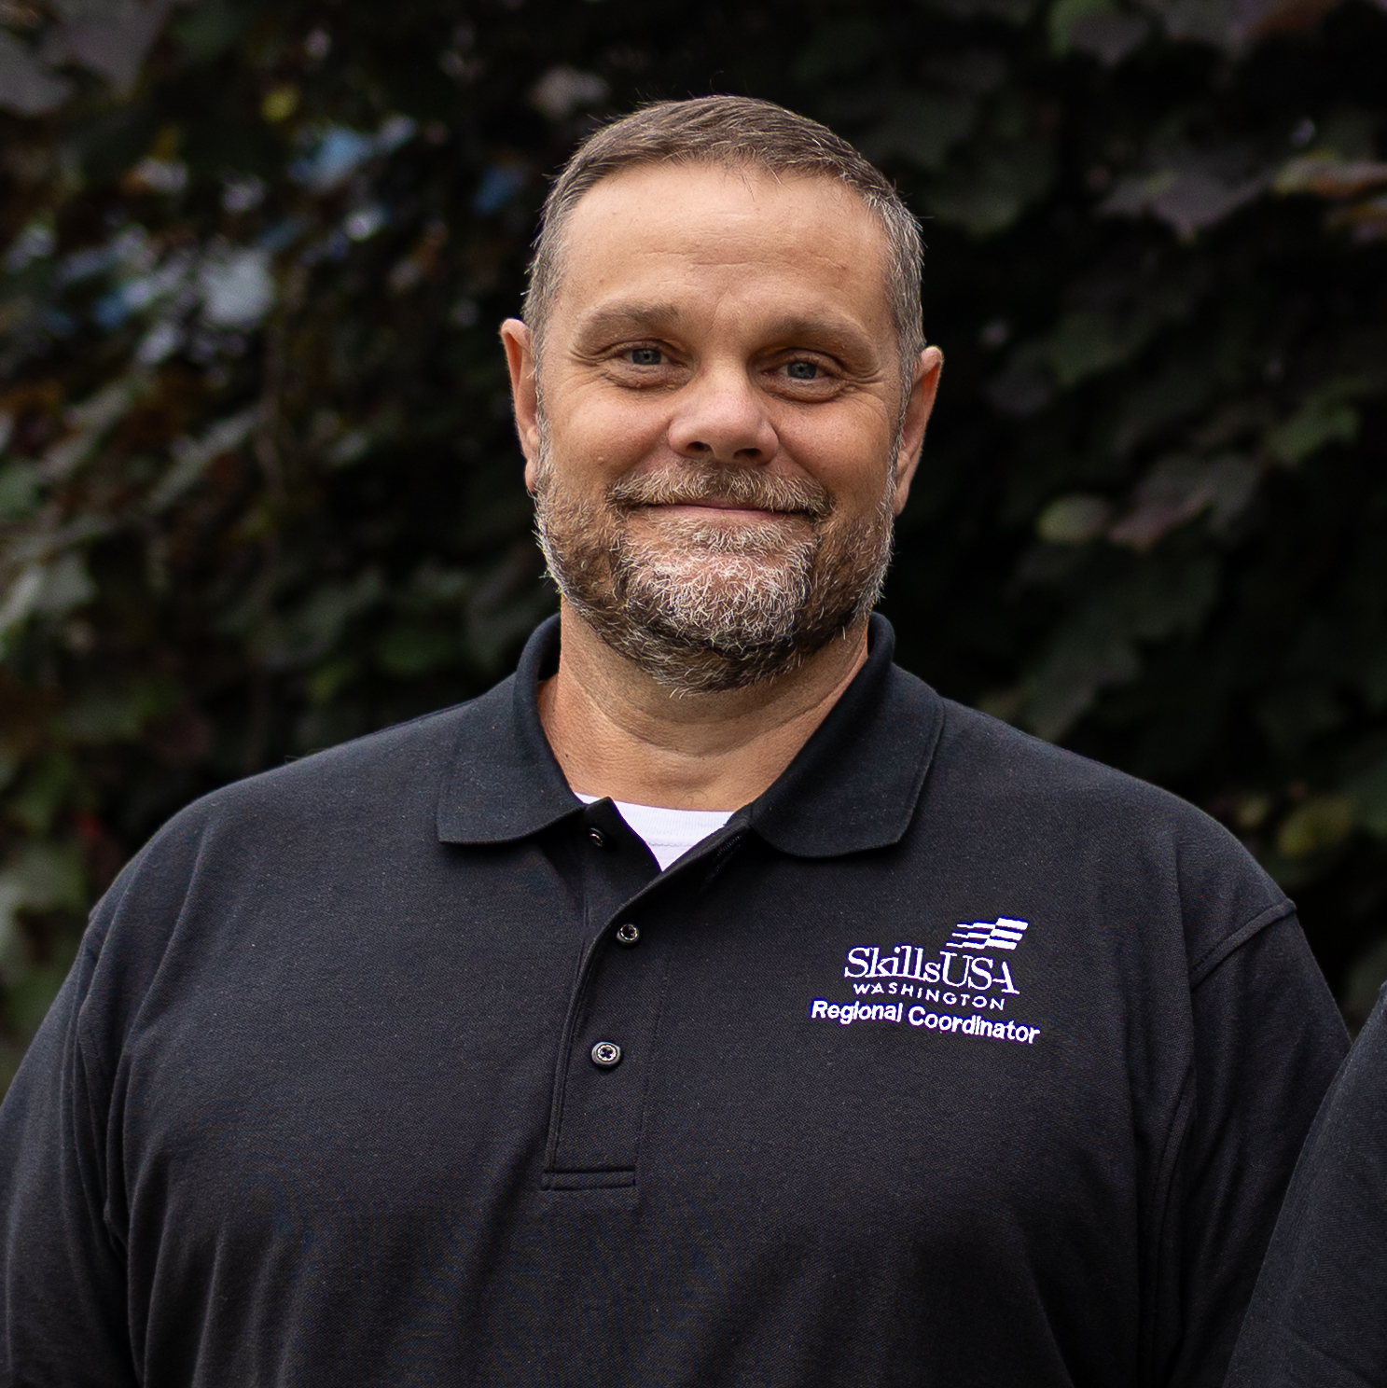
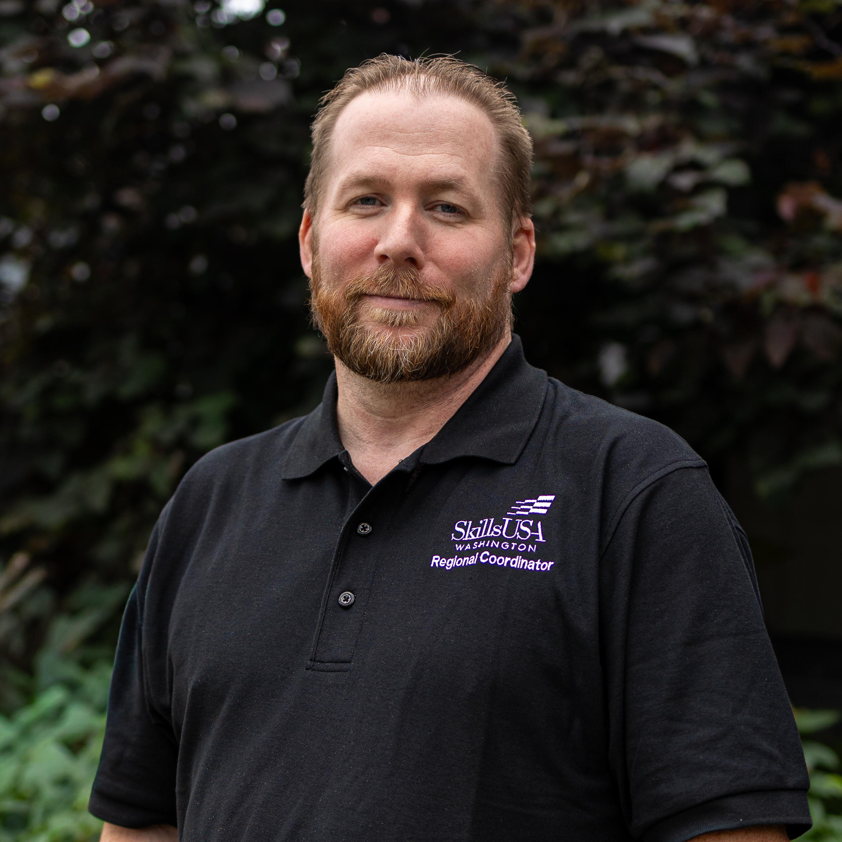
Puget Sound South Regional Coordinators
Gary Milbradt
Adam Scroggins

Slide 6
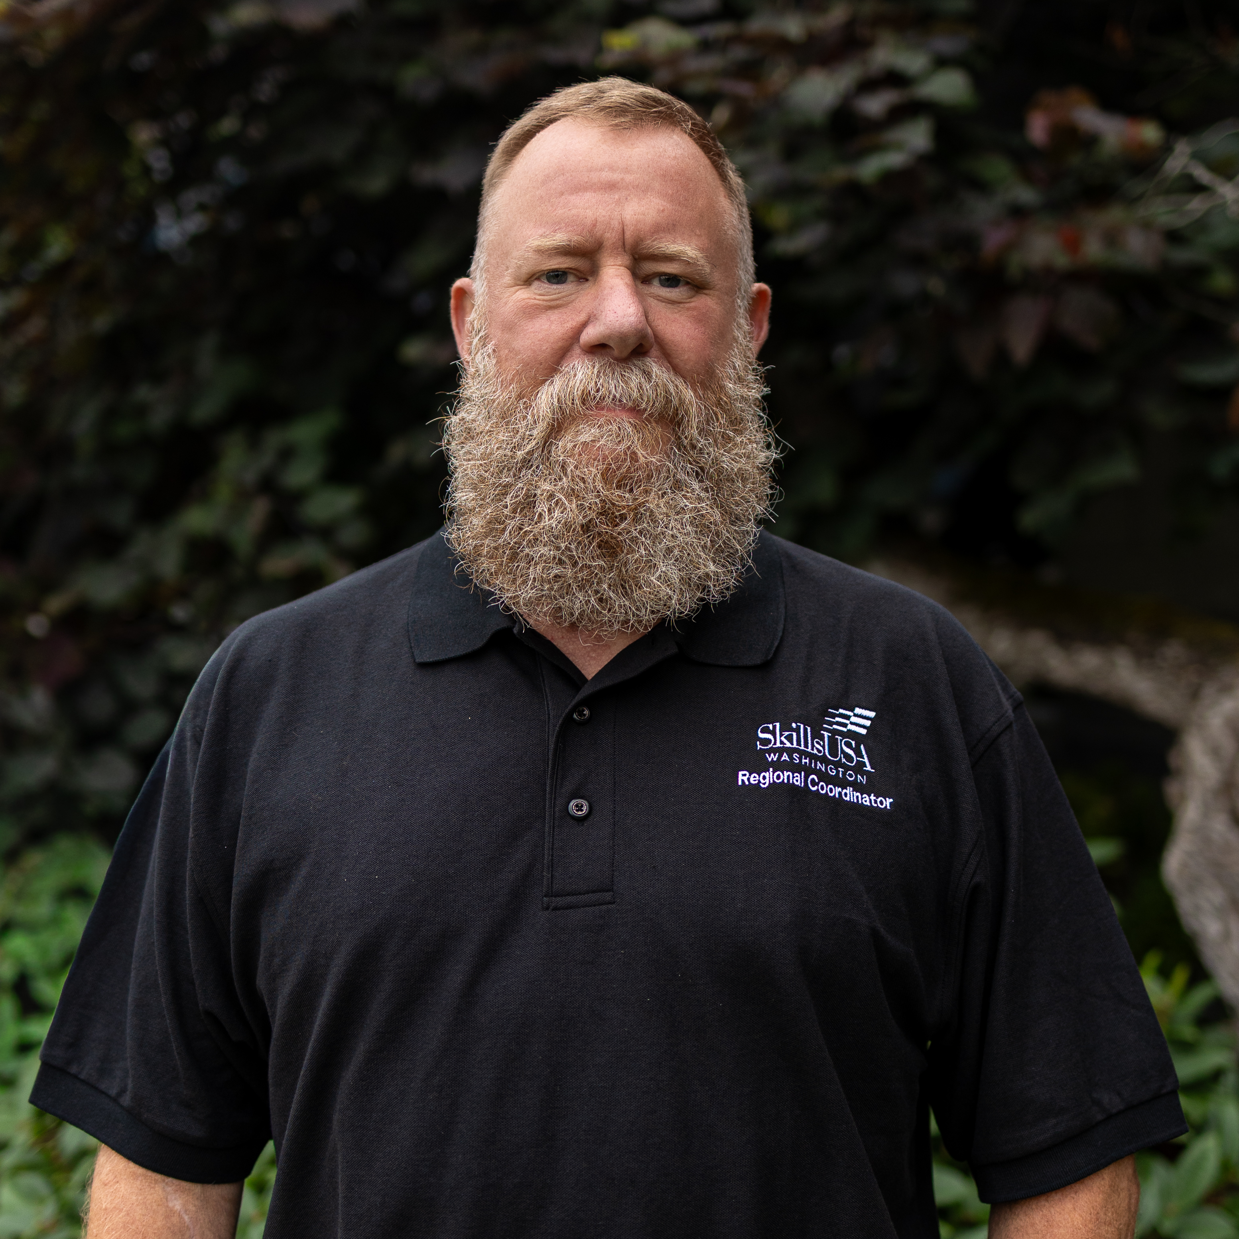
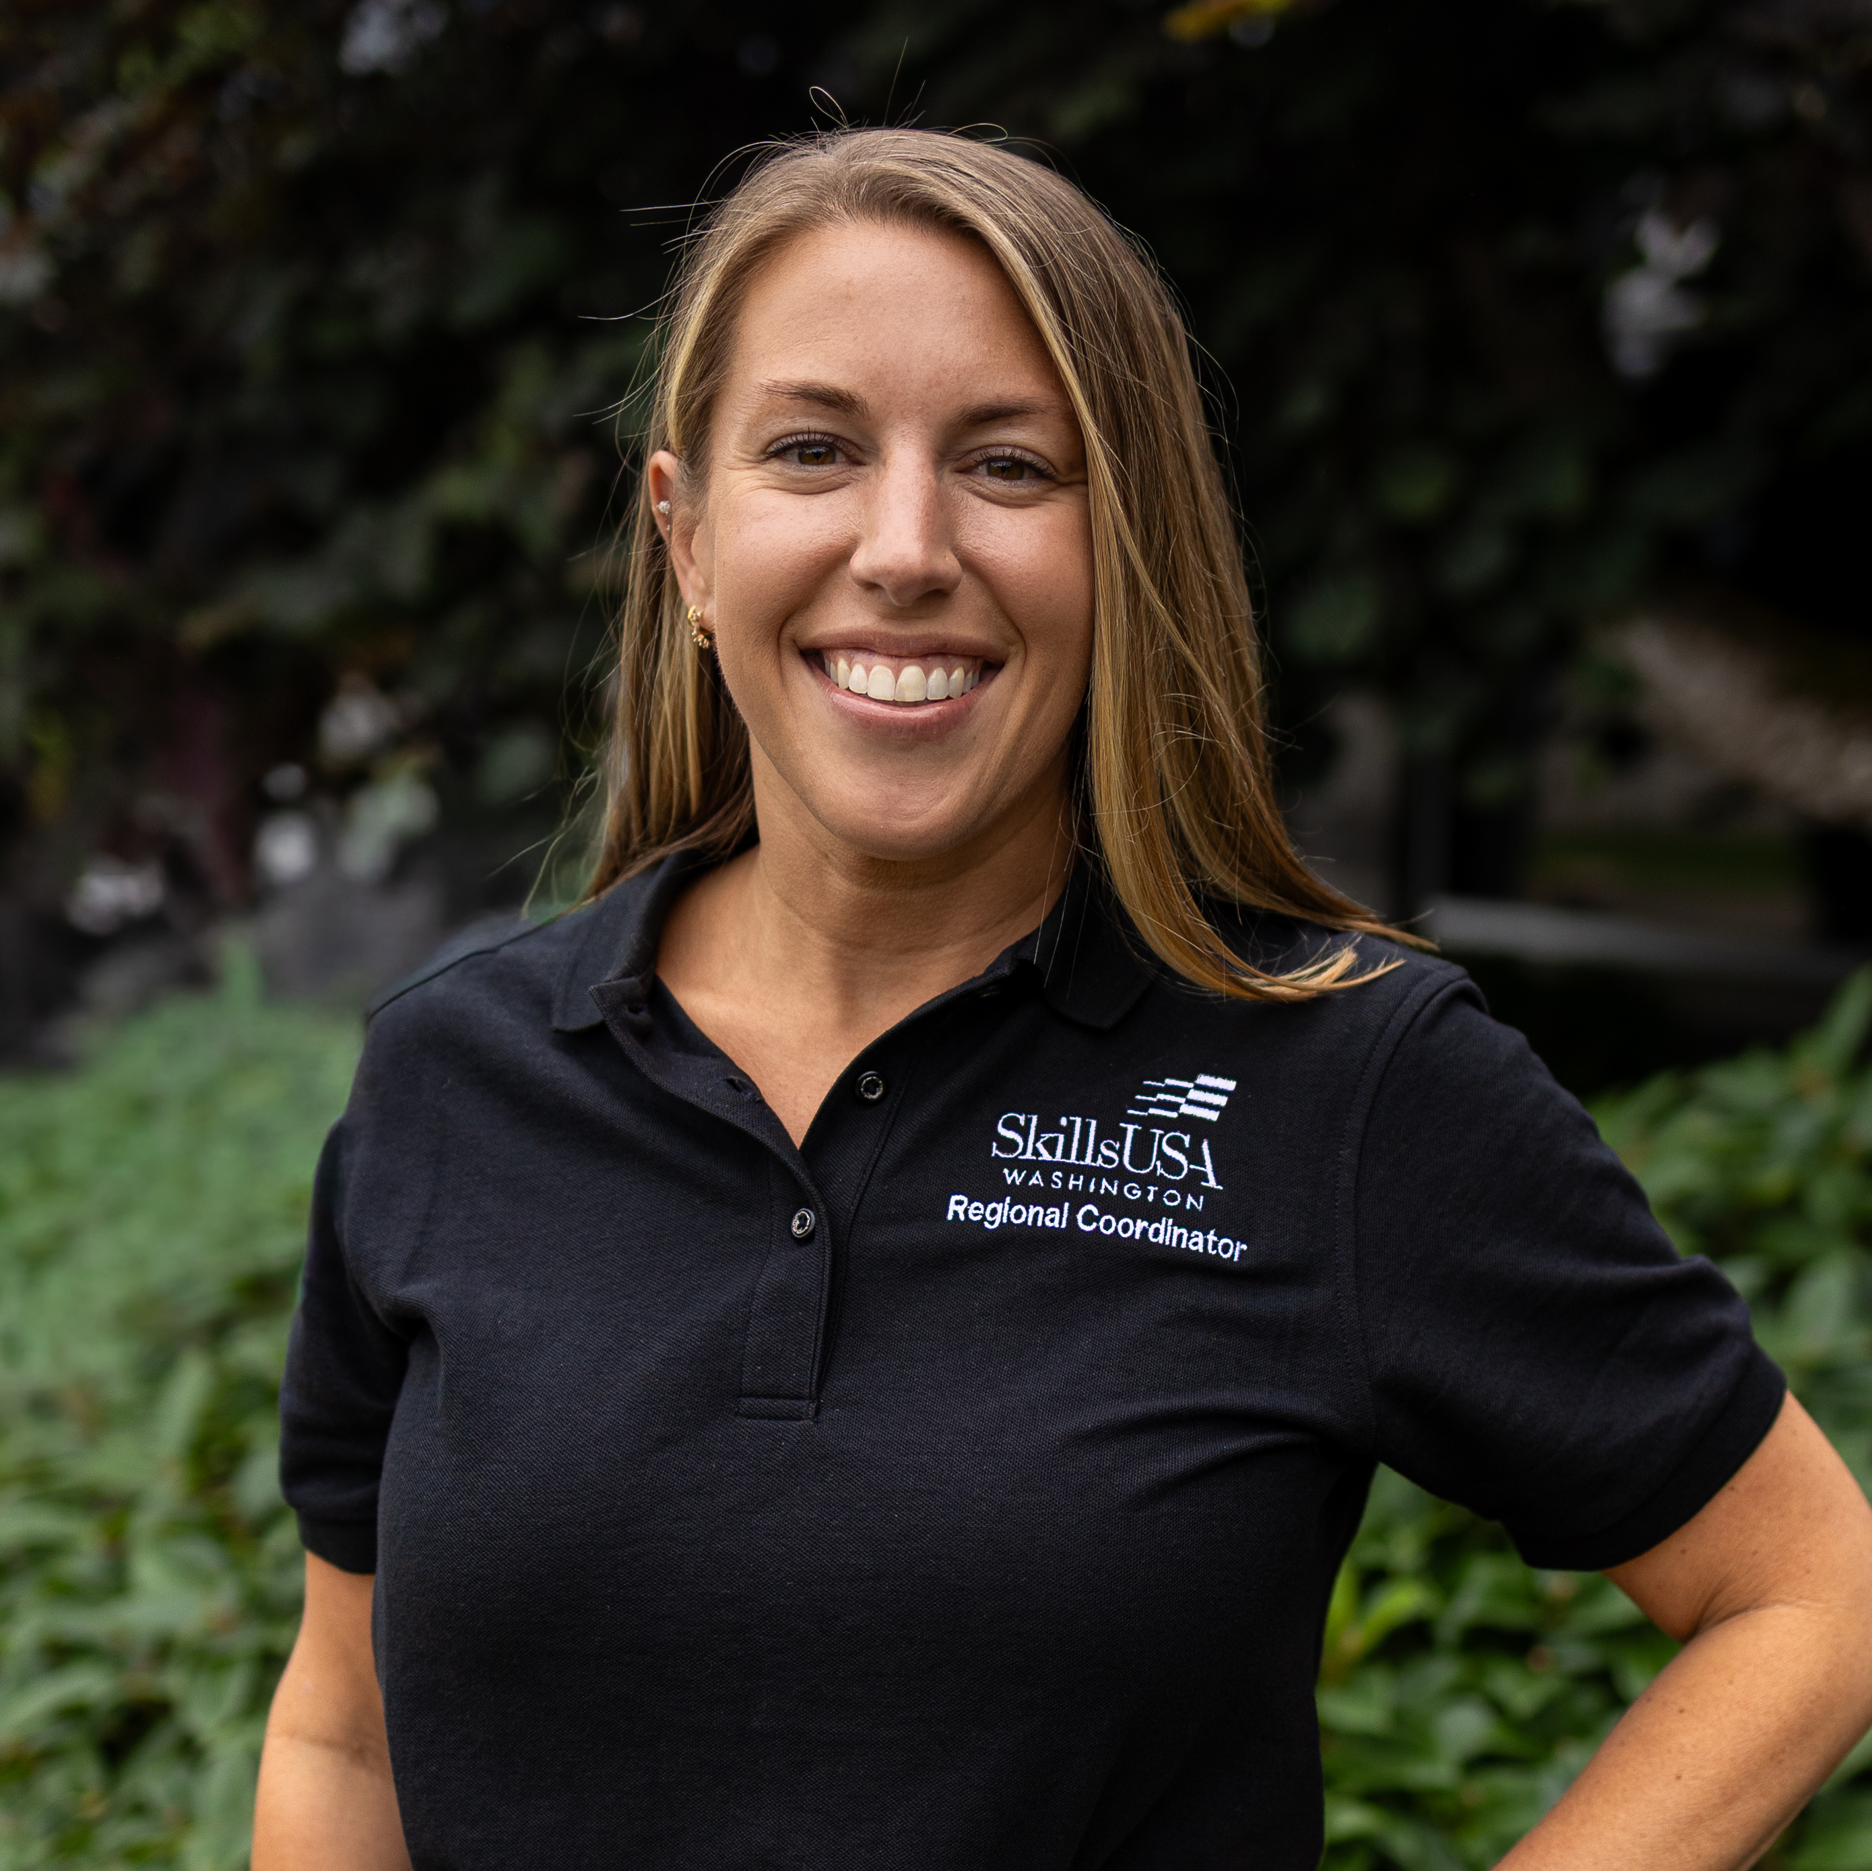
Central Regional Coordinators
Todd Smith
Lauren Thomas

Slide 7
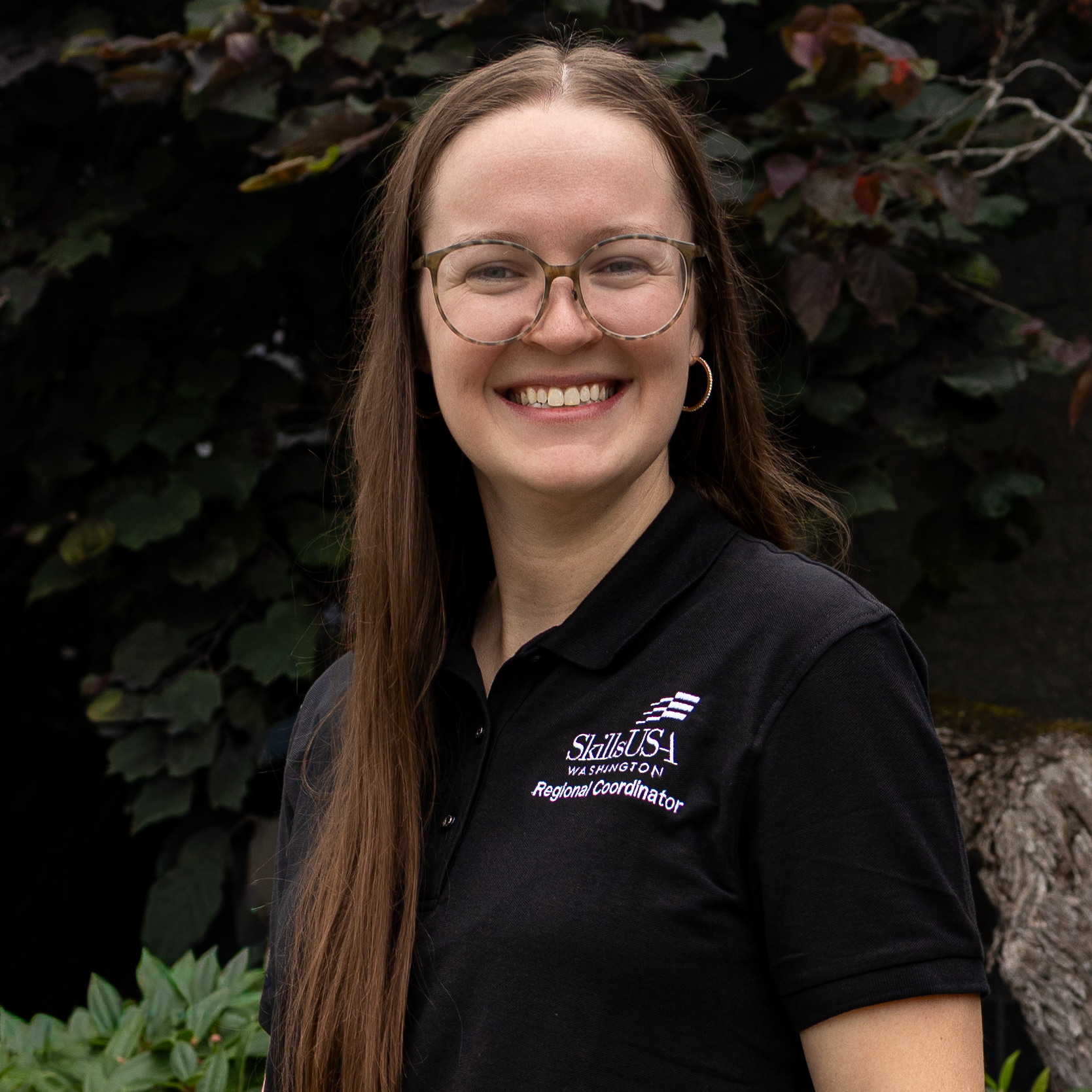
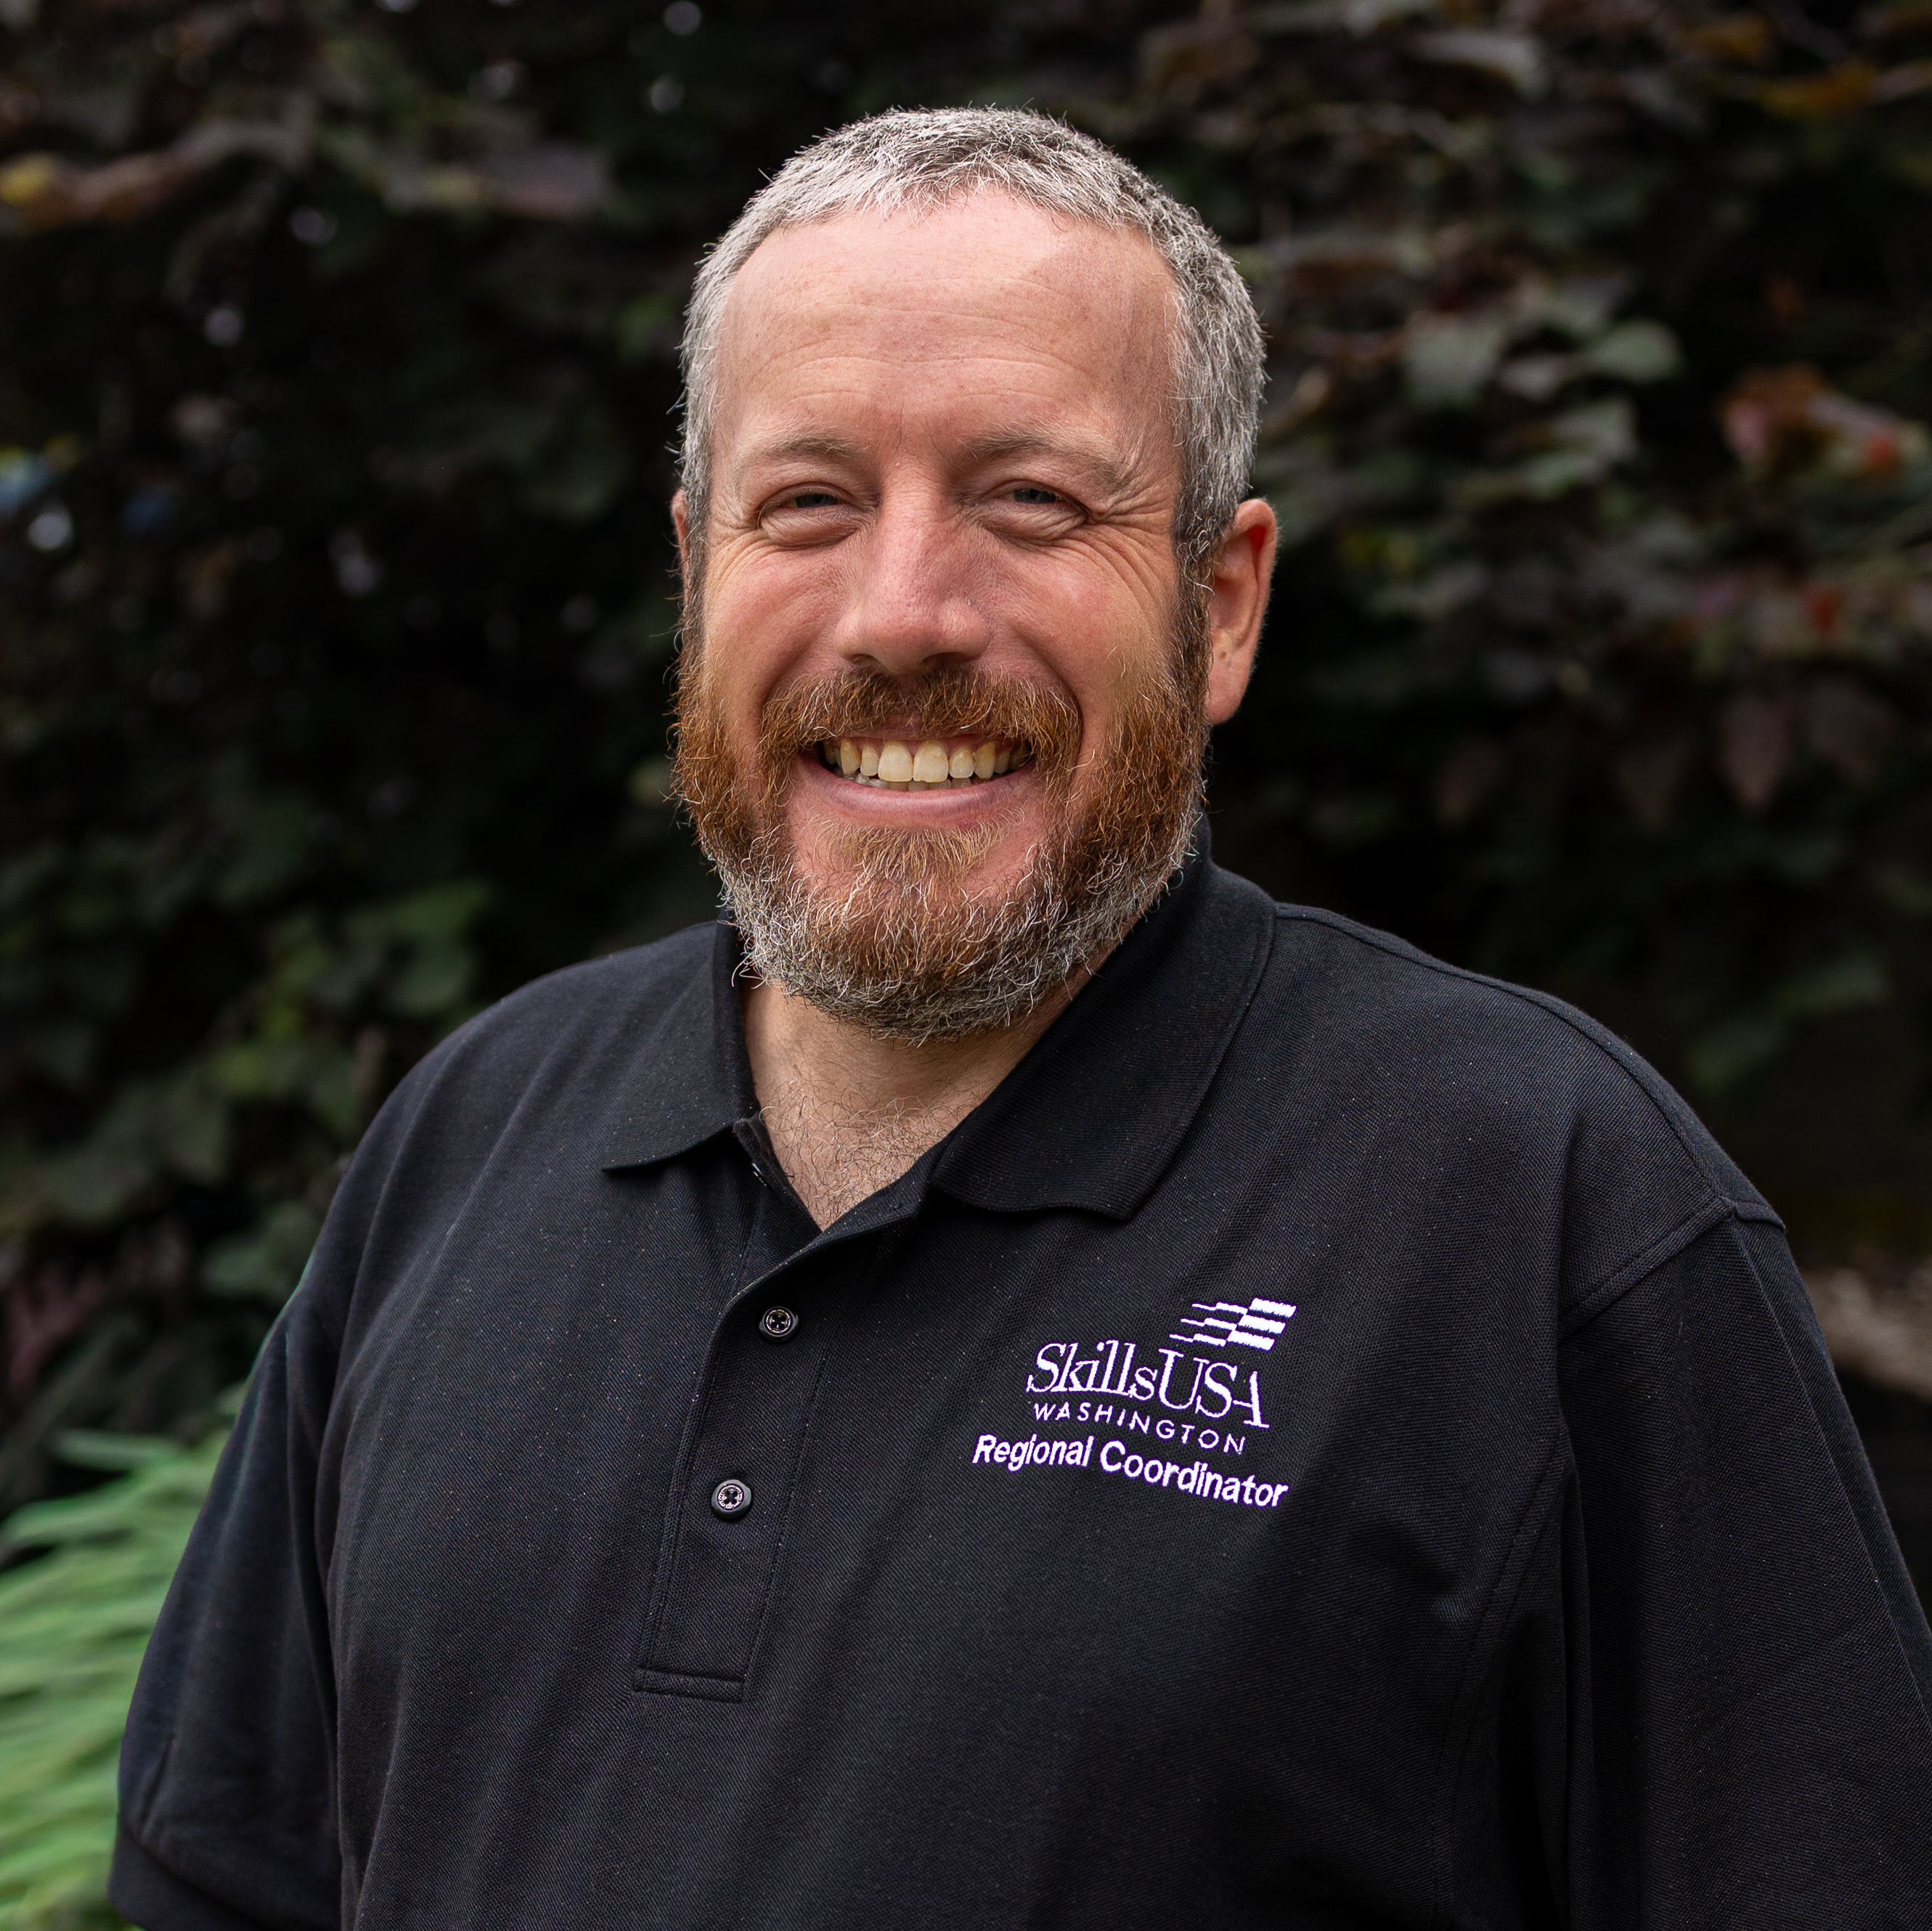
Eastern Regional Coordinators
Jessa Nocis
Brandon McDaniel

Slide 8
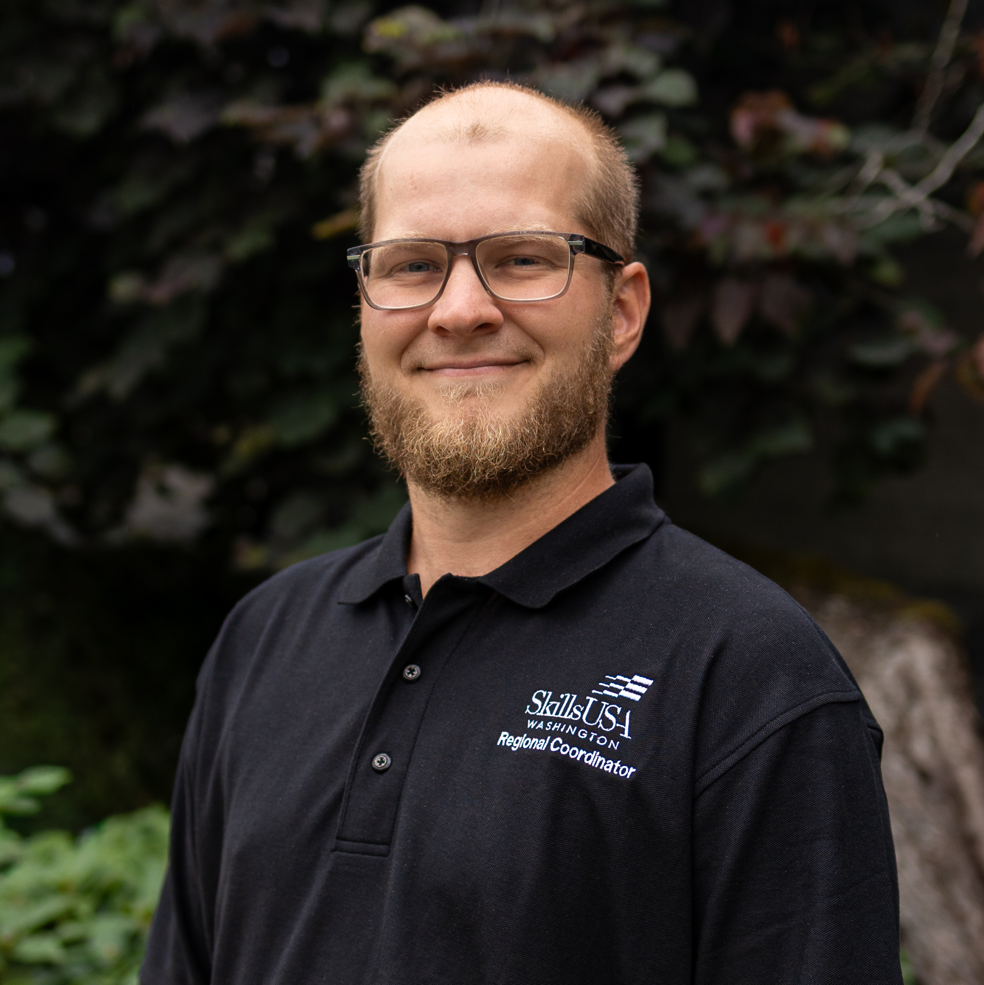
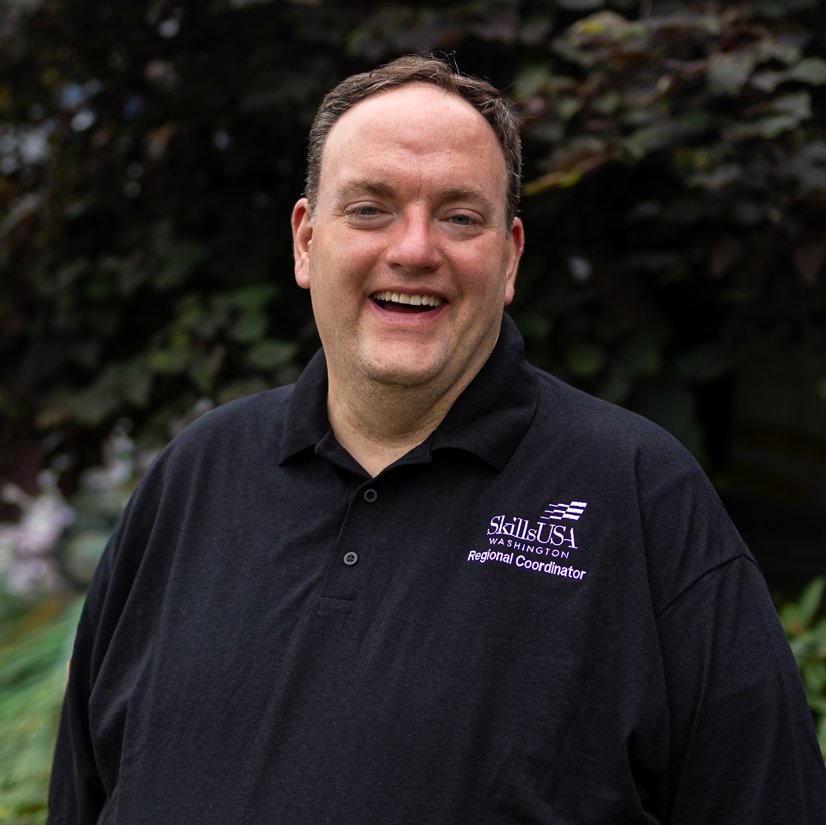
Puget Sound North Regional Coordinators
Logan McKay
Brian Long

Slide 9
Advisor Training Series
October 1: SkillsUSA Basics
October 2: NEW Regional Conference Best Practices
October 7: Crosswalk SkillsUSA Into Your Framework
October 9: Taking it to the Next Level - Career Essentials and more!
October 14: Advanced SkillsUSA Advisor Teaching Tools
Welcome Pathful!

Slide 10
All NEW Regional Programming
Single project Statewide! - Equitable enhancement
NEW Host form
Advisors must register this year – No cost
All Registrants gain access via Pathful on release date
You must be a registered member to gain access
Strict deadline
Lock Down on Submit – Be aware! This prompts
invoicing and finalizes registration. Non-amendable*

Slide 11
Advisor and Student Overview
All NEW Regional Programming
Testing is conducted on-site during the regional competition.
Only select contests include an online test.
*Leadership contests are exempt.
The project document and scorecard for contest will indicate whether a test is required.
All test links will be accessed through Pathful

Slide 12
Pre-Competition Requirements
All NEW Regional Programming
All NEW Regional Programming Advisor and Student
Membership Requirement:
  Students must be registered SkillsUSA members at least 48 hours before their regional event. (In order to receive Pathful automated email)
Technology Access:
  Students must have Pathful access and be able to log in on-site during their contest.
  Advisors should ensure students bring a charged device capable of accessing Pathful.
  Schools should verify that their district IT systems allow Pathful access prior to the event.
Know Your Contest:
  Students and advisors should review the project document and scorecard for their contest to confirm whether testing will occur.

Slide 13
Testing Procedures
All NEW Regional Programming
All NEW Regional Programming Advisor and Student
Testing Format:
  Tests are conducted online via Google Forms and accessed within Pathful.
  Students will be directed when and where to take the test by the contest host.
Testing Rules & Expectations:
  Testing is closed-book and must be completed individually.
  No phones or talking are permitted during testing.
  Hosts or assigned proctors will monitor the testing area to maintain academic integrity.
Accommodations:
  Students requiring accommodations (e.g., extended time or separate testing space) must coordinate through their advisor.
  Accommodations should be communicated to the Regional Coordinator in advance of the event. If not communicated prior to arrival and with ample prep time for the host facilities accommodations may not be met.

Slide 14
Post-Testing Procedures
All NEW Regional Programming
All NEW Regional Programming Advisor and Student
Score Inclusion:
  Test scores are included in the overall contest score and can impact final placement or ranking.
Access to Scores:
  Students and advisors will not have access to individual test scores at time of completion.
  Final overall scorecards can be reviewed upon request after the contest concludes.

Slide 15
Key Reminders
All NEW Regional Programming
All NEW Regional Programming Advisor and Student
Confirm student membership status at least two days before the event.
Verify Pathful login access and test functionality before contest day.
Students should arrive prepared with their device, charger, and login credentials.
Follow all instructions from contest hosts during the event.

Slide 16
Contest Host Overview
All NEW Regional Programming
Testing is conducted on-site during regional competitions.
Only select contests include an online test; leadership contests are exempt.
Each contest’s project document and scorecard will indicate whether a test is required.
All tests are accessed through Pathful, with links provided at the contest site. Contest hosts will receive testing scores directly to their email to input into FINAL scorecard only.

Slide 17
Pre-Competition Responsibilities
All NEW Regional Programming Contest Host
Verify Membership and Rosters
  Confirm that all competitors are registered SkillsUSA members at least 48 hours before the event to ensure Pathful access.
Technology Preparation
  Ensure the testing location has reliable internet connectivity and adequate power access for student devices.
  Remind advisors to ensure students bring charged devices(not phones) capable of accessing Pathful.
  Schools should confirm that district IT systems permit Pathful access prior to arrival.
Testing and contest Space Setup
  Prepare a quiet, supervised area suitable for testing.
  Ensure seating allows for independent work and minimizes distractions or opportunities for collaboration.
  Acquire contest materials and begin preparation of space needed for event
  Create equitable environment for all who attend to experience.
  Print scorecards for all judges
  Manage testing scores and input into final scorecard electronically. Ideally, not to be host.

Slide 18
Testing Procedures
All NEW Regional Programming
All NEW Regional Programming Contest Host
Test Administration
  Tests are completed online via Google Forms, accessed through Pathful.
  Clearly communicate testing times, locations, and expectations to all competitors before the session begins.
Monitoring and Supervision
  Designate qualified proctors or contest personnel to oversee testing.
  Enforce testing expectations:
    Testing is closed-book and completed individually.
    Phones, communication, and outside materials are not permitted.
  Report any suspected academic dishonesty or testing irregularities to the Regional Coordinator immediately.
Accommodations
  Accommodations (e.g., extended time, separate space) must be approved and coordinated in advance by the advisor and Regional Coordinator.
  Hosts should make reasonable efforts to support approved accommodations but are not required to make unplanned adjustments on-site.

Slide 19
Post-Testing Procedures
All NEW Regional Programming
All NEW Regional Programming Contest Host
Score Handling
  Test scores are automatically submitted via Pathful and included in the contest’s final scoring.
  Hosts should confirm that all students have submitted their tests before ending the session.
Data Security
  Do not share or display scores publicly.
  You will be given access to the testing scores via google spreadsheet.
  Only authorized Regional Coordinators and state office personnel may access or review score data.
Communication
  Inform students and advisors that individual test scores will not be released.
  Advise that overall contest results will be shared after official scoring is complete.

Slide 20
Key Reminders
All NEW Regional Programming
All NEW Regional Programming Contest Host
Verify student membership and Pathful access before competition day.
Prepare a distraction-free, well-monitored testing space.
Maintain professionalism and fairness throughout the testing process.
Report all testing concerns or incidents to the Regional Coordinator immediately.

Slide 21
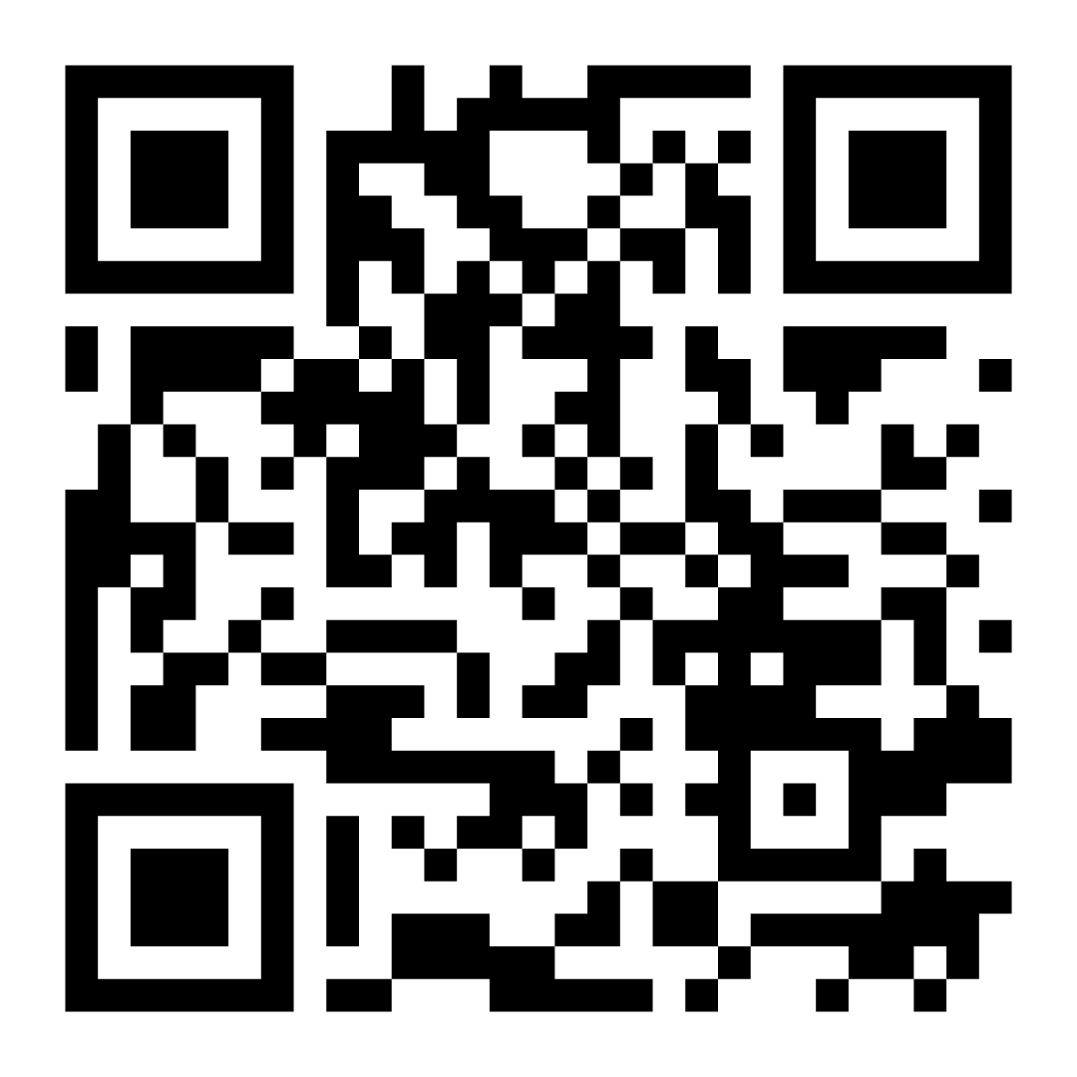



Communication
Website
Mailer
WA Yapp App

Slide 23

Thanks for being here!
Questions?

