Slide 1
SkillsUSA Washington
Integrating SkillsUSA into your
Classroom Framework
October 7th, 2025 – Virtual

Slide 2
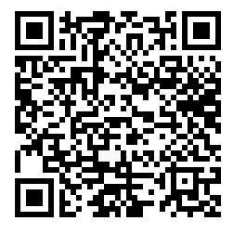
Workshop Links
This must be filled out to earn clock hours
Workshop Sign In Link:
Google Drive (Link)

Slide 3
Contact Information
Karmen Warner | State Director
  SkillsUSA Roll: Oversight of all State Operations and Communication with Nationals
  Email: director@skillsusawashington.org
Courtney Burger | Associate Director
  SkillsUSA Roll: Advisor and Student support
  Email: courtney@skillsusawashington.org
Adam Scroggins | Certified Trainer, Region Coordinator
  Instructor: Pierce County Skills Center
  Teaches: ITS & Cyber Security
  Email: pugetsoundsouth@skillsusawashington.org

Slide 4
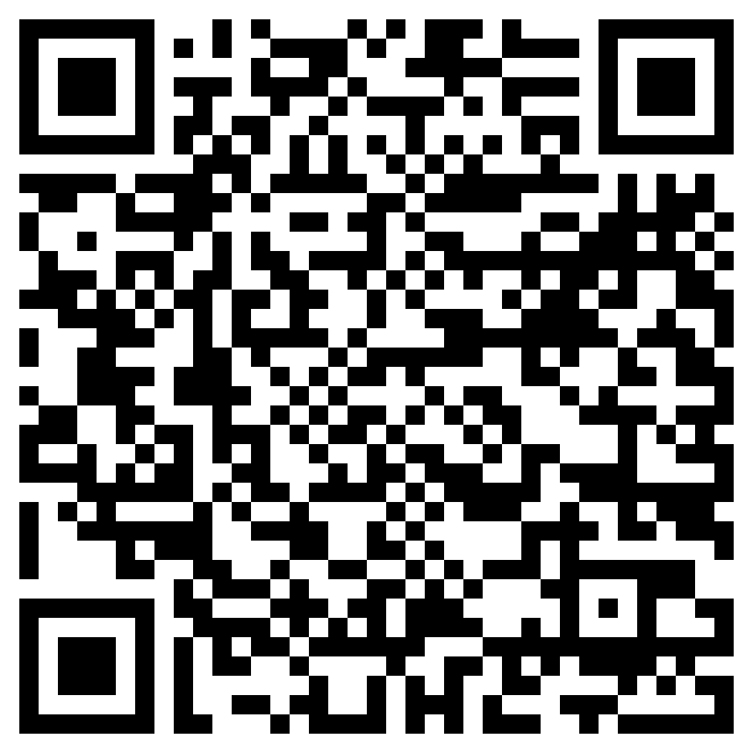
How to Stay in the know
Join the Mailing List
Click to join

Slide 5
Overview Of the Day
A Skilled and Technical Sciences (STS) Approach to Frameworks
What is Embedded 21st leadership in regards to STS Frameworks
  Terminology
  Instructor Assumptions
  RWC 28A.700.010
  The Value of a Framework
  Resources
  Sections of a Framework
  What is Embedded 21st leadership
  Employability and Leadership Activity Categorization
How to have effective leadership embedded for your STS framework
  What makes a meaningful activity
  Organize your activities in your framework
  Leadership \ Employability Unit
  Example Framework
  Brainstorming

Slide 6
Part One:
What is Embedded 21st leadership in regards to STS Frameworks

Slide 7
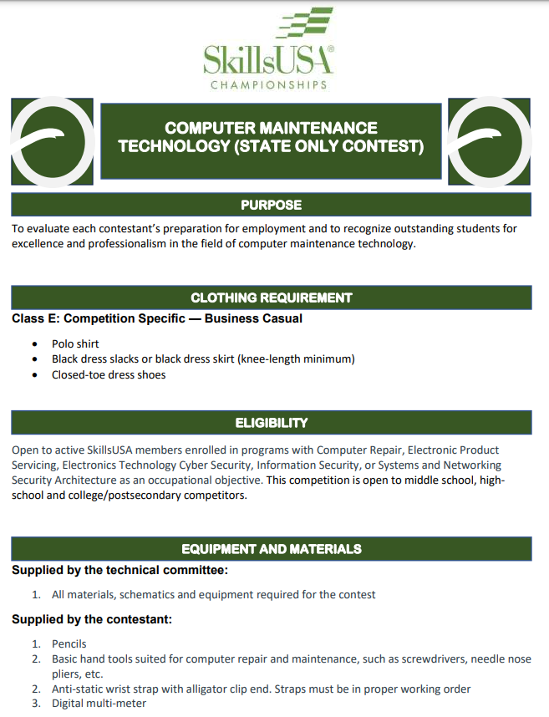
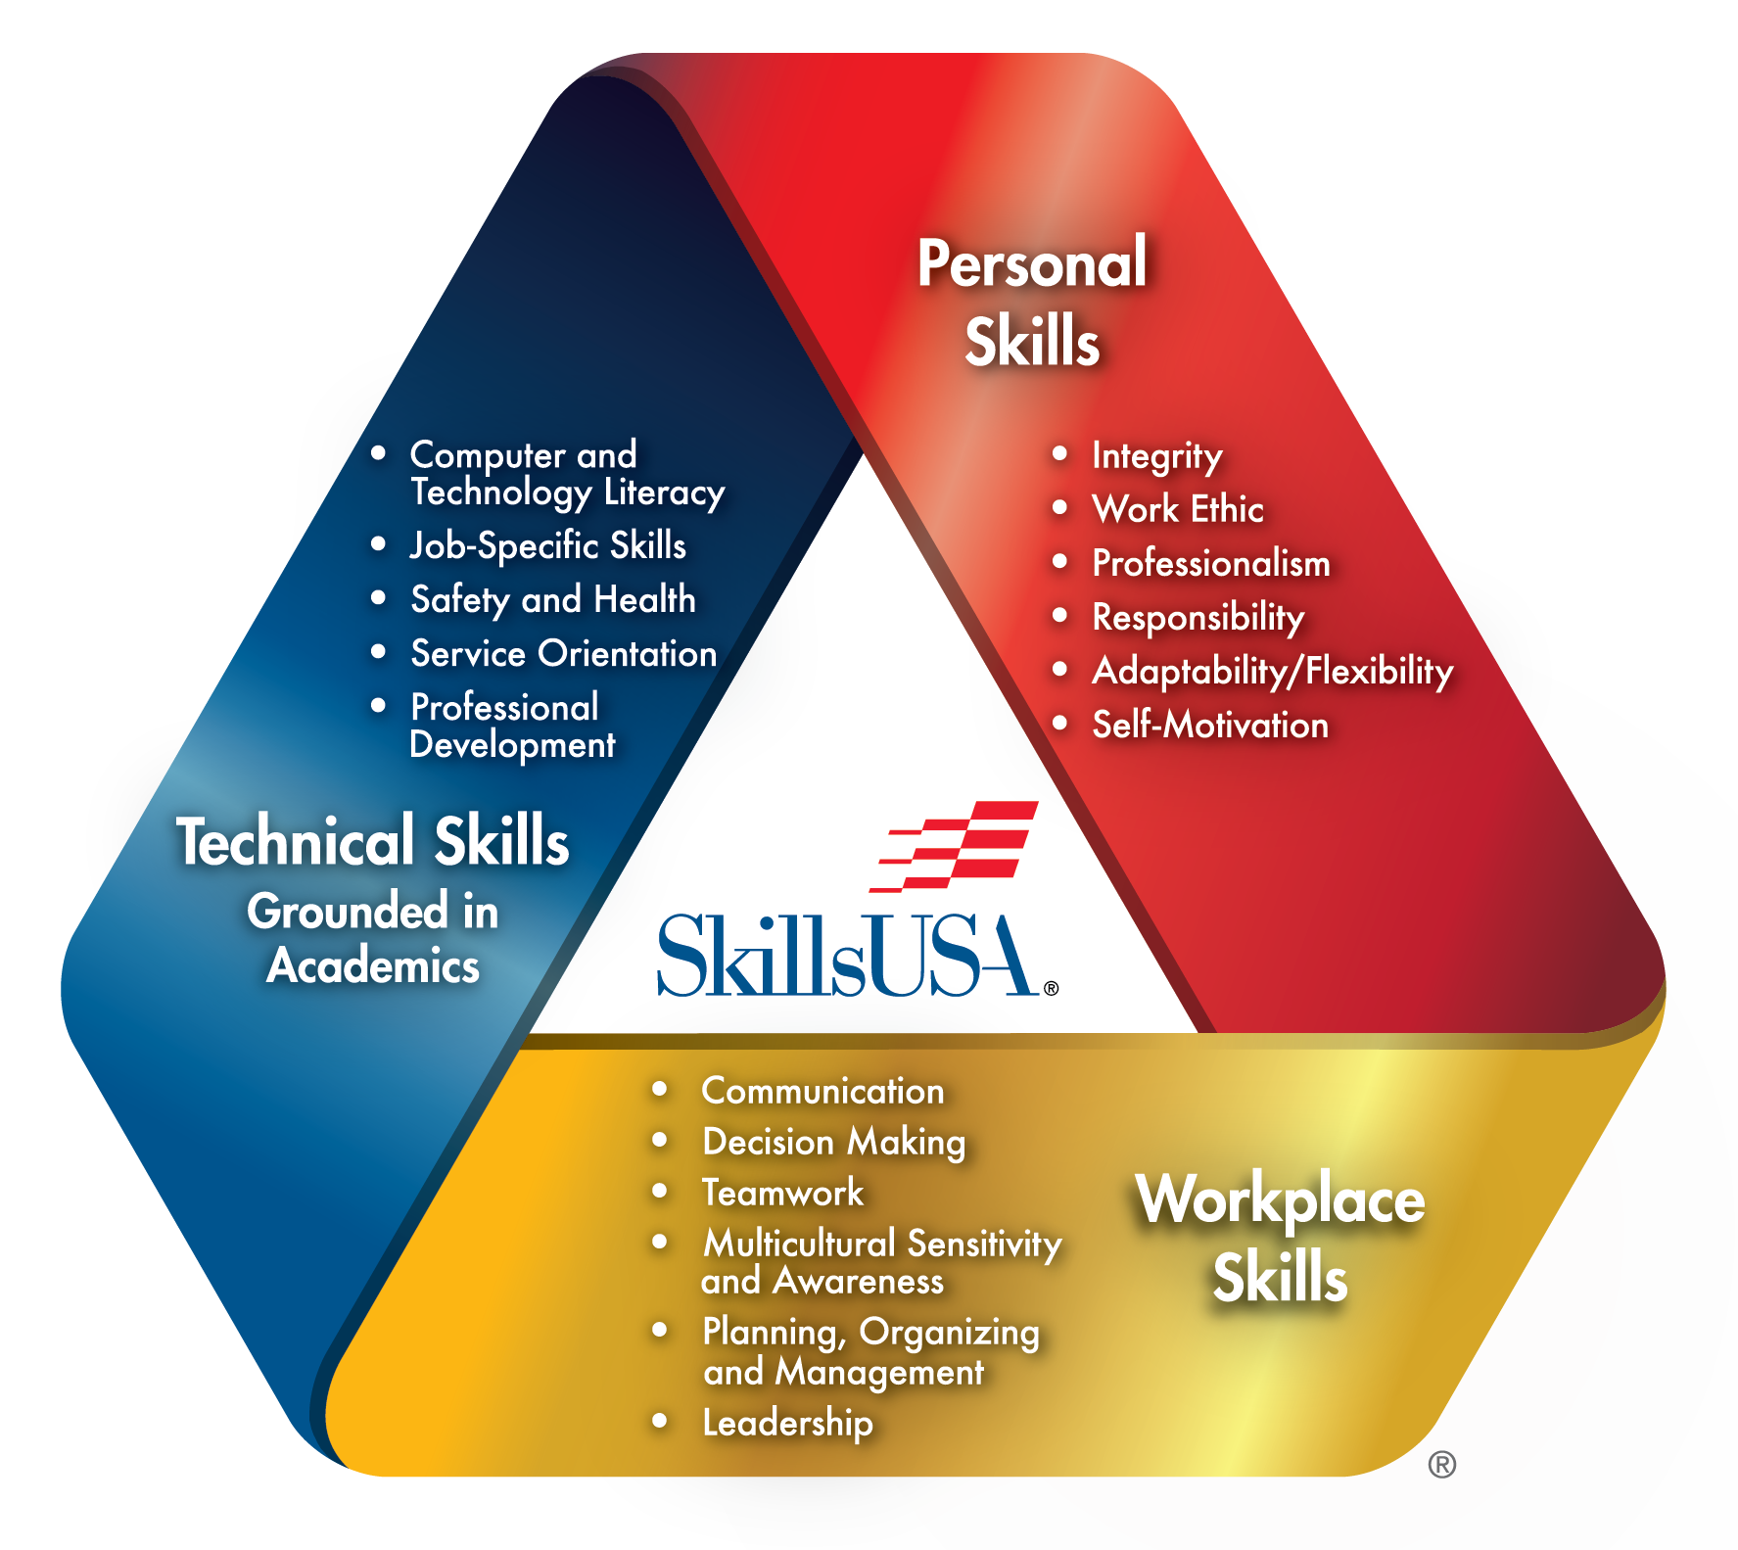
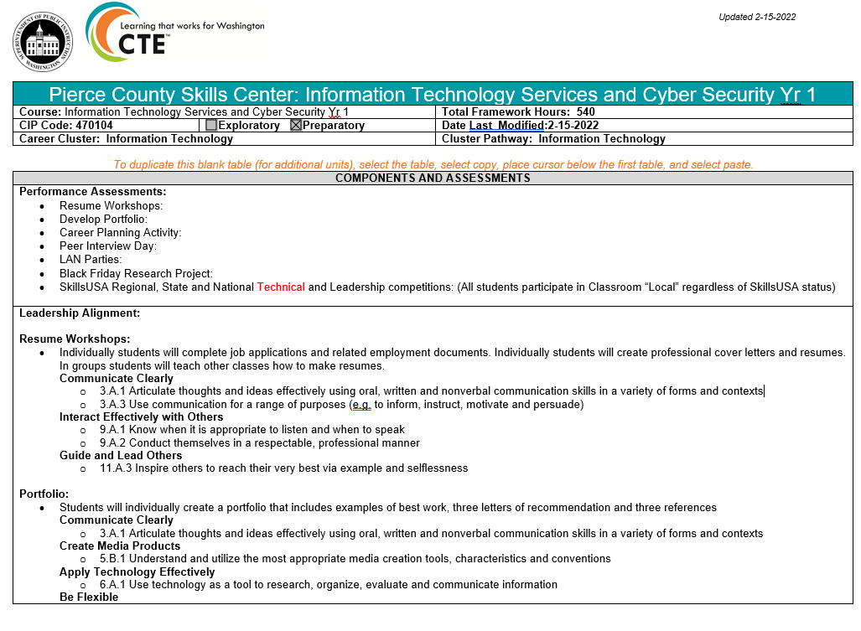
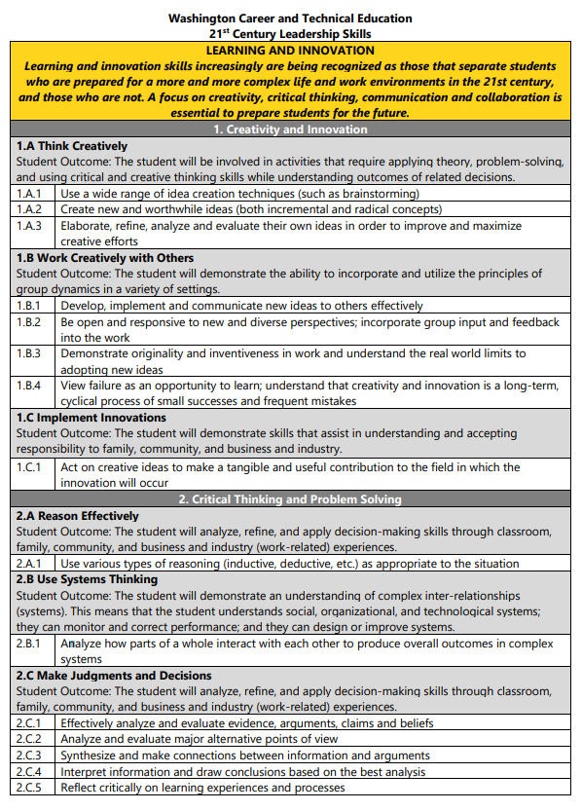
Terminology
https://www.skillsusa.org/about/skillsusa-framework/
Technical Standards
OSPI’s 21st Century Leadership Skills
SkillsUSA Framework
OSPI Course Framework

Slide 8
Assumptions
You have access to your most current copy of your course framework
You have access to OSPI’s 21st Century Leadership Skills (Link)

Slide 9
Assumptions
You are currently writing\updating your framework or are using a state approved framework
You are a
  60hr (Block)
  70hr (Trimester)
  90hr (Semester)
  180hr (Year)
  540hr (Skills Center 1-Year Program)
  1080hr (Skills Center 2-year Program) Framework

Slide 10
RCW 28A.700.010
Career and technical education—Plans—Standards—Technical assistance—Leadership development.
Frameworks are a tool used by OSPI to ensure we are meeting the expectations of RCW 28A.700.010
  Ensure academic rigor
  Align with the state’s education reform requirements, including the Washington State Learning Standards
  Help address the skills gap of Washington’s economy
  Maintain strong relationships with local CTE advisory councils for the design and delivery of career and technical education
  Align with current industry standards
  Align with state academic standards
  Annually approved by advisory committee

Slide 11
The Value of a Framework
Outlines course development
"Living" document to outline pacing of curriculum
Tool to align equivalency credit, dual credit and Industry Recognized Certifications (IRC) competencies
Outline for development of extended and work-based learning activities

Slide 12
Resources
A Google drive has been created
  Contents:
  OSPI-CTEBlankCourseFrameworkTemplate
  Information Technology Services and Cyber Security Yr 1 – Leadership
  Washington CTE Leadership Skills
  2024-25-state-approved-irc-list
  Framework leadership review
  Location:
  Google Drive (Link)

Slide 13
How to update a framework
Look at your IRC to determine what UNITS you need
Identify what assessment you will need for each unit
Identify the IRC standard\objective related to the assessment
Identify Washington 21st Century Leadership Skills that will be utilized in your unit\assessment
Is there a CTSO lesson or Contests that aligns with the unit
  Identify the Technical Standard Objective
  Does It match the IRC objective? No need to add the objective
  It doesn’t match the IRC objective? Add the Technical Standard objective to the framework

Slide 14
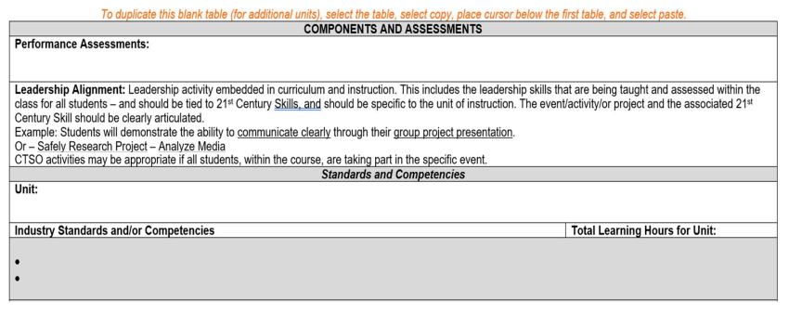
Sections of a Framework
Performance Assessments:
  Formative and/or Summative specific to the unit including any certifications if applicable
Leadership Alignment:
  Matching Principle, Specific event/project/activity and Specific 21st Century Skill for the unit
Unit:
  Title of Unit
Industry Standards/Competencies:
  Industry partnership are a great resource or Industry web sites. Your Program Supervisor may also have some resources•
Total Learning Hours for Unit:
  Hours specific to that unit

Slide 15
Washington 21st Century Leadership Skills

Slide 16
Todays Focus
We will “Mostly” be looking at Leadership Standards in your framework today
OSPI 21st Century Leadership Skills
All CTSO’s will align to the same “Standards”

Slide 17
Embedded 21st leadership
What is Embedded 21st leadership in regards to STS Frameworks
  Leadership Alignment = Activity/Event/Assignment that is Specific to the Unit of Instruction + 21st Century Skill
Example 1:
  Activity: Help Desk Technician Troubleshooting
  21st Century Skill:
    1.A Think Creatively
    2.A Reason Effectively
    2.C Make Judgments and Decisions
    2.D Solve Problems
    3.A Communicate Clearly
    6.A Apply Technology Effectively
  CTSO Tie-in: (Not Required)
    Customer Service Competition in the Classroom
    Have students develop Customer Service Scenarios based on the industry you teach

Slide 18

Embedded 21st leadership
Example 2:
  Activity: Gaming Computer Request for Proposal (Culminating Unit Project)
  21st Century Skill:
    8.A Manage Goals and Time
    8.B Work Independently
    6.A Apply Technology Effectively
    4.B Use and Manage Information
    3.A Communicate Clearly
  CTSO Tie-in: (Not Required)
    CTSO Provided Lesson Plans - Levering Your Leadership with POWERRful Presentations

Slide 19
Feedback
Chat Discussion:
Identify a leadership activity you incorporate in your class
Is the activity…
  Isolated to a specific day independent of a unit
  Part of a specific Unit
  Span multiple units “Year Long Activities”
What specific 21st century skills does it address?

Slide 20
Examples of Activities
Single Event
  Resume Workshops
  Peer Interview Day
  Black Friday Research Project
Contained to a Unit
  Customer Service Scenarios
  Troubleshooting Scenarios
  2nd Years Teaching Telecom Cabling
Spans the course
  Develop Portfolio
  Career Planning Activity
  LAN Parties
  SkillsUSA Local, Regional, State and National Leadership competitions

Slide 21
How to have effective leadership embedded
STS leadership

Slide 22
What Makes a Meaningful Activity
Putting my CTSO hat on!
  Embedded within lessons that are structured to build coherence
  Help students make connections to information, industry or community
  Students learn by actively engaging in real-world and personally meaningful projects
  Activities are tied to 21st leadership
Putting my SkillsUSA hat on!
  Find ways to incorporate CTSO activities in classroom instruction so “ALL” students gain the benefit regardless of membership
  Create a school PLC to develop leadership activities (multiple CTSO’s working together?)

Slide 23
What Makes a Meaningful Activity
Lean into the Curriculum your CTSO provides
Don’t reinvent the wheel
Utilize what is provided and modify it as needed
Use this as your “Minimum Standard”

Slide 24
Organize Activities (Single Unit)
Single Event
  Resume Workshops (Multiple CTSO’s)
  Peer Interview Day (Multiple CTSO’s)
  Black Friday Research Project (Community outreach)
Contained to a Unit
  Customer Service Scenarios (Multiple CTSO’s)
  Troubleshooting Scenarios (My class only)
  2nd Years Teaching Telecom Cabling (My class only)
Spans the course
  Develop Portfolio (Multiple CTSO’s)
  Career Planning Activity (Multiple CTSO’s)
  LAN Parties (Community outreach)
  SkillsUSA Local, Regional, State and National Leadership competitions (School wide)

Slide 25
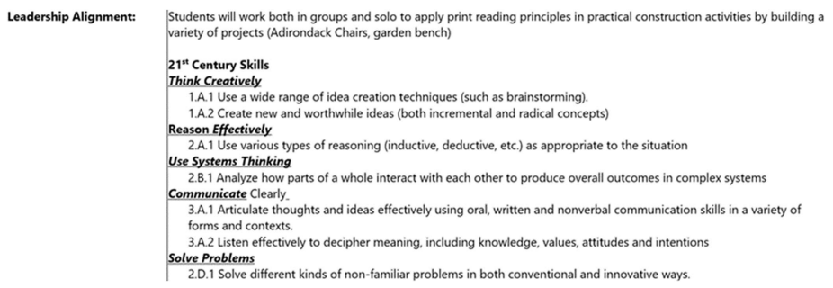
Embedded 21st leadership
What is Embedded 21st leadership in regards to STS Frameworks
  Leadership Alignment = 21st Century Skill + Activity/Event/Assignment that is Specific to the Unit of Instruction
Example:

Slide 26
Activates in your Frameworks
School wide, Year Long and Multiple CTSO activities are placed in one unit

Slide 27
Leadership \ Employability Unit
Advantage of an individual Leadership\Employability unit:
  Majority of your activities are located in one place
  You don’t have to force a Resume activity into an unrelated unit.
  Easier to update as a “Living Document”
  Can be shared among multiple programs \ Classes
  Most CTSO’s have these activities

Slide 28
Organize Activities (Multiple Units)
Single Event
  Resume Workshops (Multiple CTSO’s)
  Peer Interview Day (Multiple CTSO’s)
  Black Friday Research Project (Community outreach)
Contained to a Unit
  Customer Service Scenarios (Multiple CTSO’s)
  Job Interview (Mock Interviews)
  Prepared Speech (Gaming Computer Research)
  Skills Demonstrations (Telecommunications Cabling, ITS, IoT Smart Home)
  Troubleshooting Scenarios (My class only)
  2nd Years Teaching Telecom Cabling (My class only)
Spans the course
  Develop Portfolio (Multiple CTSO’s)
  Career Planning Activity (Multiple CTSO’s)
  LAN Parties (Community outreach)
  SkillsUSA Local, Regional, State and National Leadership competitions (School wide)

Slide 29
Leadership \ Employability Unit
Utilize CTSO competitions in class
  Break them down into mini assessments
  Scouring Rubrics are already made
  Standards are already documented
  All Students gain the experience
  You prepare your CTSO students for competition in class
E.g. Job Interview, Prepared Speech, Customer Service, Skills Demonstrations

Slide 30
Setting Goals and Objectives
https://skillsusawashington.org/events/month/
Student Engagement
Recruiting Events
Monthly meetings
Student ownership
Extended Learning
Curriculum
New Piece to use
Embed for all students
Incorporate into class framework
Is it an Individual Project, Unit Project or Year Long Project
Competitions
New Standards
New Contests
Incorporate into class
Leadership Development
Conferences
Workshops
Flip the classroom

Slide 31
SkillsUSA Framework
Integration
Program of Work

Slide 32
Details
How Detailed do I need to Get

Slide 33
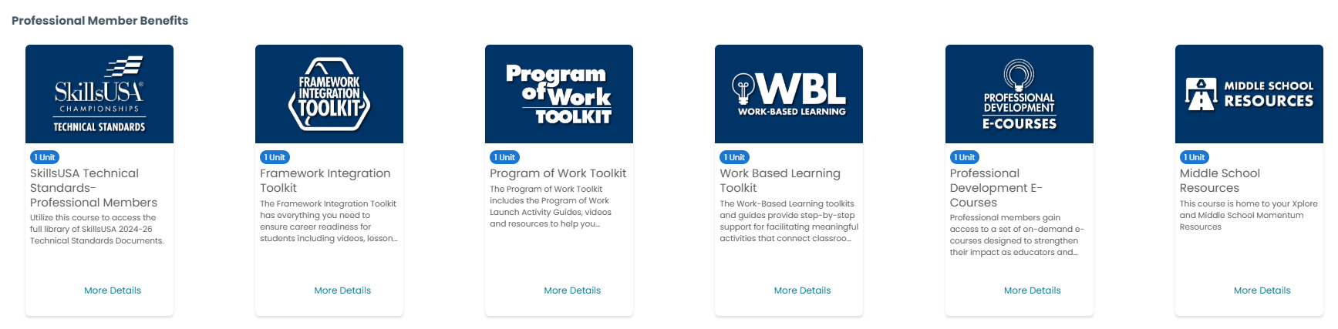
Professional Member Resources
https://mycareeressentials.org/
Each of these pieces of curriculum could be added as multiple projects\units

Slide 34

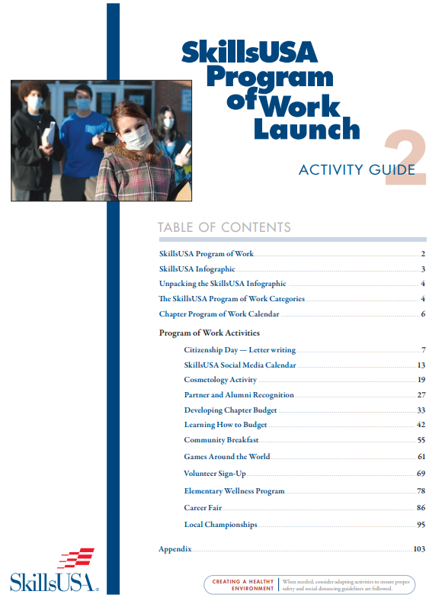
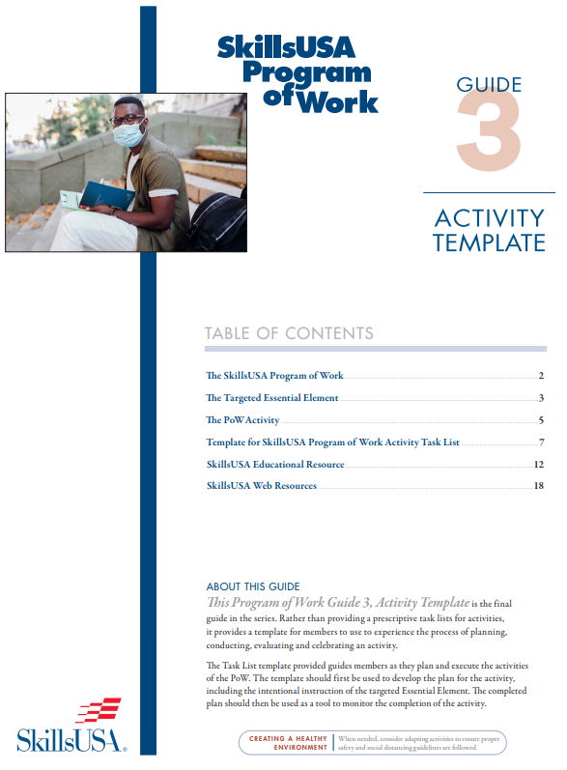
Program of Work Integration Toolkit
Add screenshot of framework integration toolkit
Templates & Resources
12 Activities
6 Activities

Slide 35
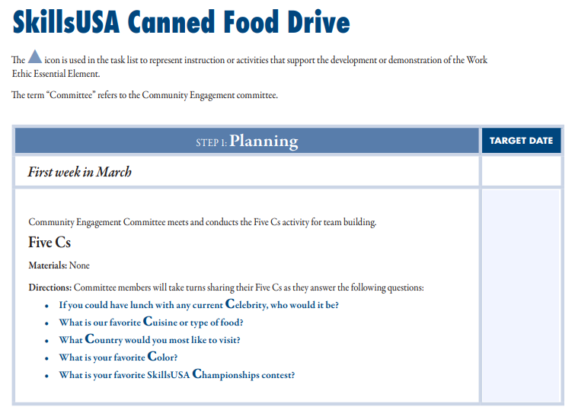
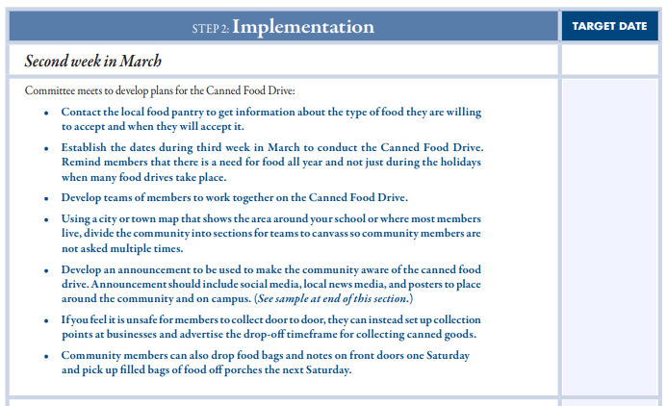
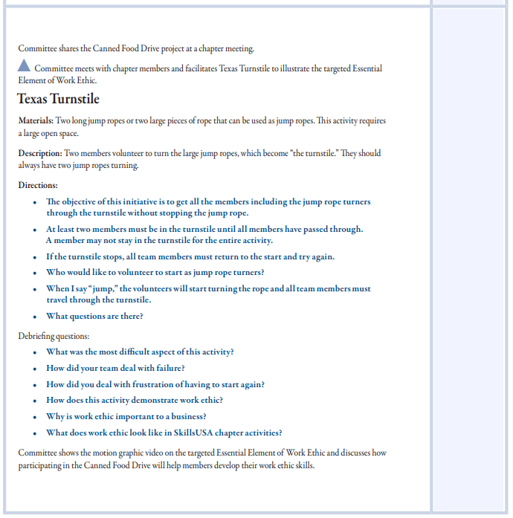
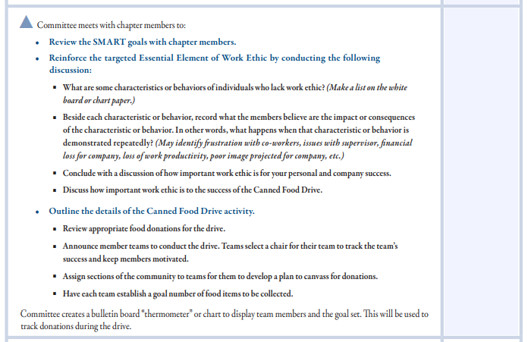
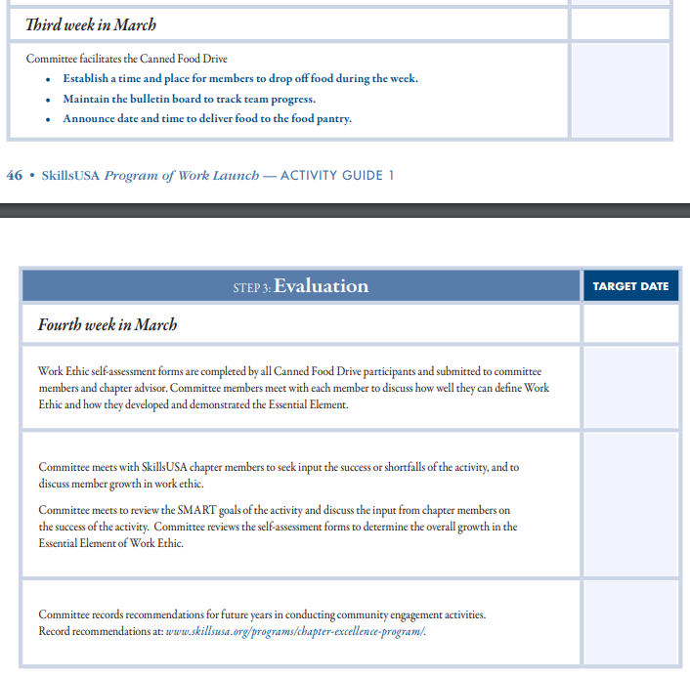
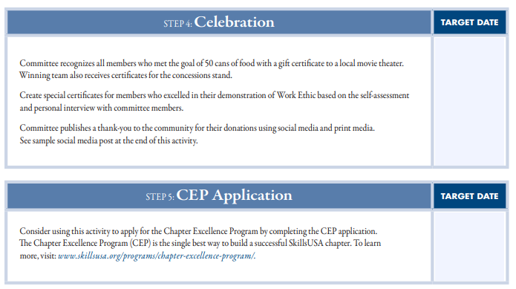
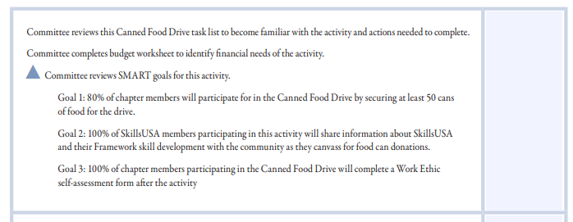
Activity Lesson Plans

Slide 36
Canned Food Drive Materials
Planning Sheets
Smart Goals Sheets
Example Committee Meeting
Budget Planning Sheet
Implementing the Activity Directions
Example Flyer \ Announcement Form
Facilitating the Activity
Activity Evaluation Forms
Self Assessment Sheet

Slide 37
Cross walking the SkillsUSA Technical Standards to the
OSPI Leadership Standards

Slide 38
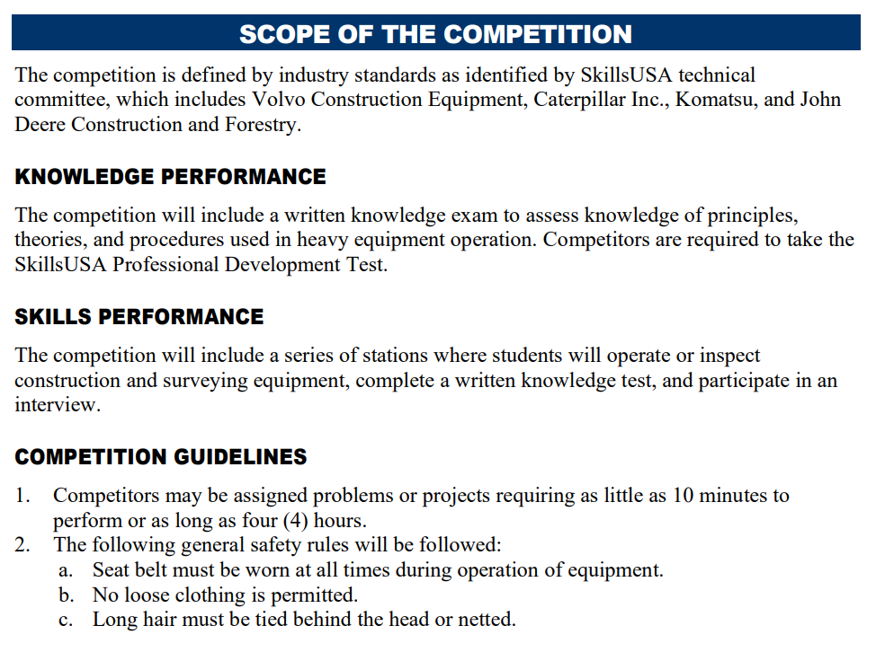
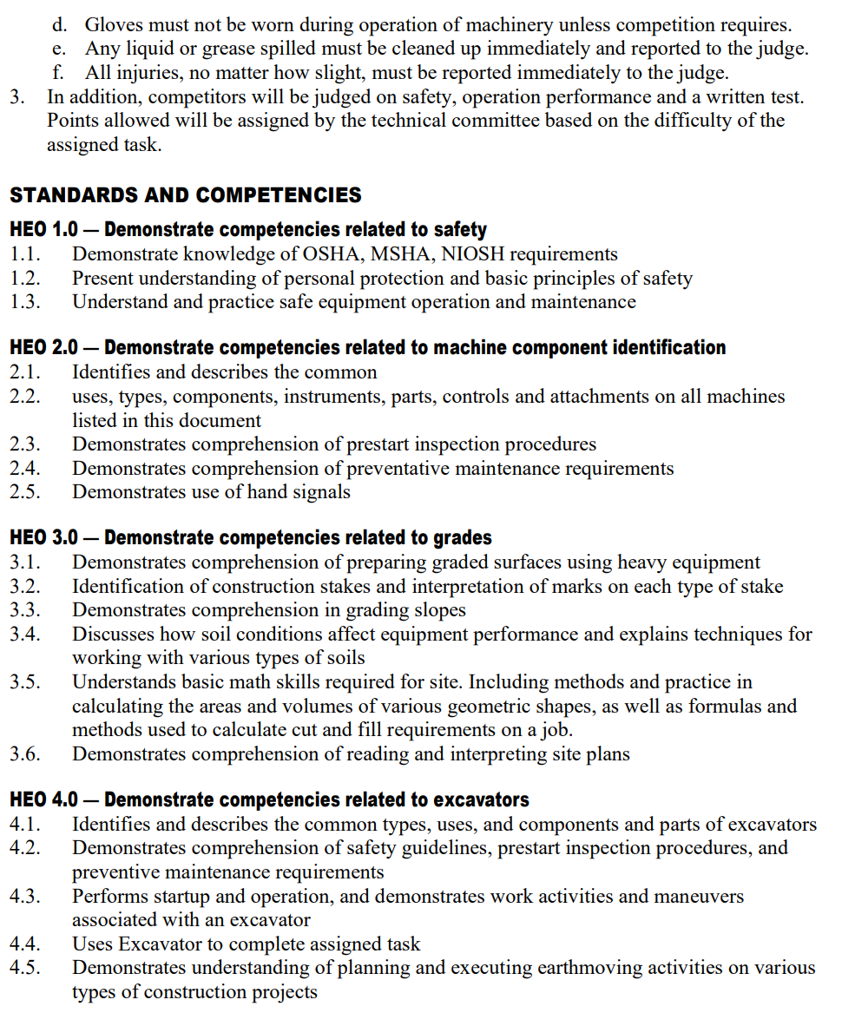
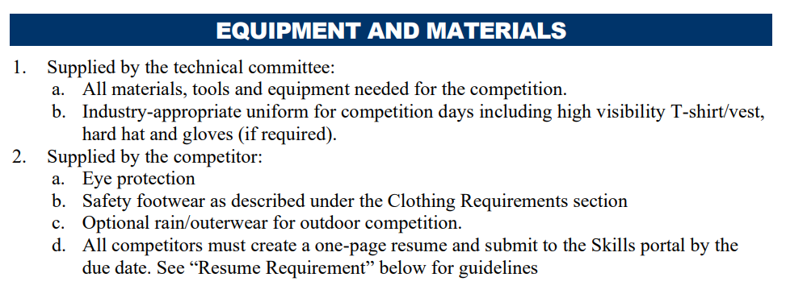
Aligning Curriculum with SkillsUSA Standards
SkillsUSA Framework
OSPI Leadership Skills

Slide 39
Embedding SkillsUSA Activities in Lesson Plans
Competition Embedded in Curriculum
SkillsUSA Curriculum
Extended Learning Activities
Technical Standards
Leadership Standards
Communication & Presentations
Extended Learning
Fundraising & Community Service
Verify against SkillsUSA standards and add to your Framework
Utilize Contests as Assessments
Verify against OSPI Leadership standards and add to your Framework
Utilize Contests as Assessments
Add to your Framework
Utilize SkillsUSA Curriculum (POWERRful) series
Add to your Framework
Add to your OSPI Program of Work
Utilize SkillsUSA Program of Work Toolkit
Add to your Framework
Add to your OSPI Program of Work
Utilize SkillsUSA Program of Work Toolkit
Leadership contests with Communication focus
Extemporaneous Speaking
Prepared Speech
Job Interview
Job Skills Demo A

Slide 40












Additional Curriculum
https://www.skillsusa.org/shop/
Team Building
Bellringers
Ice Breakers
Group Activities
Decision Making
SkillsUSA Framework
Communication
Conflict
Leadership
Critical Thinking
Presentations
Meetings
Parliamentary Procedure

Slide 41
Integrating Curriculum
Identify what you are already doing well and label it SkillsUSA
Identify one or two pieces of curriculum to increase effectiveness of your program
Identify what contests you are willing\able to support
Empower students to explore SkillsUSA
Utilize contests as assessments in your classroom
Empower your Advisory Committees to take part in SkillsUSA activities and provide resources

Slide 42
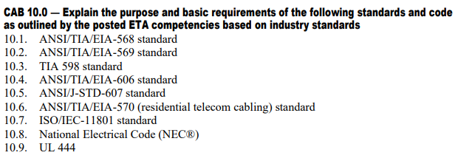
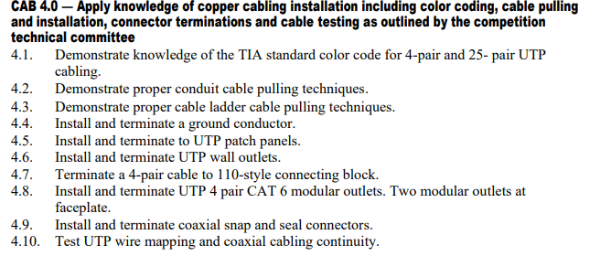
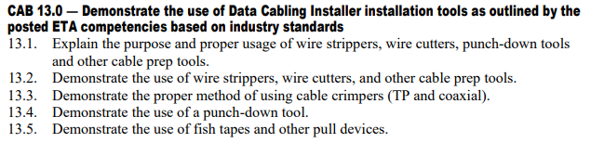
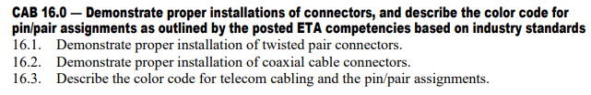
Integrating Curriculum (Telecom)
Add to Program Framework
Formative Assessments
  Define hardware labels
  Make Jumper Cables
  Make Coaxial Cable
  Punch down Assessment
Summative Assessments
  Install serviceable connections between walls
  Room Rewiring Project

Slide 43
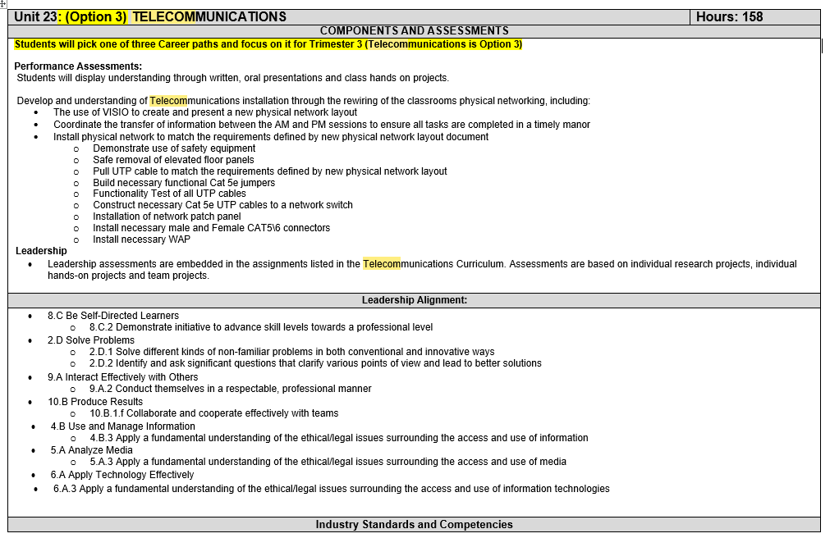
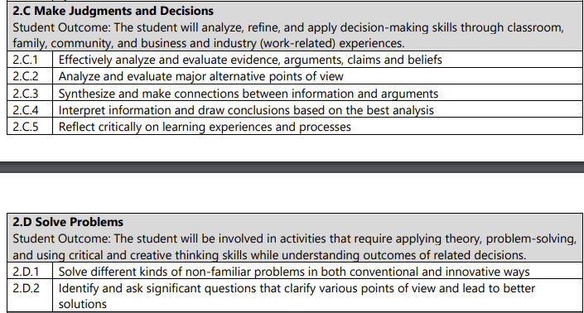
Crosswalk
CAB 13.0
OSPI Leadership Skills
Class Framework

Slide 44
Why add contests to curriculum
I was not an expert in speeches and presentations so I added Leadership contests that aligned with my IRC & Units
I wanted more alignment new and Current IRC’s
1st year Teaching
Competition directly aligned with IRC
Extemporaneous Speaking
Information Technology Services
Job Interview
By Year 3
By Year 7
Computer Maintenance
Telecommunications Cabling
Job Skills Demo A
Cybersecurity
Customer Service
Prepared Speech

Slide 45
Contests in Curriculum Example
By year 12, these are the CTSO Contests Supported by an IT class that are incorporated into the class Framework\Units
Occupational
Technical
Leadership
Career Pathways Showcase
Computer Maintenance
Extemporaneous Speaking
Related Technical Math
Community Service
Cybersecurity
Job Interview
T-Shirt Design
Customer Service
Information Technology Services
Job Skills Demo A
Other
Occupational Health and Safety
Internet of Things Smart Home Install
Pin Design
CareerSafe Video
Telecommunications Cabling
Prepared Speech
National Pin & T-Shirt Design
Quiz Bowl
Sate Pin & T-Shirt Design
* No Student has competed but is supported

Slide 46
A Word from the State Office

Slide 47
What Questions do you have?
Open Floor for Questions
Group Discussion and Sharing Experiences
Next Steps and Action Plans

Slide 48
Resources and Contacts
Contacts:
Karmen Warner: director@skillsusawashington.org
Courtney Burger: courtney@skillsusawashington.org
Central Region: Central@skillsusawashington.org
Eastern Region: Eastern@skillsusawashington.org
Olympic Region: Olympic@skillsusawashington.org
Southwest Region: Southwest@skillsusawashington.org
PS North Region: Pugetsoundnorth@skillsusawashington.org
PS South Region: Pugetsoundsouth@skillsusawashington.org
Nationals Customer Care: customercare@skillsusa.org
Documents:
Resources: https://skillsusawashington.org/resources/advisors/
12 Steps to Start the Year
Breaking down the Framework
2024-25 Program of Work
Membership Kit
Brand Portal
Membership Enrollment
Mailing List:
Sign up now
Social Media:
Social Media Links: https://linktr.ee/skillsusawashington
Instagram: skillsusawa
Linkedin: https://www.linkedin.com/company/skillsusa-washington/
Facebook: https://www.facebook.com/skillsusawa/
Scholarships:
https://skillsusawashington.org/resources/students/

Slide 49
Join the Mailing List
Thank you for all you do for your students

