Slide 2
SkillsUSA 101: Starting Strong
A New Adviser’s Guide to SkillsUSA, from Introduction to Integration
October 1st, 2024 - Virtual

Slide 3
SkillsUSA New Advisor
This must be filled out to earn clock hours
Clock Hour Registration Link:
Google Drive Link:

Slide 4
Contact Information
Karmen Warner
Title: State Director
SkillsUSA Roll: Oversite of all State Operations and Communication with Nationals
Email: director@skillsusawashington.org
Adam Scroggins
Instructor: Pierce County Skills Center
Teaches: ITS & Cyber Security
SkillsUSA Rolls:
SkillsUSA Washington Certified Trainer
SkillsUSA Washington Board President
Email: pugetsoundsouth@skillsusawashington.org
Courtney Burger
Title: Associate Director
SkillsUSA Roll: Advisor and Student support
Email: Courtney@skillsusawashington.org

Slide 5
Agenda
State Director Update
SkillsUSA as an organization
SkillsUSA Washington structure
Costs
Essential Dates
Starting Strong
Resources
Integrating Curriculum
Funding
Contact Information

Slide 6
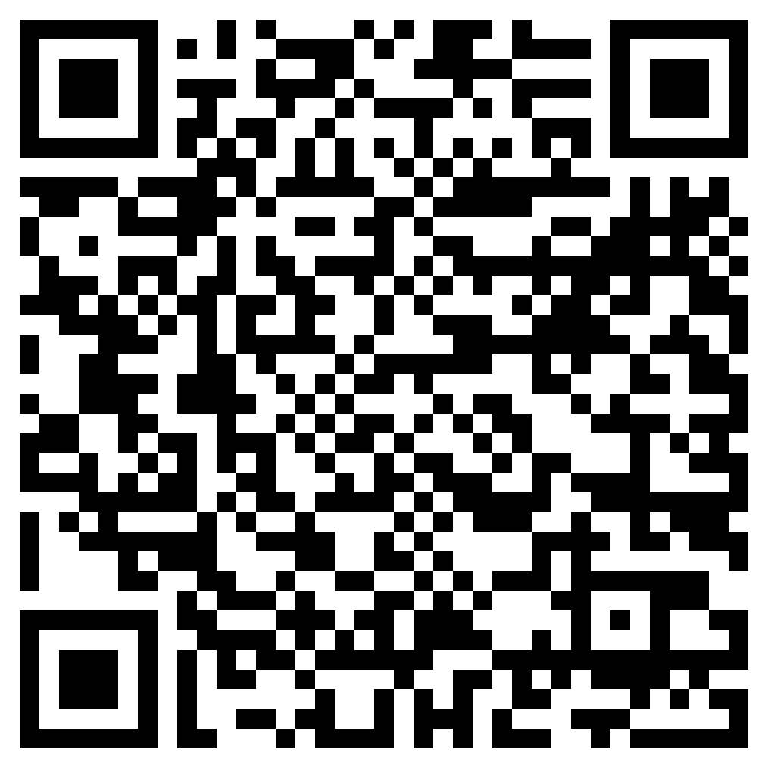
How to Stay in the know
Join the Mailing List
Click to join

Slide 7
A Word from the State Office

Slide 8
Workshop Expectations

Slide 9
About SkillsUSA
https://www.skillsusa.org/
https://Skillsusawashington.org
Founded 1965, as Vocational Industrial Clubs of America (VICA)
VICA changed its name to SkillsUSA in 2004
SkillsUSA has expanded to include more than 130 different technical, occupational, and leadership competitions.
Partnership of businesses, industry, and educational
Provides scholarships, job opportunities, and advanced training
Over 400,000 members - Middle schools, High schools, and Postsecondary

Slide 10
SkillsUSA Mission Statement

Slide 11
National Partners (600+)
https://www.skillsusa.org/who-we-are/leaders-and-partners/official-partners/
Diamond Level
Platinum Level
Gold Level
Silver Level
Bronze Level

Slide 12
State Partners (50+)
https://skillsusawashington.org/who-we-are/partners/

Slide 13
State Divisions
SkillsUSA Washington is divided into three Divisions
Middle School
High School
Post Secondary
Technical College
State College
University

Slide 14
SkillsUSA Structure in Washington State
Board of Directors
SkillsUSA Washington Apprenticeship Council
Central Region
Eastern Region
Olympic Region
Puget Sound North Region
Puget Sound South Region
Southwest Region
State Director
Karmen Warner
Chapters
Schools
Classes
Chapters
Schools
Classes
Chapters
Schools
Classes
Chapters
Schools
Classes
Chapters
Schools
Classes
Chapters
Schools
Classes
Associate Director
Courtney Burger
Officer Trainer
David Barragan
Accounts Payable
Kara Krebs
Communications
Veronika Zwicke
State Officers

Slide 15
Costs
https://skillsusawashington.org/events/month/
Student - $20 ($12 state, $8 national)
Professional - $ 30 ($10 state, $20 national) – Technical standards included
Regional Dues – defined by region ($5 to $10 regional contest fee typ.)
Registration must be paid to receive:
Access to Career Essentials
Educational resources – Lesson Plans, Activities, Worksheets, Etc.
Technical Standards for competitions
Connect to other instructors in your Career Clusters
Ability to register for competitions (Region, State and Nationals)

Slide 16
Key Dates and Events
https://skillsusawashington.org/events/month/
October 25th & 26th - Fall Leadership Camp (Black Diamond, WA)
November 22nd – Regional Contest Host Commitment Deadline
March 27th to 29th – State Leadership and Skills Conference (Lakewood, WA)
October 1st – SkillsUSA 101: (todays training)
October 3rd - SkillsUSA Chapter of Excellence Program and Applications
October 8th - Advisor Training – Preparing for Regional Competitions
October 10th - Advisor Training – SkillsUSA Advanced – Teaching Tools
October 15th – Advisor Training – Embracing DEI in the CTE Classroom
October 17th – Advisor Training – Integrating SkillsUSA into your Classroom Framework
October 22nd – Round Table: Statewide Support for Advisors

Slide 17
Steps to Start Strong - Resources
https://skillsusawashington.org/resources/advisors/
Advisor Resources located at https://skillsusawashington.org/resources/advisors/
Familiarize yourself with SkillsUSA
Secure Support from Administration and other Advisors
Register: Contact the State office to file Chapter Paperwork
Build Leadership Team
Elect Chapter Officers
Advisor Training – State and National Option
Create a Program of Work
Promote and Recruit
Hold Chapter Meetings
Engage in Activities
Competitions and Events
Extended Learning Activities

Slide 18
Steps to Start Strong
Tips for early success:
Understand this shouldn’t be more work, rather a redirection of what you are already doing only with resources
Contact your regional coordinator
Start small with focus
Identify contests you can support
Identify students who have an interest in leadership and competition
Build your core\legacy students (returning next year)
Volunteer to judge contests
Utilize your Regional Coordinator and State Office

Slide 19
Gaining School Administration Support
https://www.skillsusa.org/news/national-research-center-data-shows-skillsusa-members-are-learning-essential-skills-and-developing-career-plans/
Share the benefits of SkillsUSA membership
Majority of SkillsUSA members feel engaged in coursework that prepares them for higher education or careers by teaching.
Responsibility: 66%
Work Ethic: 60%
Teamwork: 59%
Communication: 55%
Decision Making: 43%
Professionalism: 47%
Academic and Career Impact
Positive Influence on GPA: 53%
Career Understanding: 58%
Future Education Plans: 41%
Academic Preparation for Career: 36%
Desire to Own a Business: 17%
Data provided by: National Research Center for College and University Admissions (NRCCUA)

Slide 20
Gaining School Administration Support
https://www.skillsusa.org/news/national-research-center-data-shows-skillsusa-members-are-learning-essential-skills-and-developing-career-plans/
SkillsUSA members Future Plans and Opportunities
Career and Education Plans
Technical Field Career: 55%
Four-Year College: 40%
Technical College: 14%
Community College: 12%
Military: 6%
Apprenticeship/Certification: 4%
Work After High School: 4%
SkillsUSA Opportunities
Work-Based Learning: 37%
Competitive Skills Events: 30%
Community Service: 19%
Professional Development: 13%
Leadership Roles: 7%
Student Demographics and Performance
Gender: 58% male, 42% female
B Average: 54%
A Average: 32%
Data provided by: National Research Center for College and University Admissions (NRCCUA)

Slide 21
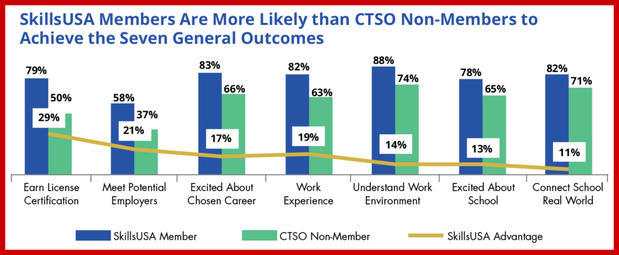
Gaining School Administration Support
https://skillsusachampions.org/2023/01/new-report-highlights-the-skillsusa-advantage/
Data provided by: National Research Center for College and University Admissions (NRCCUA)

Slide 22
Highlighting SkillsUSA Benefits to Students
Academic and career benefits
Enhanced Career Readiness
Improved Academic Performance
Networking and Career Opportunities
Personal and professional growth opportunities
Leadership Development
Professionalism and Ethics
Confidence and Public Speaking
Success stories and testimonials
Watch on Youtube
Notes:
Enhanced Career Readiness: SkillsUSA prepares students for the workforce by equipping them with technical skills, leadership abilities, and professional attitudes that are highly valued by employers.
Improved Academic Performance: Participation in SkillsUSA activities and competitions helps students apply academic concepts in real-world scenarios, reinforcing their learning and often leading to better grades and higher levels of academic achievement.
Networking and Career Opportunities: SkillsUSA provides students with opportunities to network with industry professionals, potential employers, and peers from across the nation, opening doors to internships, job offers, and career advancements.

Slide 23
SkillsUSA Framework & Curriculum

Slide 24
Integrating SkillsUSA Curriculum
What am I already doing
Can I identify the activity as SkillsUSA
Is what I am doing better than SkillsUSA
Is what I am doing aligned to local industry
Am I already providing SkillsUSA without knowing it
Should I re-invent the wheel

Slide 25
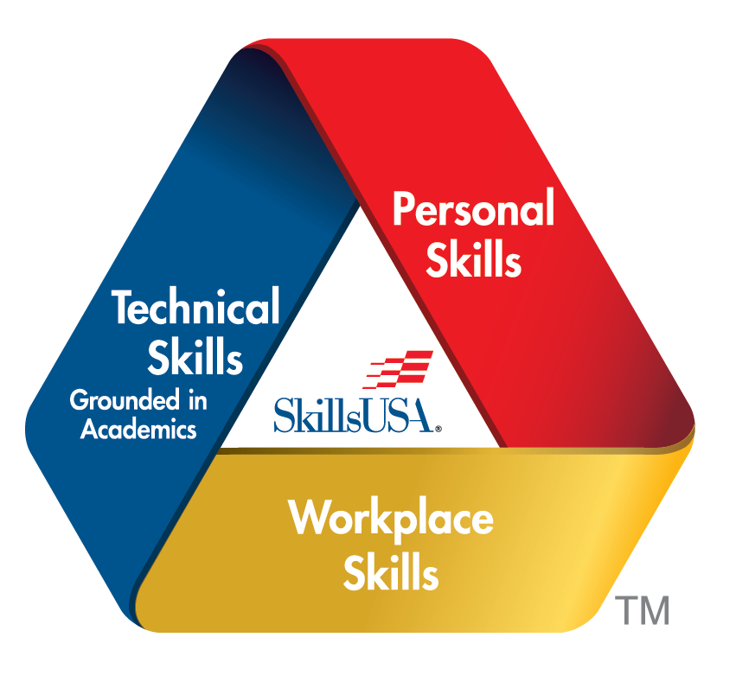
SkillsUSA Framework
https://www.skillsusa.org/about/skillsusa-framework/
Integrity
Work Ethic
Professionalism
Responsibility
Adaptability /Flexibility
Self-Motivation
Computer and Technology Literacy
Job-Specific Skills
Safety and Health
Service Orientation
Professional Development
Communication
Decision Making
Teamwork
Multicultural Sensitivity and Awareness
Planning, Organizing and Management
Leadership

Slide 26
Absorb Website
https://absorb.skillsusa.org/
The Following resources can all be found on the Absorb website once you are Paid Professional Member
Career Essentials
Jump Into Stem
CareerSafe Online
Skill Connect Assessments
Technical Standards
LEAD

Slide 27
Career Essentials
https://mycareeressentials.org/
Experiences
Project-Based Learning Activities
Lesson Plans
Assessments
Real-World Scenarios
Interactive Content
Workbooks
Assessments
Competency-Based Assessments
Performance Tasks
Feedback Tools
Additional Resources
Industry Connections
Career Exploration Tools
Soft Skills Training
Certification Preparation
Career Essentials can be used as…
Instructor Led
Independent study
Virtual study
Students who complete Career Essentials earn an industry-recognized credential that sets them apart from other applicants.
Notes:
curriculum offers a variety of resources aimed at developing essential career readiness skills

Slide 28
Jump into STEM!
https://mycareeressentials.org/
Developed to introduce middle school students to the fields of Science, Technology, Engineering, and Mathematics (STEM) through engaging, hands-on activities
Provides a fun and engaging way to explore STEM subjects
Helps develop essential skills such as teamwork, communication, and problem-solving.
Encourages early interest in STEM careers.
Offers a structured, ready-to-implement curriculum that aligns with educational standards.
Supports teachers with comprehensive resources and professional development.

Slide 29
Skill Connect Assessments
https://mycareeressentials.org/
Online assessments that measures technical and employability skills
Industry-Validated Content
Competency-Based Assessment
Interactive and Engaging
Students: Identifies areas for improvement, guiding further study and skill development.
Instructors: Offers a reliable tool for assessing student progress and program effectiveness.
Employers: Helps in identifying potential hires with verified skills and competencies

Slide 30
Technical Standards
https://mycareeressentials.org/
https://www.skillsusa.org/competitions/skillsusa-championships/categories-and-descriptions/
Over 100 Technical, Leadership and Occupational contests
Comprehensive guidelines and criteria for competitions
Detailed descriptions of the competencies and skills required for each competition area
Ensure that students understand both the challenges of the competitions and the demands of their future careers
Aligned to Industry Certifications and Standards
Can be used to align to your course framework
Contest Descriptions can be found here (Link)

Slide 31
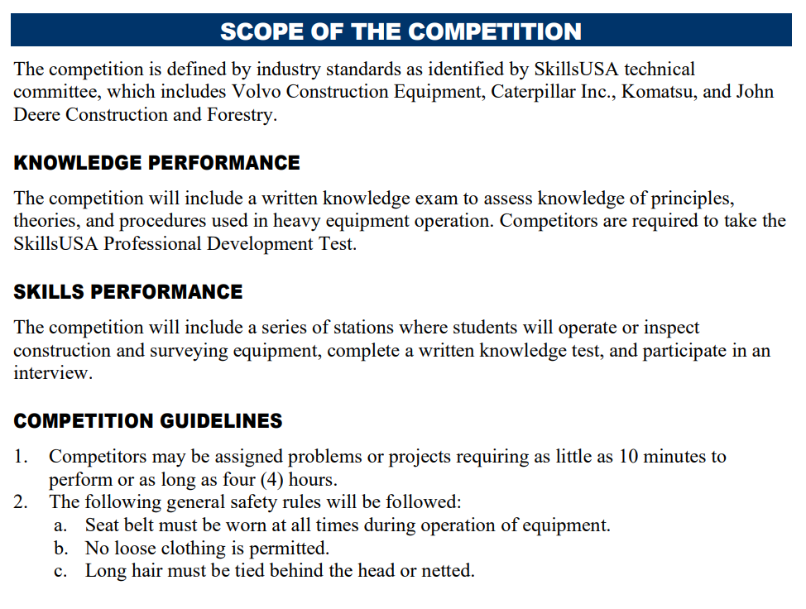
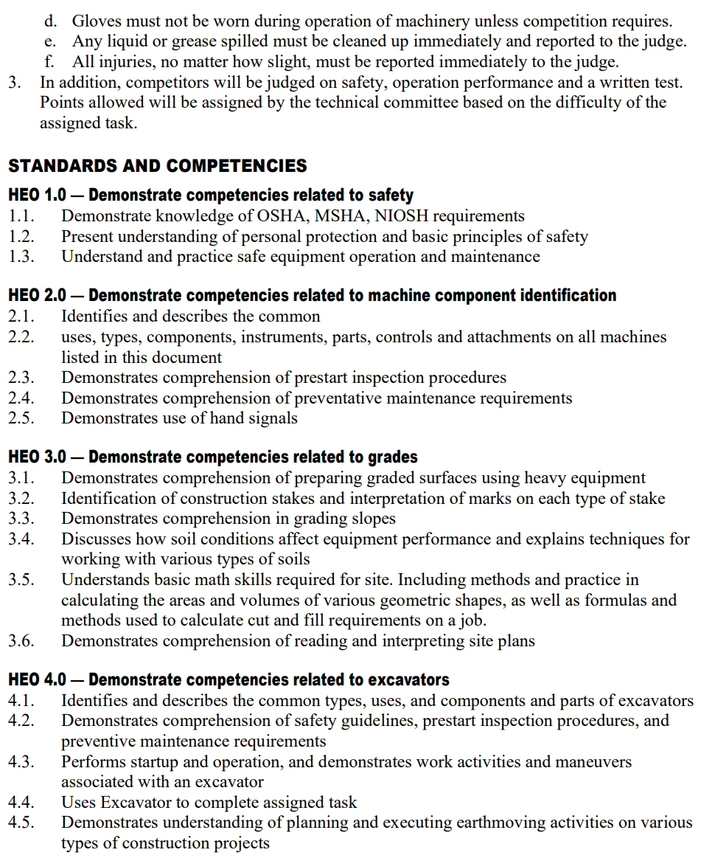
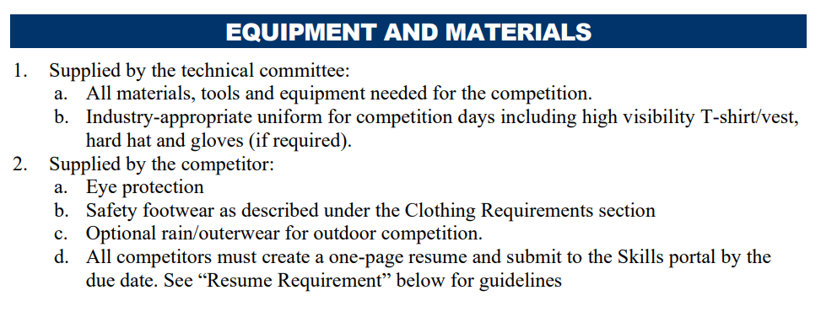
Tech Standards – What’s Included
CLOTHING REQUIREMENT
ELIGIBILITY
EQUIPMENT AND MATERIALS
Supplied by host
Supplied by contestant
SCOPE OF THE CONTEST
Knowledge Performance
Skill Performance
Contest Guidelines
Standards and Competencies

Slide 32
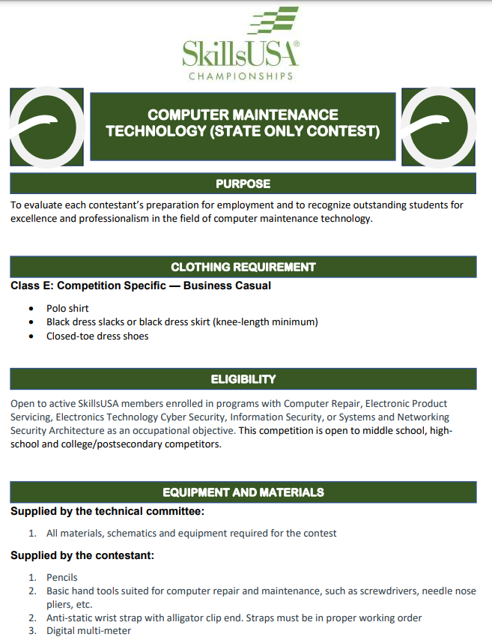
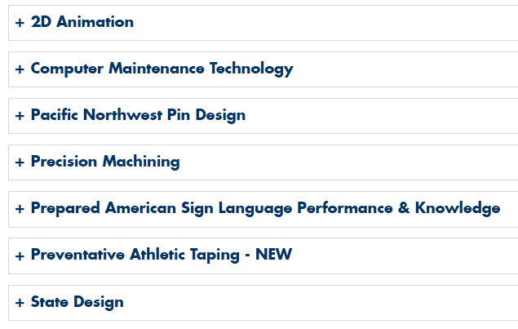
State Only Tech Standards
https://skillsusawashington.org/competitions/state-only/
Contests that are only offered in Washington State
There is no opportunity to compete at a National Level
Designed with the help of local industry and advisory
Can only be found on the SkillsUSA Washington website
https://skillsusawashington.org/competitions/state-only/

Slide 33
CareerSafe Online
https://www.careersafeonline.com/
CareerSafe was formed to help make jobs safer for young workers
Partnering with SkillsUSA through their CareerSafe Online Training courses.
Students learn to recognize potential safety and health hazards in any workplace
OSHA 10-Hour Construction
OSHA 10-Hour General Industry
OSHA 30-Hour Construction

Slide 34
LEAD (Leadership, Engagement, Action, and Development)
https://mycareeressentials.org/
A leadership development curriculum designed to cultivate leadership skills among students by engaging them in activities that foster personal growth, teamwork, and professional development.
Encourages students to take initiative and lead projects.
Promotes civic engagement and social responsibility
Develops both personal skills (e.g., self-awareness, confidence) and professional skills (e.g., public speaking, project management).
Activities and resources to help students develop public speaking skills

Slide 35
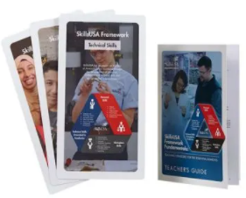
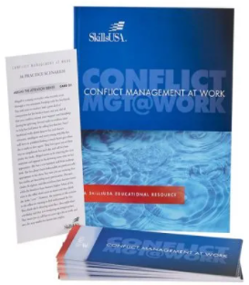
Additional Curriculum
https://www.skillsusa.org/shop/
Team Building
Bellringers
Ice Breakers
Group Activities
Decision Making
SkillsUSA Framework
Communication
Conflict
Leadership
Critical Thinking
Presentations
Meetings
Parliamentary Procedure

Slide 36
Integrating Curriculum

Slide 37
Integrating Curriculum
Identify what you are already doing well and label it SkillsUSA
Identify one or two pieces of curriculum to increase effectiveness of your program
Identify what contests you are willing\able to support
Empower students to explore SkillsUSA
Utilize contests as assessments in your classroom
Empower your Advisory Committees to take part in SkillsUSA activities and provide resources

Slide 38
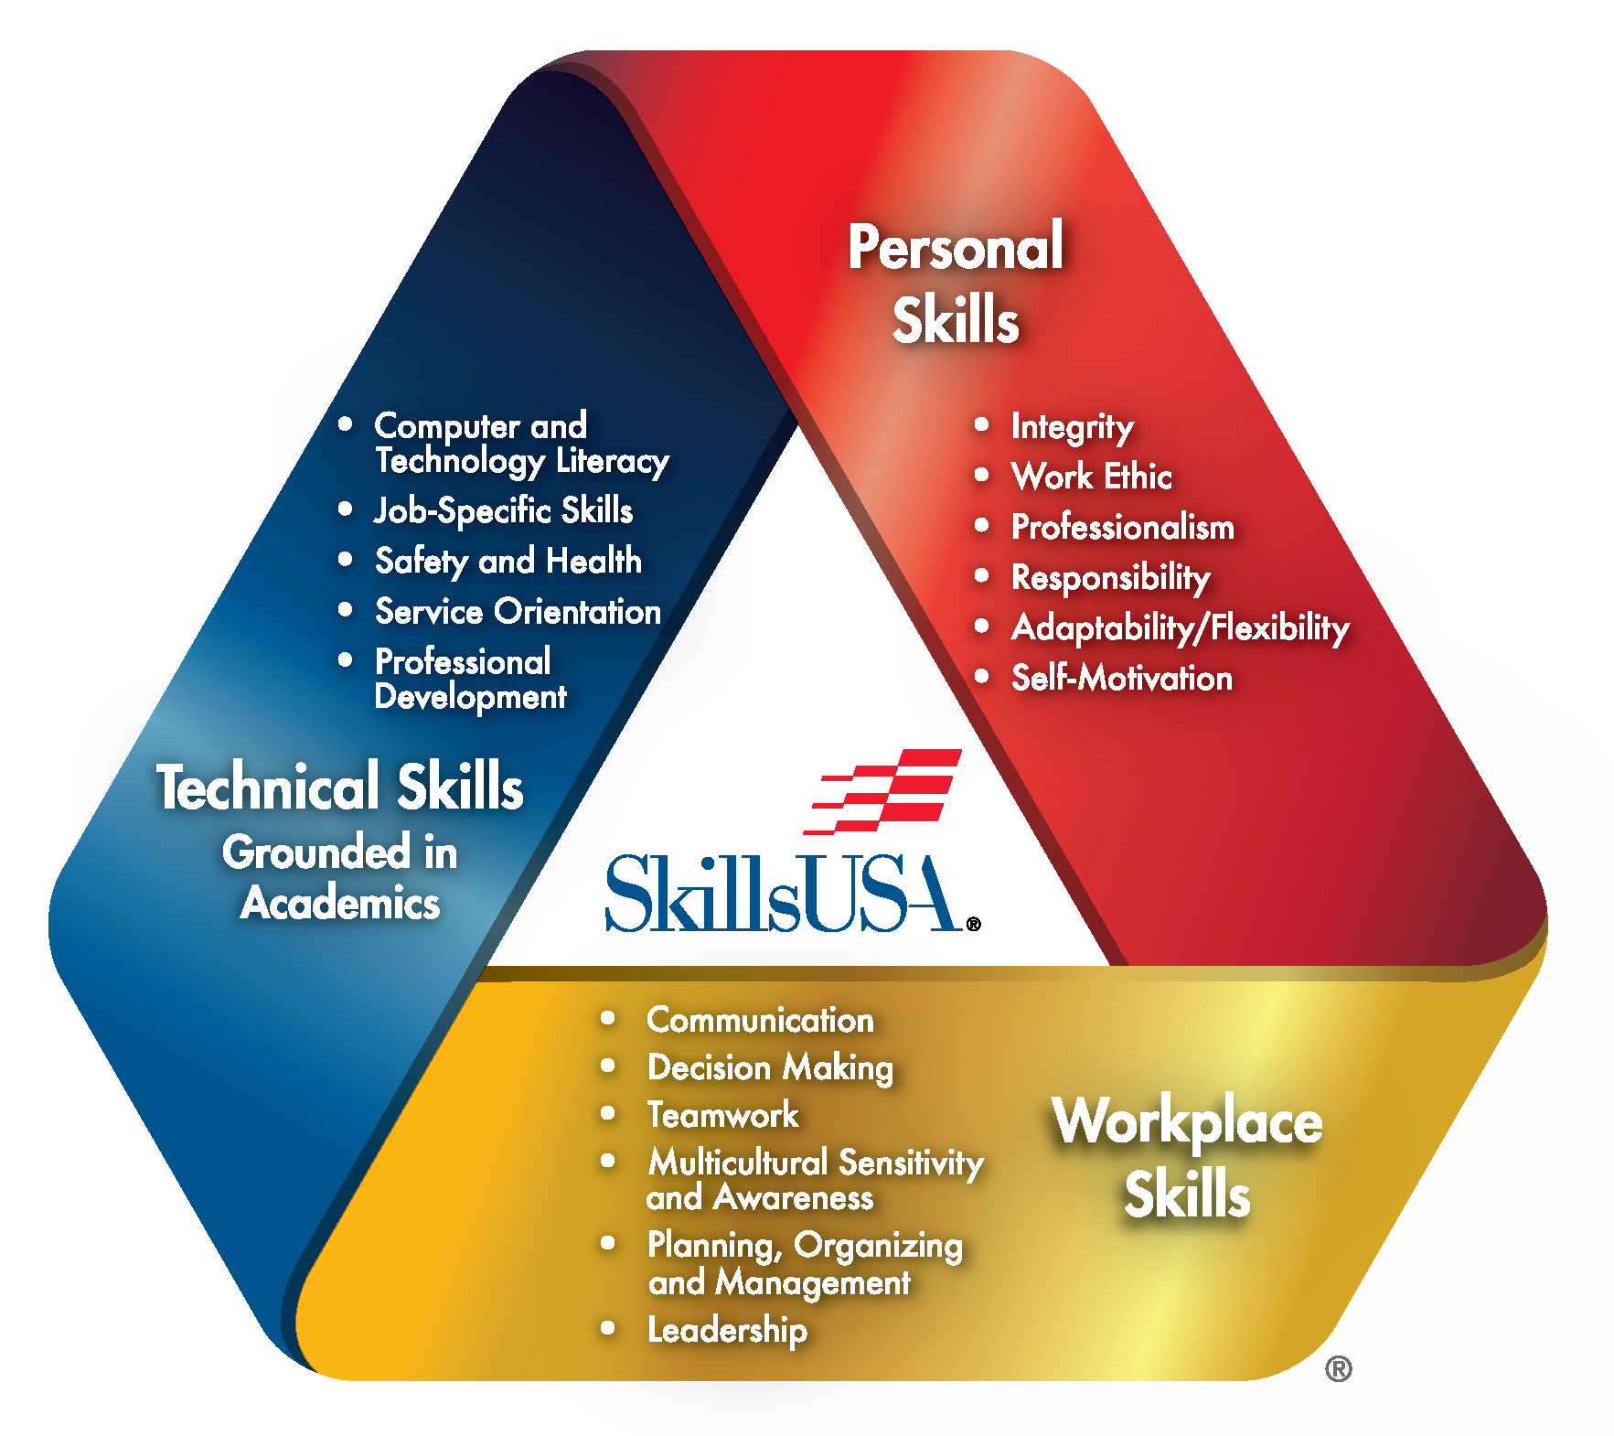
Evaluate Your Program
Evaluate areas you could use additional support
Identify resources that can help your program
Don’t reinvent the wheel
Work with your Regional Coordinators, State Office and State Trainers to find what works best in your program

Slide 39
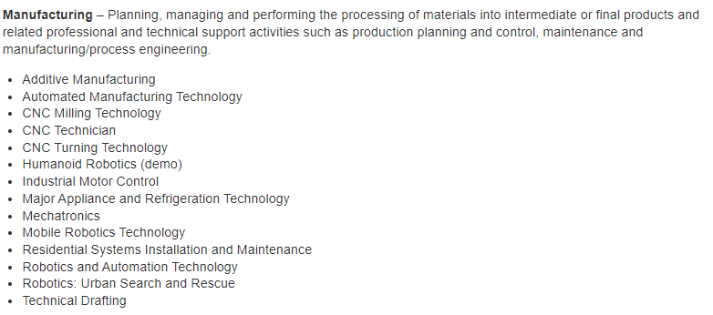
Competitions
127 Nationally recognized competitions
16 Career Clusters
Each Career Cluster has multiple competitions

Slide 40
Contests in Curriculum Example
Contests Supported by an IT class that are incorporated into the class curriculum
Occupational
Technical
Leadership
Career Pathways Showcase
Computer Maintenance
Extemporaneous Speaking
Related Technical Math
Community Service
Cybersecurity
Job Interview
T-Shirt Design
Customer Service
Information Technology Services
Job Skills Demo A
Other
Occupational Health and Safety
Internet of Things Smart Home Install
Pin Design
CareerSafe Video
Telecommunications Cabling
Prepared Speech
National Pin & T-Shirt Design
Quiz Bowl
Sate Pin & T-Shirt Design
* No Student has competed but is supported

Slide 41
Integrating Curriculum
Skills Competition as Assessments:
Framework Standards for Industry are built into the Technical Standards
Grade sheet \ assessments are already built
Supporting documents \ assessments for modules have been completed
Look at non-course contests
Job Skills Demo A
Job Interview
Audio Video Production
Create a PLC
Expand assessments

Slide 42
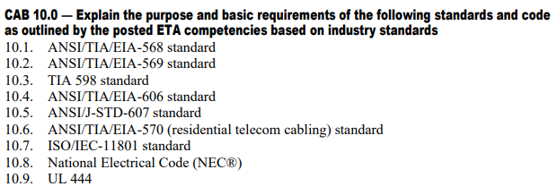
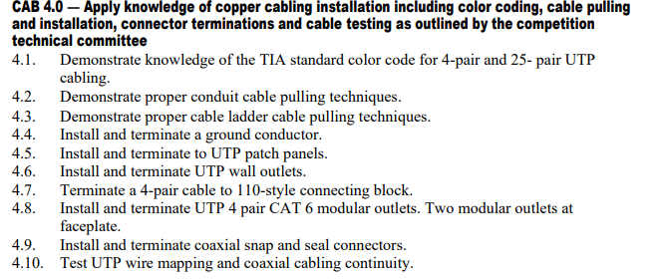
Integrating Curriculum
Add to Program Framework
Formative Assessments
Define hardware labels
Make Jumper Cables
Make Coaxial Cable
Punch down Assessment
Summative Assessments
Install serviceable connections between walls
Room Rewiring Project

Slide 43
Competition Schedule
October
Fall Advisor Meetings
Start of identification of regional contests
Advisors announce interest for regional competitions
Host for regionals identified
Registration must be paid to compete in regionals
Regional competitions held
Must compete in regionals to qualify for State
November
December
January – 1st week of February

Slide 44
Securing Funding and Resources

Slide 45
Securing Funding & Resources
Administrative Funding
Budget Allocation
Professional Development Funds
CTE Grants
External Grants and Scholarships
Non Profits: SkillsUSA National and State, Perkins Grant, Gates Foundation, or local educational foundations
Corporate Grants: corporations that have educational outreach programs
Local Businesses: Sponsorships and Donations
Industry Partners: They may provide financial support, equipment donations, or mentorship opportunities

Slide 46
Securing Funding & Resources
Fundraising Activities
School Based: Organize Events related to your Industry focus
Sales: Make products to sell
Online: Solicit donations online, leverage social media to promote fundraising and share Student success stories
Resource and Donations
Equipment and Supplies: Equipment, tools, and supplies
Professional Services: Guest lectures, workshops, or mentorship

Slide 47
Securing Funding & Resources
Community and Alumni Support
PTA/PTO Grants
Alumni Donations
Alumni Events
Advocacy and promotion
Showcase Success: Present Achievements
Showcase Success: Student Testimonials
Engage Stakeholders
School Board Presentations: Gain their support and potentially secure additional funding
Community Outreach: Social Media, presentations, newsletters, and open houses

Slide 48
Milestones
September
Identify areas of curriculum need
Connect with Regional Coordinator
Identification of contests your class can support
Attend the Fall Advisor Meetings
Recruit SkillsUSA members
Hold a Class\School SkillsUSA Leadership event
Have students identify contests of interest
Advisors announce interest for regional competitions
Host for regionals identified
Contest Preparation for students
Fundraising Activities to offset costs of Regional and State Events
Registration must be paid to compete in regionals
Regional competitions held
Must compete in regionals to qualify for State
October
November
December
January – February

Slide 49
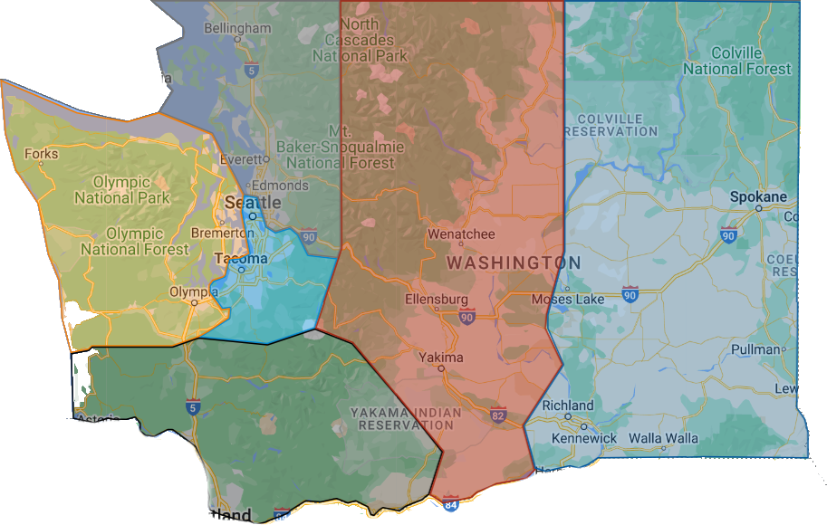
Region Contacts
Link to Regional Map
Southwest
Nathan Younger
Ray Nelson
Olympic
Megan Ritchie
Tyler Renz
Puget Sound South
Gary Milbradt
Adam Scroggins
Central
Lauren Thomas
Todd Smith
Eastern
Jessa Nocis
Terry Yeigh
Brandon McDaniel
Dan Parker
Puget Sound North
Mary Rawlins
Teri Bravomejia
6
4
2
5
3
1
Email: “Region name”@Skillsusawashington.org
e.g. Pugetsoundsouth@skillsusawashington.org

Slide 50
Resources and Contacts
Contacts:
Karmen Warner: director@skillsusawashington.org
Courtney Burger: courtney@skillsusawashington.org
Central Region: Central@skillsusawashington.org
Eastern Region: Eastern@skillsusawashington.org
Olympic Region: Olympic@skillsusawashington.org
Southwest Region: Southwest@skillsusawashington.org
PS North Region: Pugetsoundnorth@skillsusawashington.org
PS South Region: Pugetsoundsouth@skillsusawashington.org
Nationals Customer Care: customercare@skillsusa.org
Documents:
Resources: https://skillsusawashington.org/resources/advisors/
12 Steps to Start the Year
Breaking down the Framework
2024-25 Program of Work
Membership Kit
Brand Portal
Membership Enrollment
Mailing List:
Sign up now
Social Media:
Social Media Links: https://linktr.ee/skillsusawashington
Instagram: skillsusawa
Linkedin: https://www.linkedin.com/company/skillsusa-washington/
Facebook: https://www.facebook.com/skillsusawa/
Scholarships:
https://skillsusawashington.org/resources/students/

Slide 51
What Questions do you have?

Slide 52
Closing
Don’t Reinvent the wheel
Understand this shouldn’t be more work, rather a redirection of what you are already doing only with resources
Identify what you are already doing well and label it SkillsUSA
Start small with focus: Identify one or two pieces of curriculum to increase effectiveness of your program
Utilize contests as assessments in your classroom
Identify what contests you are willing\able to support
Empower students to explore SkillsUSA
Identify students who have an interest in leadership and competition
Build your core\legacy students (returning next year)
Volunteer to judge contests
Utilize your Regional Coordinator and State Office
Empower your Advisory Committees to take part in SkillsUSA activities and provide resources

Slide 53
Thank You
Join the Mailing List
Thank you for all you do for your students

