Slide 2
SkillsUSA Washington
October Training Series
Preparing for Regional Championships
October 8th, 2024 - Virtual

Slide 3
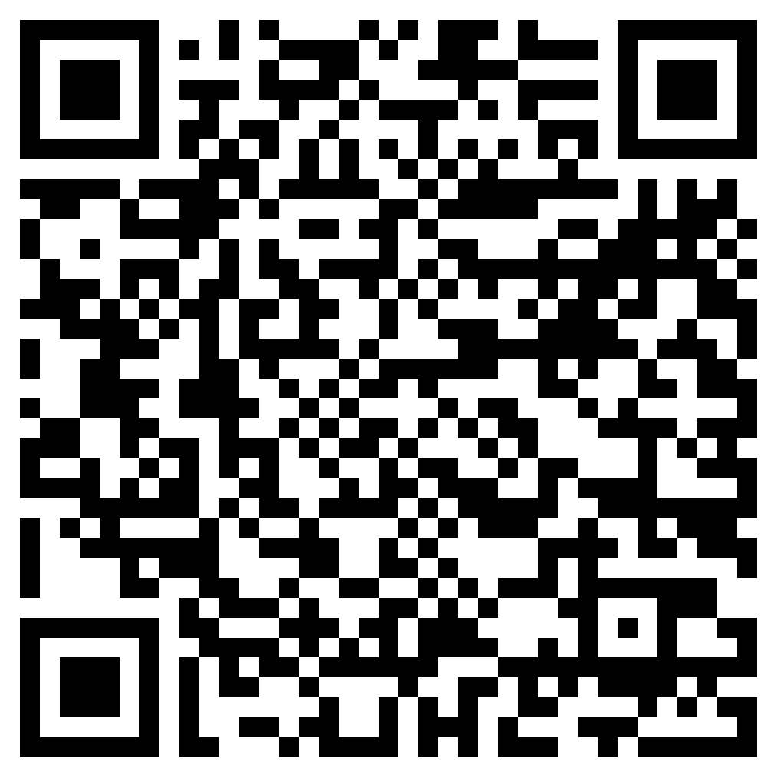
How to Stay in the know
Join the Mailing List
Click to join

Slide 4
Contact Information
Karmen Warner | State Director
SkillsUSA Roll: Oversight of all State Operations and Communication with Nationals
Email: director@skillsusawashington.org
Adam Scroggins | Board Chair, Certified Trainer
Instructor: Pierce County Skills Center
Teaches: ITS & Cyber Security
Email: pugetsoundsouth@skillsusawashington.org
Courtney Burger | Associate Director
SkillsUSA Roll: Advisor and Student support
Email: courtney@skillsusawashington.org

Slide 5
Steps to Host a Contest
What to Think About
State Mindset
Projects
Resources
Standards
New
Existing
Facilities
Dress Code
Region History
Judges
Communication
Materials

Slide 6
Workshop Expectations

Slide 7
State Divisions
SkillsUSA Washington is divided into three Divisions
Middle School
High School
Post Secondary
Technical College
State College
University

Slide 8
Competitions
Local Competition
Required for larger competitions
Determines who you send to Regionals
As many as a student can handle
Must qualify at regional to get an invitation to state
Can compete in a combination of 3 contests. (only one technical)
1st place gets invited to Nationals
May only compete in one competition
Regional Competition
State Competition
National Competition

Slide 9
Washington State Mindset
All Contests should match the “National Tech Standards”
Local, Regional, State and National contests should be scaffold ensuring each level of competition covers more content than the previous.
The National Competition is up to 8 hours long and should test all knowledge learned in the standards.
The State Competition is up to 6 hours and should test up to 75% of the standards
Regional Competitions up to 4 hours and should test a majority of the standards as allowed by the host resources
Local competition is done in class or after school and is limited to the chapter and the local host resources

Slide 10
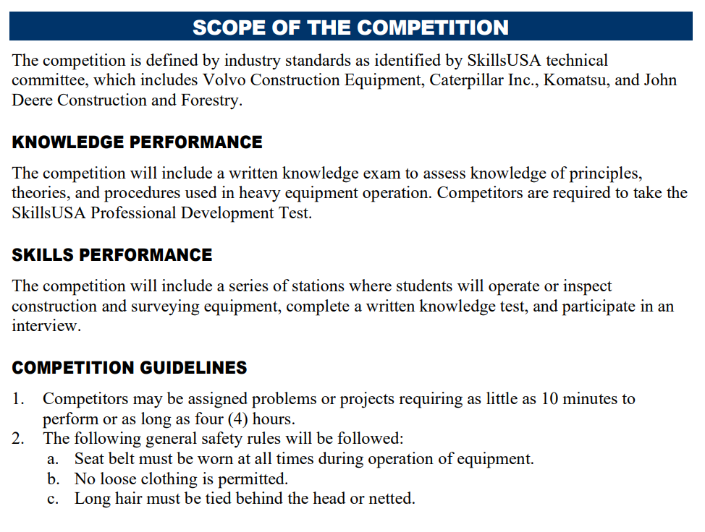
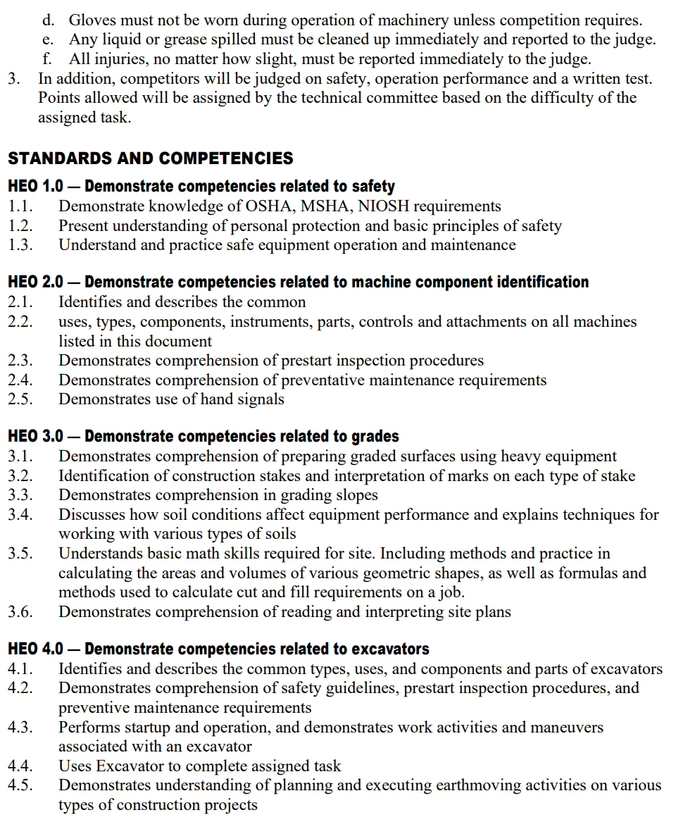
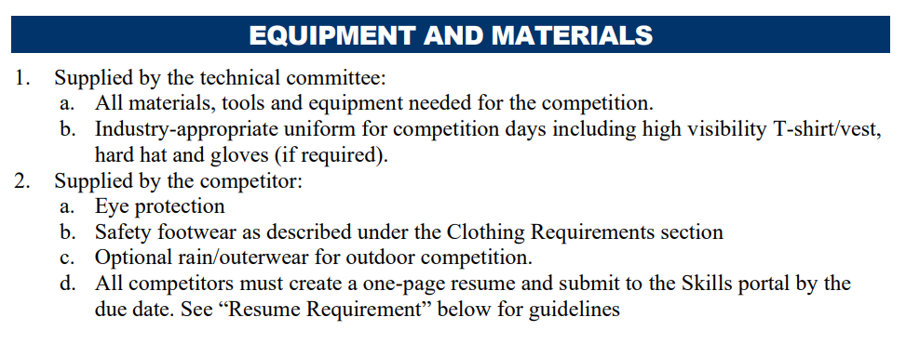
Tech Standards – What’s Included
CLOTHING REQUIREMENT
ELIGIBILITY
EQUIPMENT AND MATERIALS
Supplied by host
Supplied by contestant
SCOPE OF THE CONTEST
Knowledge Performance
Skill Performance
Contest Guidelines
Standards and Competencies

Slide 11
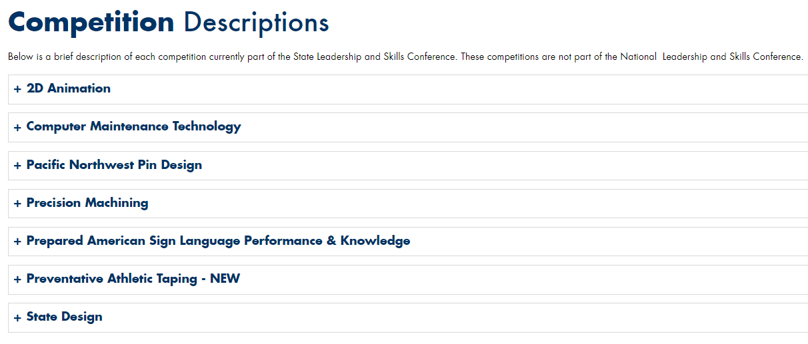
Tech Standards – State Only
https://skillsusawashington.org/competitions/state-only/

Slide 12
Accessing Resources
https://Skillsusawashington.org

Slide 13
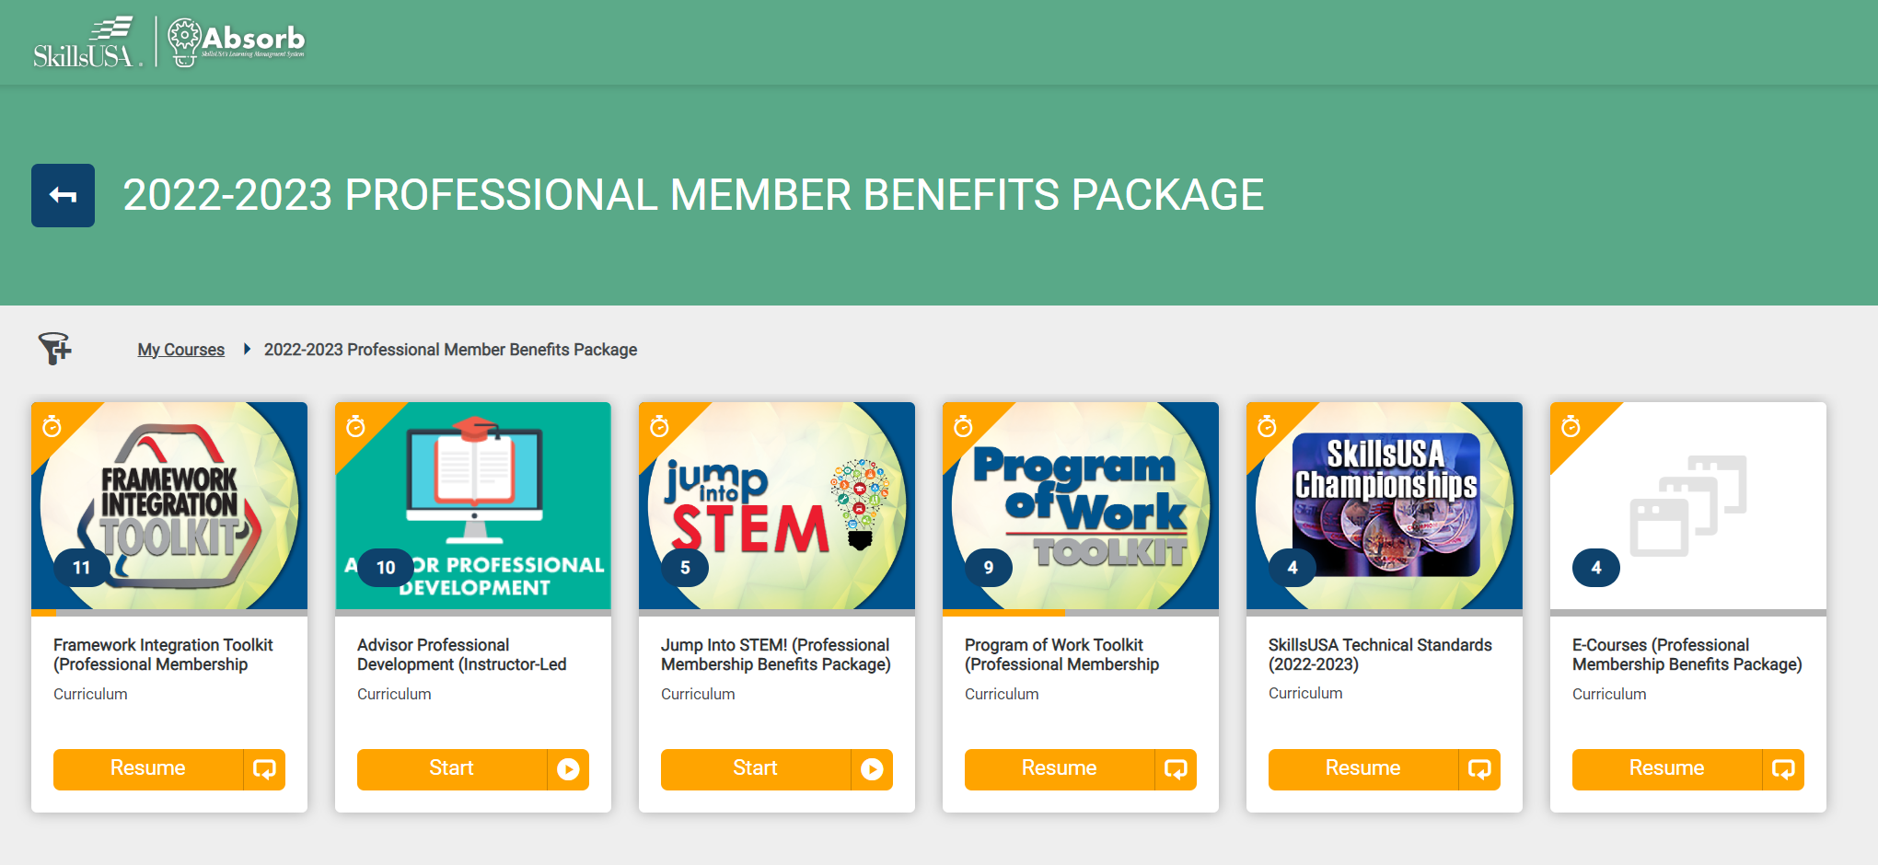
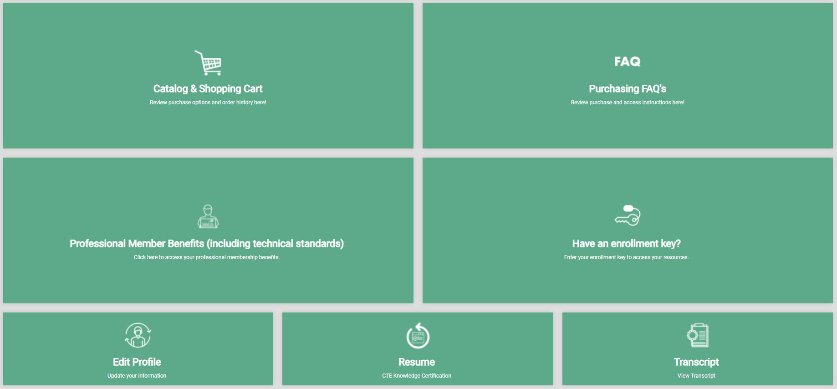
SkillsUSA Absorb
https://mycareeressentials.org/

Slide 14
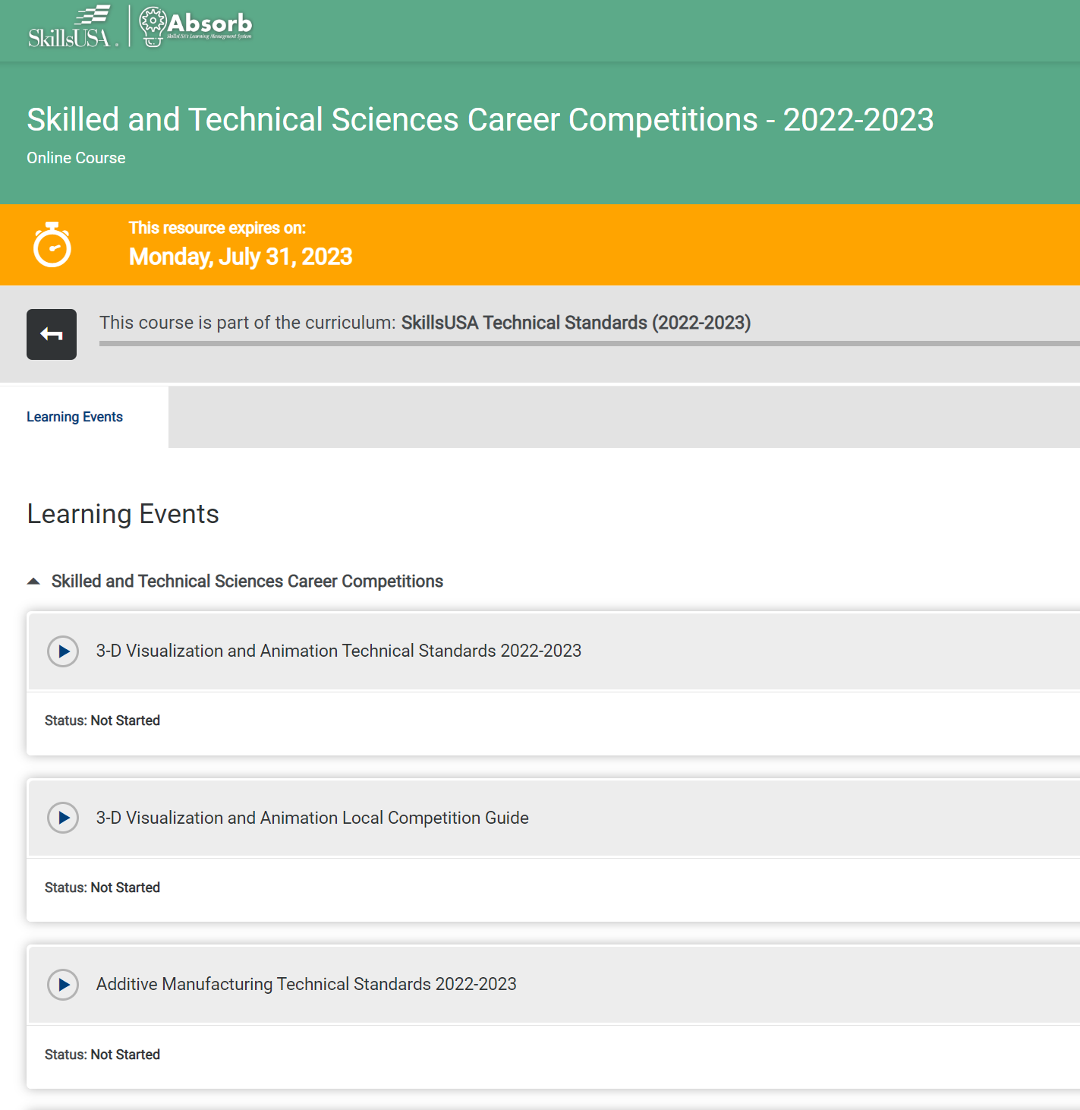
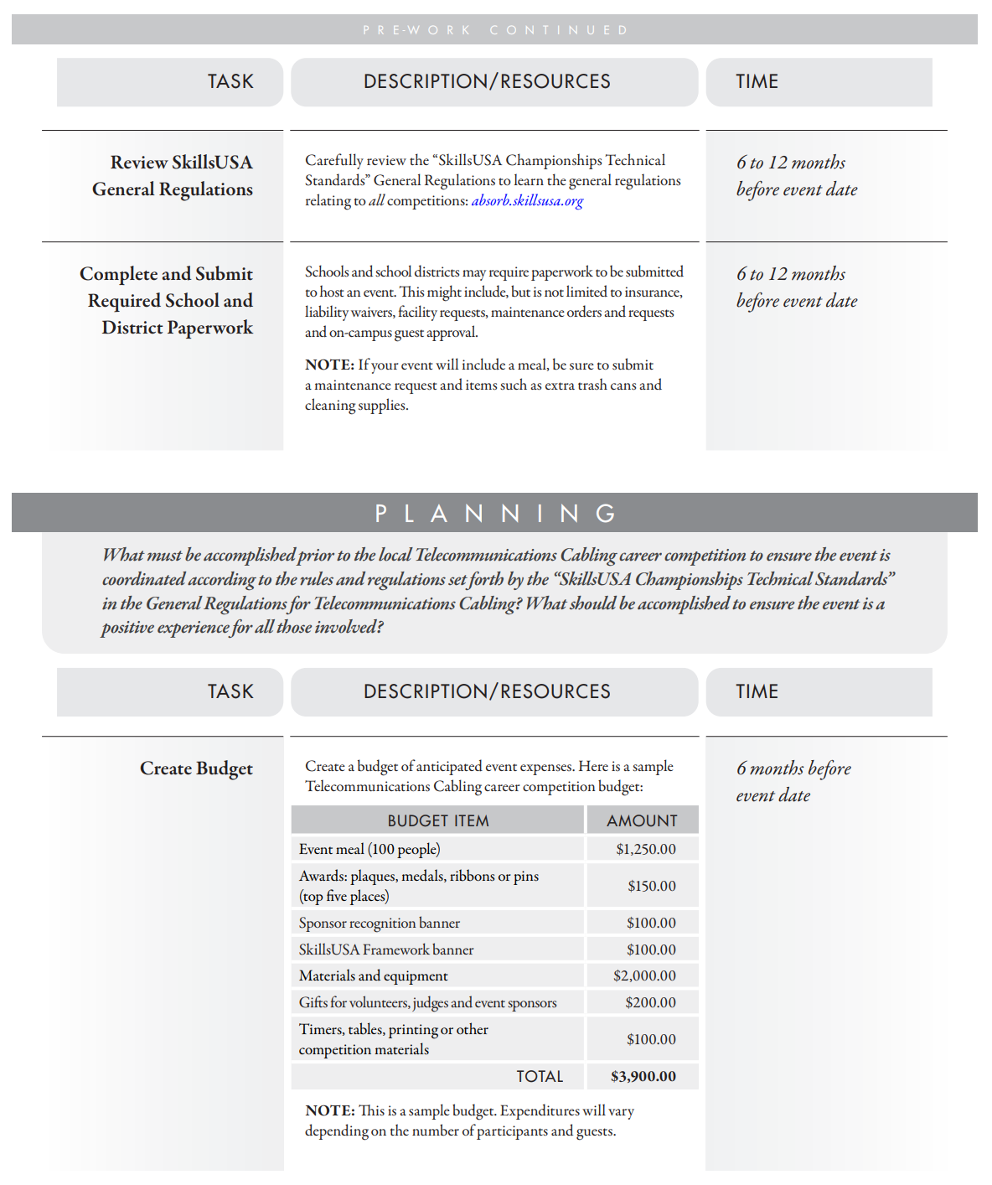
SkillsUSA Absorb
https://mycareeressentials.org/

Slide 15
Deciding if you want to host
https://skillsusawashington.org/resources/
Prior to committing to host read and understand the following:
Competition Operating Policies
Grievance Policy for contests
Technical Standards for the competition

Slide 16
Dress Code
For a Regional level Washington state believes in not setting barriers for students
Students should be dressed for an interview or in Industry appropriate clothing
For National competitions students must follow the dress code stated in the Technical Standards for the competition they are competing in
New or growing chapters contact Karmen or Adam for information on how to access grants to purchase SkillsUSA materials
View Clothing Regulations

Slide 17
Communication
October and November
Identify where you can host the competition
Notify the Region Representative of your interest to host
Notify the Region Representative of your interest in students competing
If no one from the region expresses interest before the November cutoff, the contest will not be run that year.
November
Solicit advice\support from other region advisers
Gain tentative commitment from judges\host sites for contest
Fill out the Contest Announcement template and provide it to the Region Representative
November 22nd – Regional Contest Host Commitment Deadline

Slide 18
Communication
November through Contests date
By January 1st a pre populated ContestScoreCard.xls will be sent to each contest host
Hosts should communicate with all advisors sending students regarding any specifics of the competition
One Week out
Send last minute announcements to attending competitors
Review the contest prompt, technical standards for items covered in the contest prompt with the judges
Review clothing requirements for the contest
Review resume and written test requirements for the contest

Slide 19
Communication
Day of
Host contest and hold an award ceremony.
Certificate Template is located in the google drive
By February 3rd 2025
Email Region Representative the filled out ContestScoreCard.xls
Email any receipts for reimbursement to the Region Representative

Slide 20
General Rules
For a individual contest, all students must compete in the same environment
Location, Date & Equipment supplied by host
If regions host multiple contests at the same location on the same day (e.g. leadership)
Regions will determine how many competitions a student can compete in based on available space and judges

Slide 21
Contest Score Card

Slide 22
Important Dates
https://skillsusawashington.org/
November 22nd – Host Commitment for Regional Competition Deadline
December 1st – Registration opens for Regional Competitions (must be paid members to compete)
December 20th – Deadline closes for Regional Competitions (Must be a paid member)
January 31st – Last day for Regional “Technical Competitions”
February 1st – Last day for Regional “Leadership Competitions”

Slide 23
SO YOU WANT TO HOST A CONTEST

Slide 24
Projects \ Competitions

Slide 25
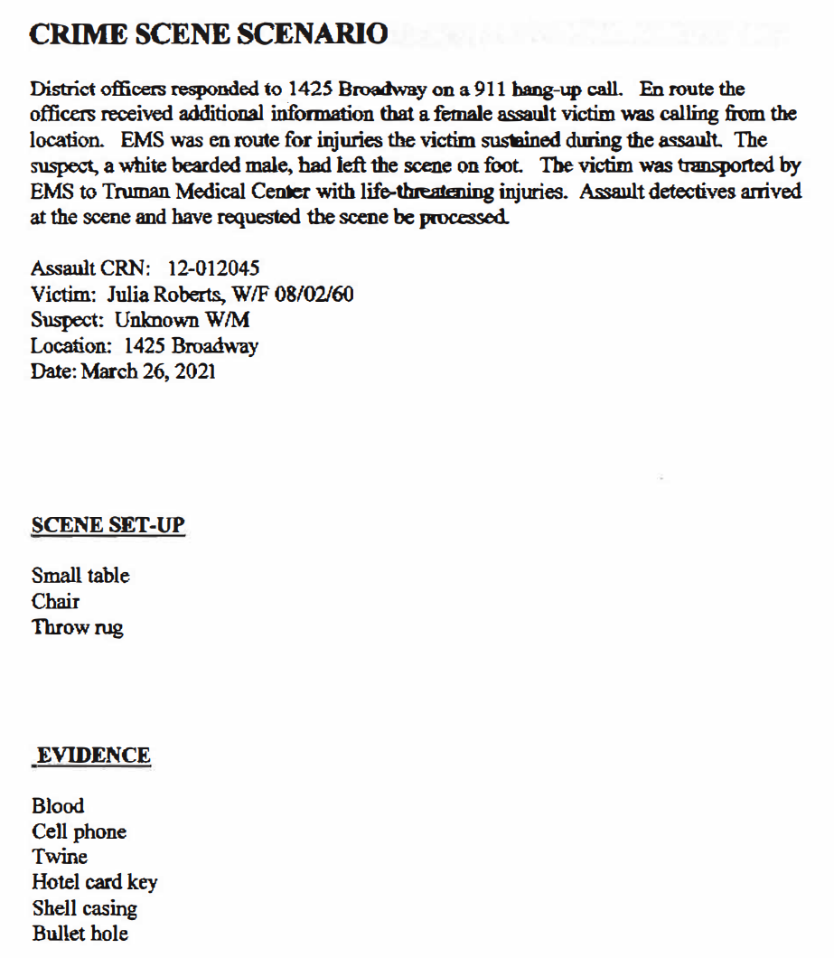
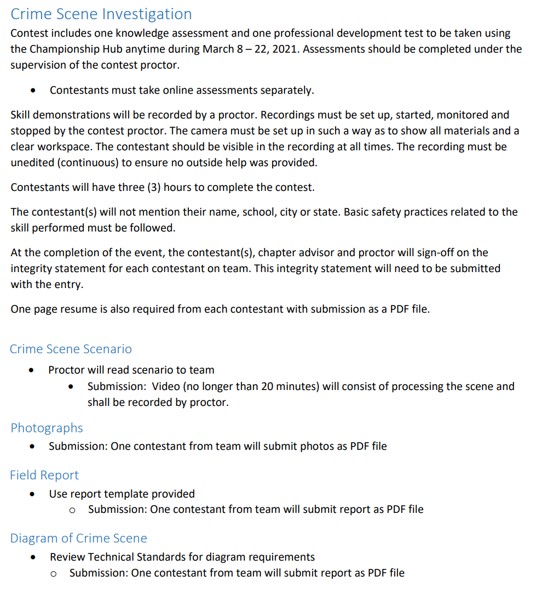
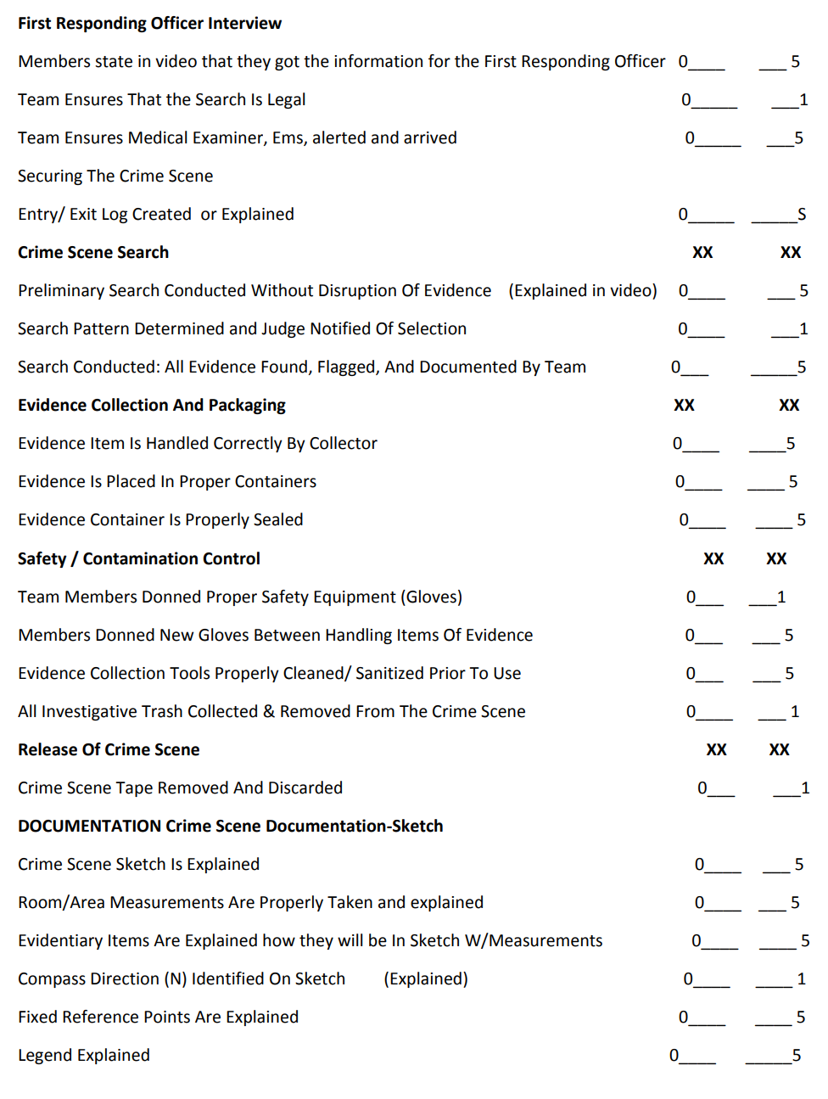
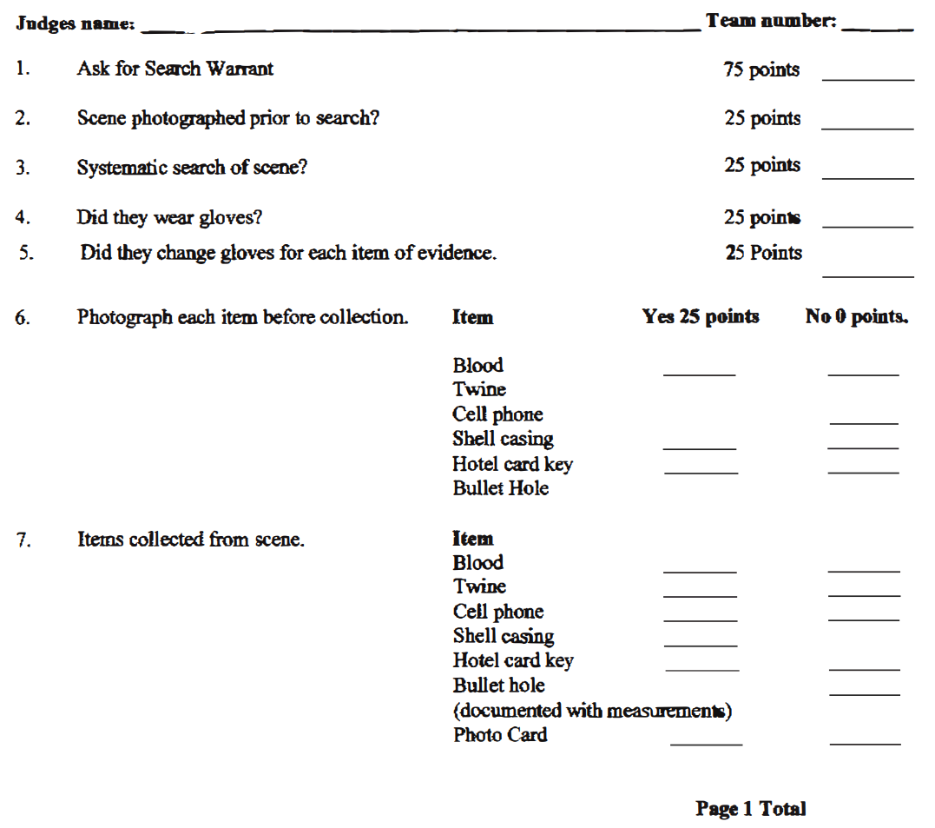
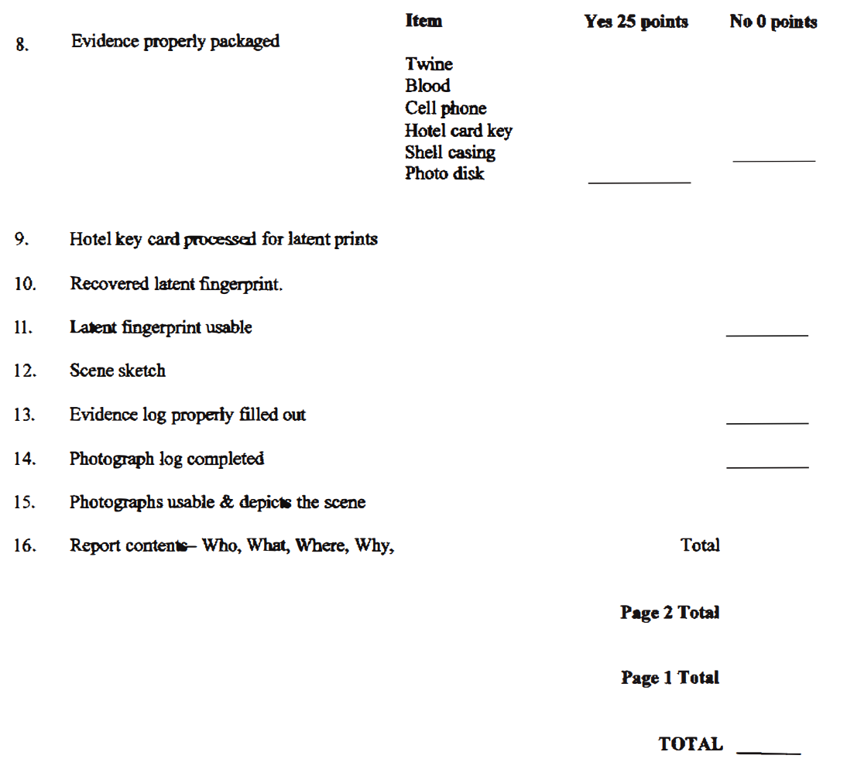
Existing Projects
Don’t reinvent the wheel
Contact your regional coordinator for example projects
Utilize National Rubric\scoresheets

Slide 26
Region History
Don’t reinvent the wheel
Identify who has run the competition in the past and ask for advice
Contact neighboring regions
Ask how they are going to run the competition
Ask to attend\participate
Ask to observe

Slide 27
Use SkillsUSA Partners (600+)
https://www.skillsusa.org/
Diamond Level
Platinum Level
Gold Level
Silver Level
Bronze Level

Slide 28
Get Local
https://www.centralwelding.com/

Slide 29
Use Materials Provided
Take inventory:
What facilities will you use
Your Class\School
Industry host location
Equipment that you\host have
Materials that will be used
What expendables will be used
Will it be donate or purchased
What Judges can you secure
What are other Advisers brining to the table

Slide 30
Facilities
Review the Tech Standards
Does the facility allow:
Proper assessment
Number of contestants
Does the equipment:
Meet Industry Standard
Allow for all competitors to be on even playing field
Document what equipment will be provided and what the contestant needs to bring

Slide 31
Judges
Solicit Judge
Utilize your Advisory members
Reach out to local industry
Use the competition to introduce your program to community
Have students talk to local industry (community outreach and extended learning)
Utilize Advisers who will attend
Ask friends and family

Slide 32
Materials
Secure consumables
Utilize your Advisory members
Reach out to local industry
Have students talk to local industry (community outreach and extended learning)
Purchase consumables
DO NOT DO THIS WITHOUT REGION APPROVAL
You will not be reimbursed without prior approval
Region rep will tell you how you can be reimbursed

Slide 33
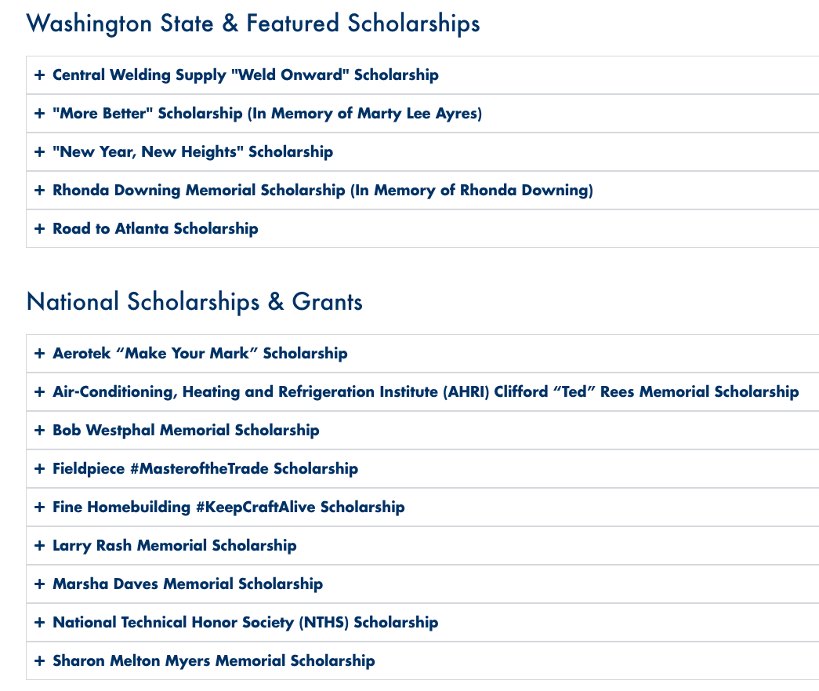
Scholarships
https://skillsusawashington.org/resources
After you have awarded 1st – 3rd place notify Advisors and competitors to check the SkillsUSA Washington website for Scholarship opportunities

Slide 34
What Questions do you have?

Slide 35
Technical Standards
https://mycareeressentials.org/
https://www.skillsusa.org/competitions/skillsusa-championships/categories-and-descriptions/
Over 100 Technical, Leadership and Occupational contests
Comprehensive guidelines and criteria for competitions
Detailed descriptions of the competencies and skills required for each competition area
Ensure that students understand both the challenges of the competitions and the demands of their future careers
Aligned to Industry Certifications and Standards
Can be used to align to your course framework
Contest Descriptions can be found here (Link)

Slide 36
Tech Standards – What’s Included
CLOTHING REQUIREMENT
ELIGIBILITY
EQUIPMENT AND MATERIALS
Supplied by host
Supplied by contestant
SCOPE OF THE CONTEST
Knowledge Performance
Skill Performance
Contest Guidelines
Standards and Competencies

Slide 37
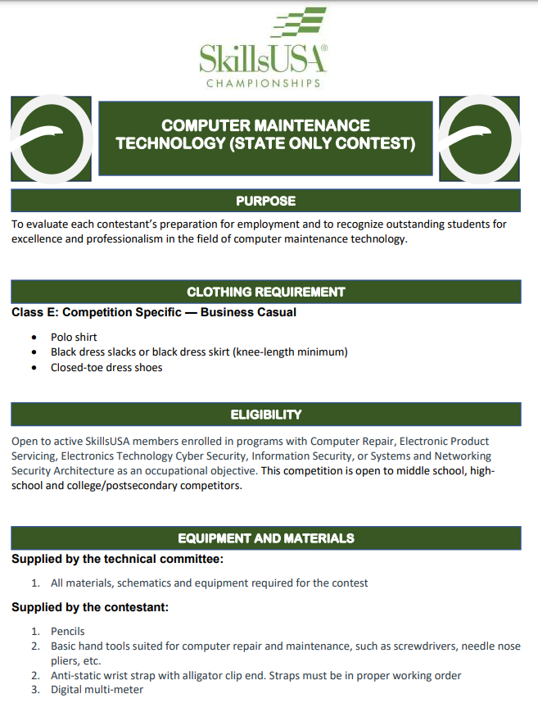
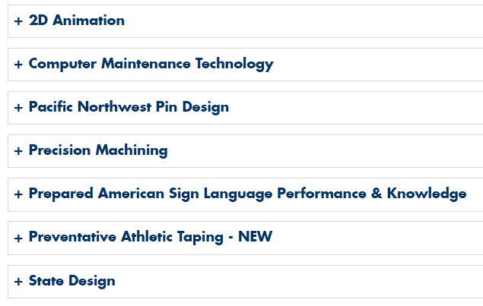
State Only Tech Standards
https://skillsusawashington.org/competitions/state-only/
Contests that are only offered in Washington State
There is no opportunity to compete at a National Level
Designed with the help of local industry and advisory
Can only be found on the SkillsUSA Washington website
https://skillsusawashington.org/competitions/state-only/

Slide 38
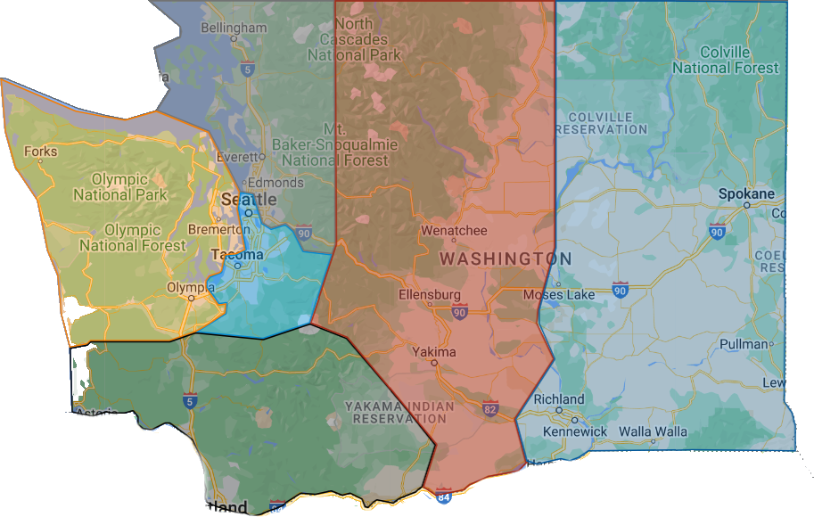
Region Contacts
Link to Regional Map
Southwest
Nathan Younger
Ray Nelson
Olympic
Megan Ritchie
Tyler Renz
Puget Sound South
Gary Milbradt
Adam Scroggins
Central
Lauren Thomas
Todd Smith
Eastern
Dan Parker
Jessa Nocis
Terry Yeigh
Brandon McDaniel
Puget Sound North
Mary Rawlins
Teri Bravomejia
6
4
2
5
3
1
Email: “Region name”@Skillsusawashington.org
e.g. Pugetsoundsouth@skillsusawashington.org

Slide 39
Resources and Contacts
Contacts:
Karmen Warner: director@skillsusawashington.org
Courtney Burger: courtney@skillsusawashington.org
Central Region: Central@skillsusawashington.org
Eastern Region: Eastern@skillsusawashington.org
Olympic Region: Olympic@skillsusawashington.org
Southwest Region: Southwest@skillsusawashington.org
PS North Region: Pugetsoundnorth@skillsusawashington.org
PS South Region: Pugetsoundsouth@skillsusawashington.org
Nationals Customer Care: customercare@skillsusa.org
Documents:
Resources: https://skillsusawashington.org/resources/advisors/
12 Steps to Start the Year
Breaking down the Framework
2024-25 Program of Work
Membership Kit
Brand Portal
Membership Enrollment
Mailing List:
Sign up now
Social Media:
Social Media Links: https://linktr.ee/skillsusawashington
Instagram: skillsusawa
Linkedin: https://www.linkedin.com/company/skillsusa-washington/
Facebook: https://www.facebook.com/skillsusawa/
Scholarships:
https://skillsusawashington.org/resources/students/

Slide 40
What Questions do you have?

Slide 41
Thank You
Join the Mailing List
Thank you for all you do for your students

