Slide 2
SkillsUSA SkillsUSA
Advanced Teaching Tools:
October 10th, 2024 – Virtual

Slide 3
Contact Information
Karmen Warner | State Director
SkillsUSA Roll: Oversight of all State Operations and Communication with Nationals
Email: director@skillsusawashington.org
Adam Scroggins | Board Chair, Certified Trainer
Instructor: Pierce County Skills Center
Teaches: ITS & Cyber Security
Email: pugetsoundsouth@skillsusawashington.org
Courtney Burger | Associate Director
SkillsUSA Roll: Advisor and Student support
Email: courtney@skillsusawashington.org

Slide 4
Agenda
Mapping Your Year
Integrating Curriculum
Competition Preparation
Collaboration Strategies
SkillsUSA Framework Mastery
Q&A and Discussion

Slide 5
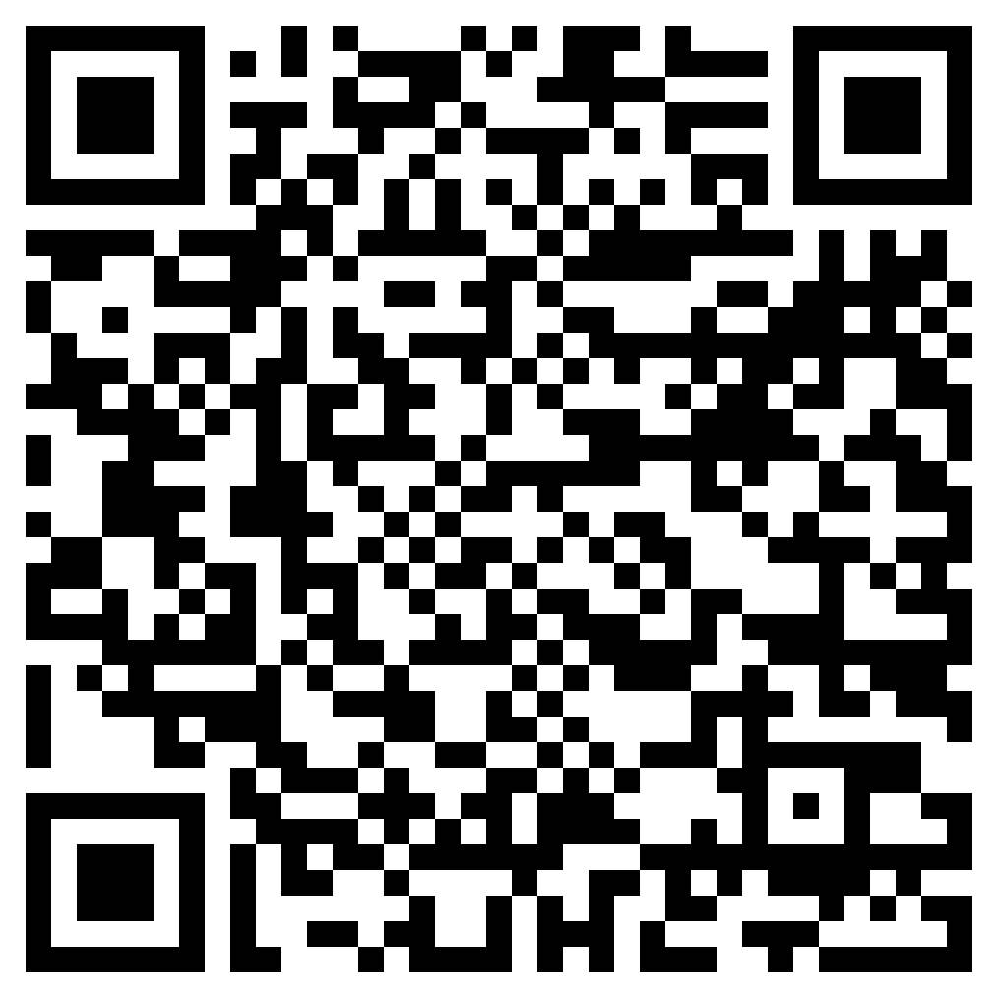
How to Stay in the know
Join the Mailing List
Click to join

Slide 6
Workshop Expectations

Slide 7
About SkillsUSA
https://www.skillsusa.org/
https://Skillsusawashington.org
Founded 1965, as Vocational Industrial Clubs of America (VICA)
VICA changed its name to SkillsUSA in 2004
SkillsUSA has expanded to include more than 130 different technical, occupational, and leadership competitions.
Partnership of businesses, industry, and educational
Provides scholarships, job opportunities, and advanced training
Over 400,000 members - Middle schools, High schools, and Postsecondary

Slide 8
SkillsUSA Mission Statement

Slide 9
National Partners (600+)
https://www.skillsusa.org/who-we-are/leaders-and-partners/official-partners/
Diamond Level
Platinum Level
Gold Level
Silver Level
Bronze Level

Slide 10
Local Partners
https://skillsusawashington.org/who-we-are/partners/

Slide 11
SkillsUSA Structure in Washington State
Board of Directors
SkillsUSA Washington Apprenticeship Council
Central Region
Eastern Region
Olympic Region
Puget Sound North Region
Puget Sound South Region
South West Region
State Director
Karmen Warner
Chapters
Schools
Classes
Chapters
Schools
Classes
Chapters
Schools
Classes
Chapters
Schools
Classes
Chapters
Schools
Classes
Chapters
Schools
Classes
Associate Director
Courtney Burger
Officer Trainer
David Barragan
Accounts Payable
Kara Krebs
Communications
Veronika Zwicke
State Officers

Slide 12
Career Clusters
https://www.skillsusa.org/Career Clusters..
Agriculture, Food & Natural Resources
Architecture & Construction
Arts, A/V Technology & Communications
Business Management & Administration
Education & Training
Finance
Government & Public Administration
Health Science
Hospitality & Tourism
Human Services
Information Technology
Law, Public Safety, Corrections & Security
Manufacturing
Marketing
Science, Technology, Engineering & Mathematics
Transportation, Distribution & Logistics

Slide 13
CTSO Responsibility
CTSOs work as an integral component of the classroom
Building upon employability and career skills
Hands-on demonstrations and real life and/or work experiences
CTSO’s help guide students in developing a career path
Gaining skills and abilities needed to be successful in careers
Extended learning activities, programs and competitive events
Students hold leadership positions at all levels
Attend leadership development conferences
Network with other students, business & industry partners
You must demonstrate that they have met these criteria
Attendance and participation at CTSO meetings and activities
Maintain membership with the CTSO

Slide 14
Resources
https://skillsusawashington.org/resources/advisors/
Advisor Resources located at https://skillsusawashington.org/resources/advisors/
Familiarize yourself with SkillsUSA’s
Secure Support from Administration and other Advisors
Register: Contact the State office to file Chapter Paperwork
Build Leadership Team
Elect Chapter Officers
Advisor Training – State and National Option
Create a Program of Work
Promote and Recruit
Hold Chapter Meetings
Engage in Activities
Competitions and Events
Extended Learning Activities

Slide 15
Map out Your Year

Slide 16
Steps to Integrate
No Matter the size of your school, the process is the same
Join the Mailer to get critical updates
Contact your Regional Coordinators
Identify areas of your class you want to improve (Regardless of CTSO)
Identify Contests you can support
Identify Curriculum you may want to utilize
Modify your classroom frameworks with
Technical Standards
OSPI Leadership Standards
Create your Program of Work
Attend the fall Advisors meeting
Stay in communication with your regional coordination team

Slide 17
Setting Goals and Objectives
https://skillsusawashington.org/events/month/
Student Engagement
Recruiting Events
Monthly meetings
Student ownership
Extended Learning
Curriculum
New Piece to use
Embed for all students
Incorporate into class framework
Goals
&
Objectives
Competitions
New Standards
New Contests
Incorporate into class
Leadership Development
Conferences
Workshops
Flip the classroom

Slide 18
SkillsUSA Framework Integration Program of Work

Slide 19
Integrating SkillsUSA Curriculum
What am I already doing
Can I identify the activity as SkillsUSA
Is what I am doing better than SkillsUSA
Is what I am doing aligned to local industry
Am I already providing SkillsUSA without knowing it
Should I re-invent the wheel

Slide 20
SkillsUSA Framework
https://www.skillsusa.org/about/skillsusa-framework/
Integrity
Work Ethic
Professionalism
Responsibility
Adaptability /Flexibility
Self-Motivation
Computer and Technology Literacy
Job-Specific Skills
Safety and Health
Service Orientation
Professional Development
Communication
Decision Making
Teamwork
Multicultural Sensitivity and Awareness
Planning, Organizing and Management
Leadership

Slide 21
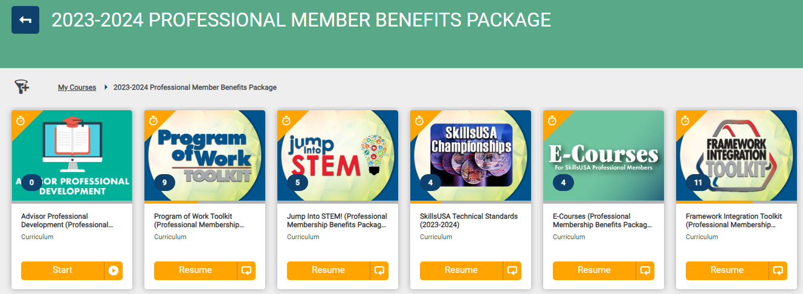
Professional Member Resources
https://mycareeressentials.org/

Slide 22
Creating a Yearly Timeline
https://skillsusawashington.org/wp-content/uploads/2024/05/leadership-ctso-pow-template_skillsusa_required-rev-52024.docx
Backwards Planning
Program of Work Toolkit:
Planning Guides:
Templates and Forms with lesson plans:
Chapter Budget
Program of Work Planner
Chapter Calendar
Leadership Development Planner
Communication Development Activities
Activity Ideas with lesson plans:
Assessment Tools:
Recognition Programs:
Utilize the tools to populate your OSPI Program of Work.
Pre-populated with state wide SkillsUSA events/workshops/conferences
https://skillsusawashington.org/wp-content/uploads/2024/05/leadership-ctso-pow-template_skillsusa_required-rev-52024.docx
Notes:
Framework Integration: SkillsUSA has a Framework that focuses on three key areas: Personal Skills, Workplace Skills, and Technical Skills grounded in academics.
The Program of Work Toolkit helps chapters integrate these areas into their activities.
Planning Guides: The toolkit provides detailed guides for planning activities in various categories, such as leadership, professional development, community service, and more. These guides offer step-by-step instructions, timelines, and resources needed to execute successful events.
Templates and Forms: To make planning easier, the toolkit includes templates for meeting agendas, project planning sheets, budget forms, and other organizational documents.
Activity Ideas: It offers a wide range of activity ideas that align with the SkillsUSA Framework, helping chapters to design programs that are both educational and engaging.
Assessment Tools: There are tools to help chapters assess the effectiveness of their activities and gather feedback from participants. This helps in refining future events and ensuring continuous improvement.
Recognition Programs: The toolkit outlines ways to recognize and reward members for their participation and achievements, which can help boost morale and encourage active involvement.

Slide 23
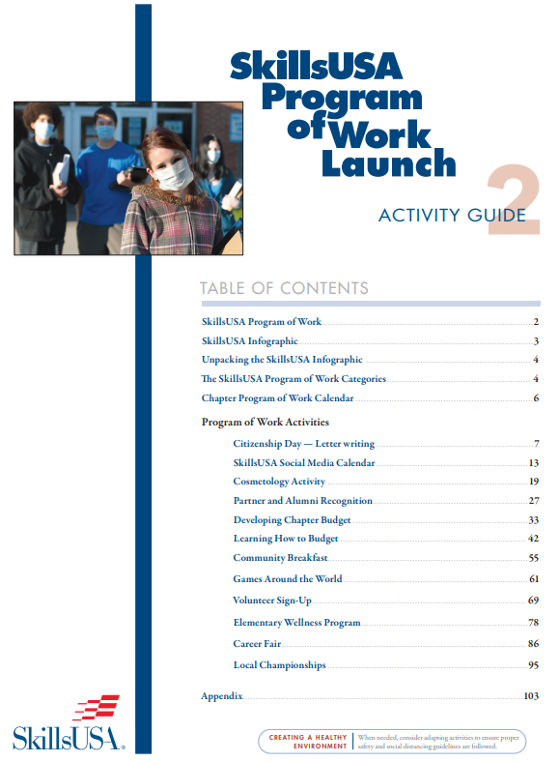
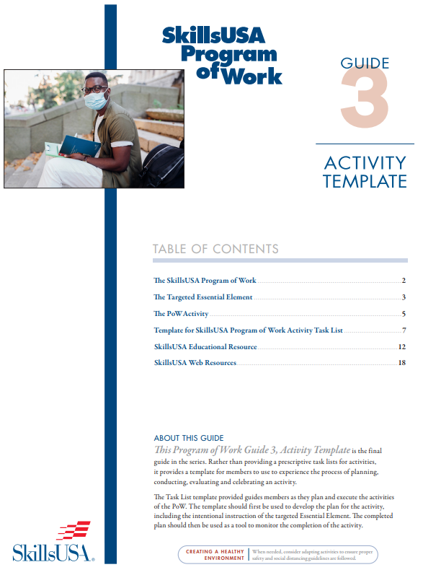
Framework Integration Toolkit
Add screenshot of framework integration toolkit
Templates & Resources
12 Activities
6 Activities

Slide 24
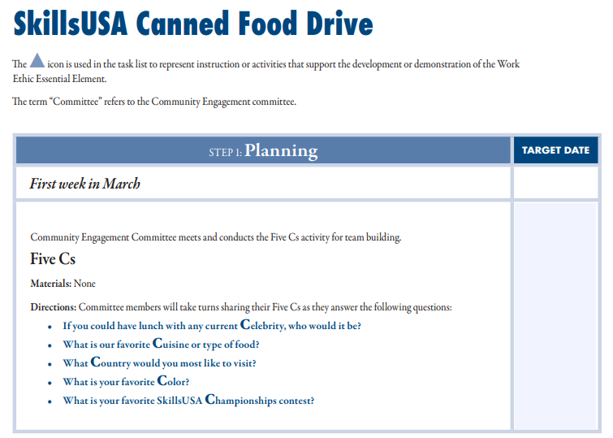
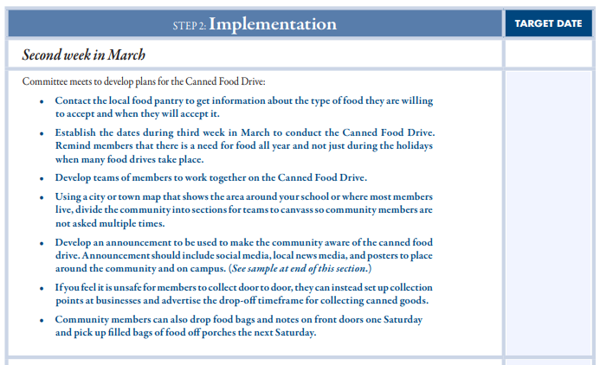
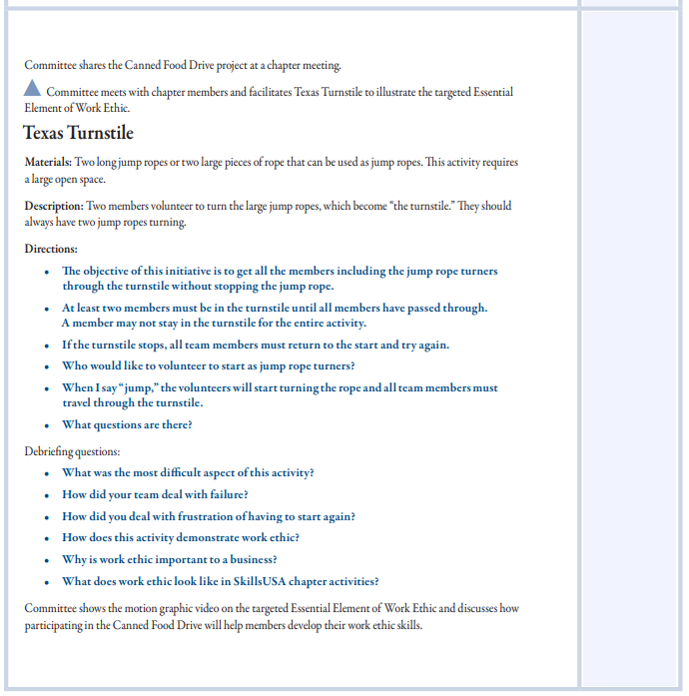
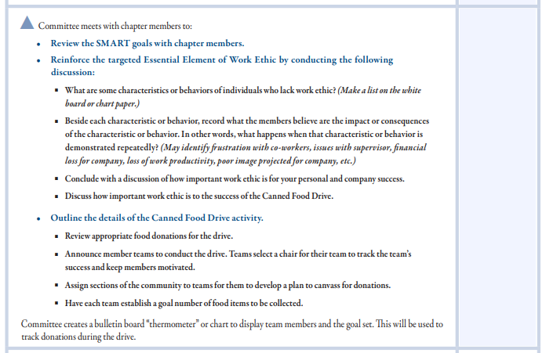
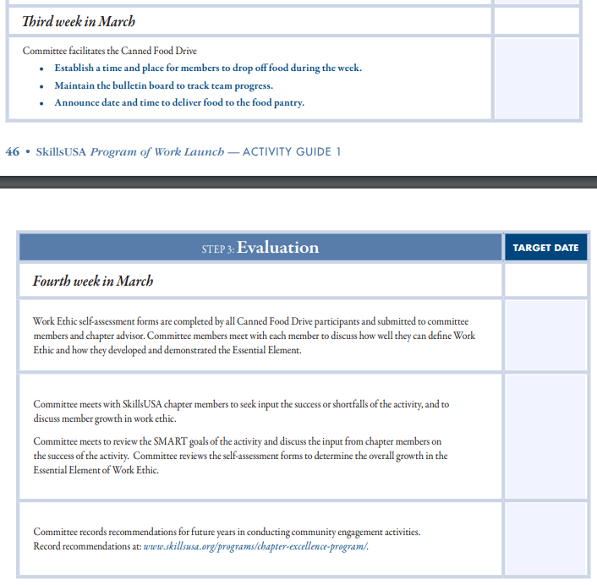
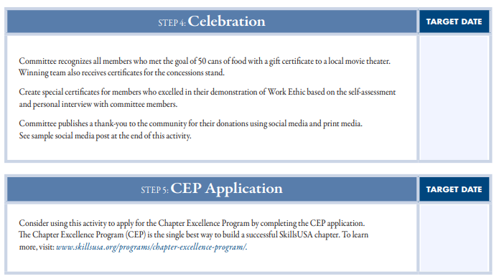
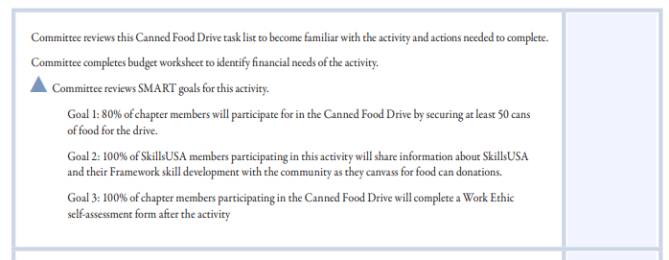
Activity Lesson Plans

Slide 25
Canned Food Drive Materials
Planning Sheets
Smart Goals Sheets
Example Committee Meeting
Budget Planning Sheet
Implementing the Activity Directions
Example Flyer \ Announcement Form
Facilitating the Activity
Activity Evaluation Forms
Self Assessment Sheet

Slide 26
Key Milestones and Deadlines
https://skillsusawashington.org/events/month/
September
October
November
December
Fall Advisors Meeting
Fall Advisor Trainings
Intent to Host Deadline
Regional Registration Deadline
Fall Leadership Camp
Intent to Compete Deadline
January
February
March
April
June
Technical Contests
Leadership Contests
SLSC Registration
SLSC
NLSC
SLSC Invite List

Slide 27
Integrating SkillsUSA Curriculum

Slide 28
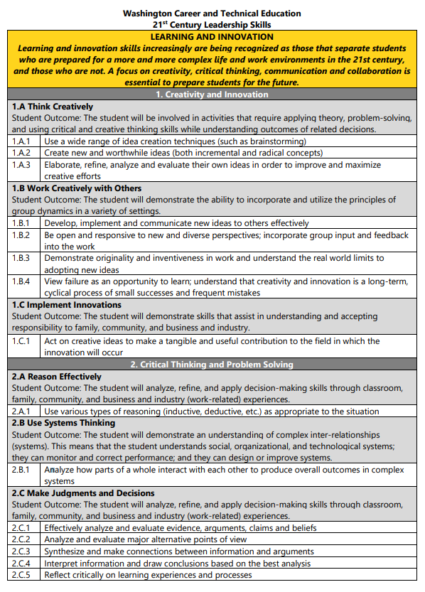
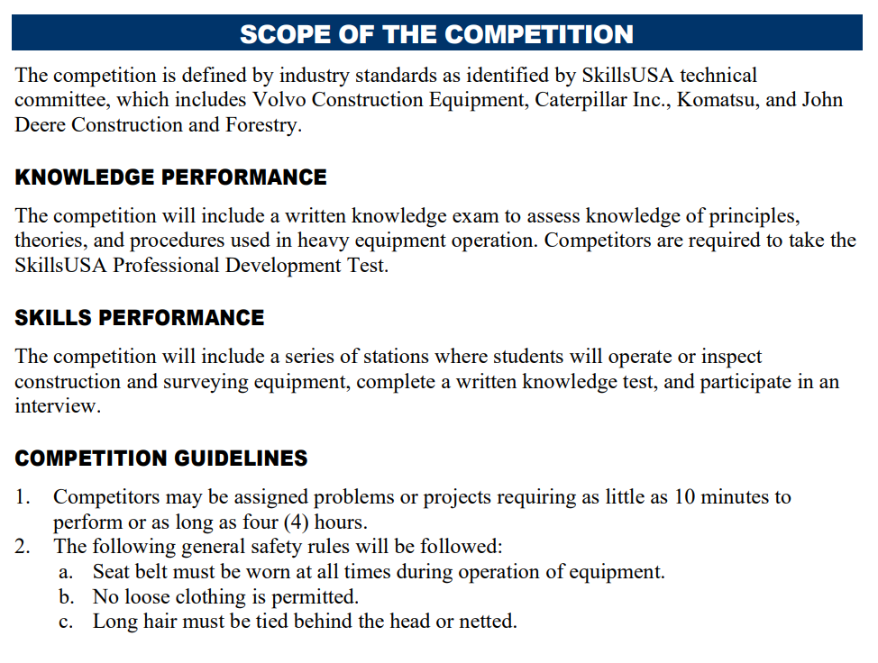
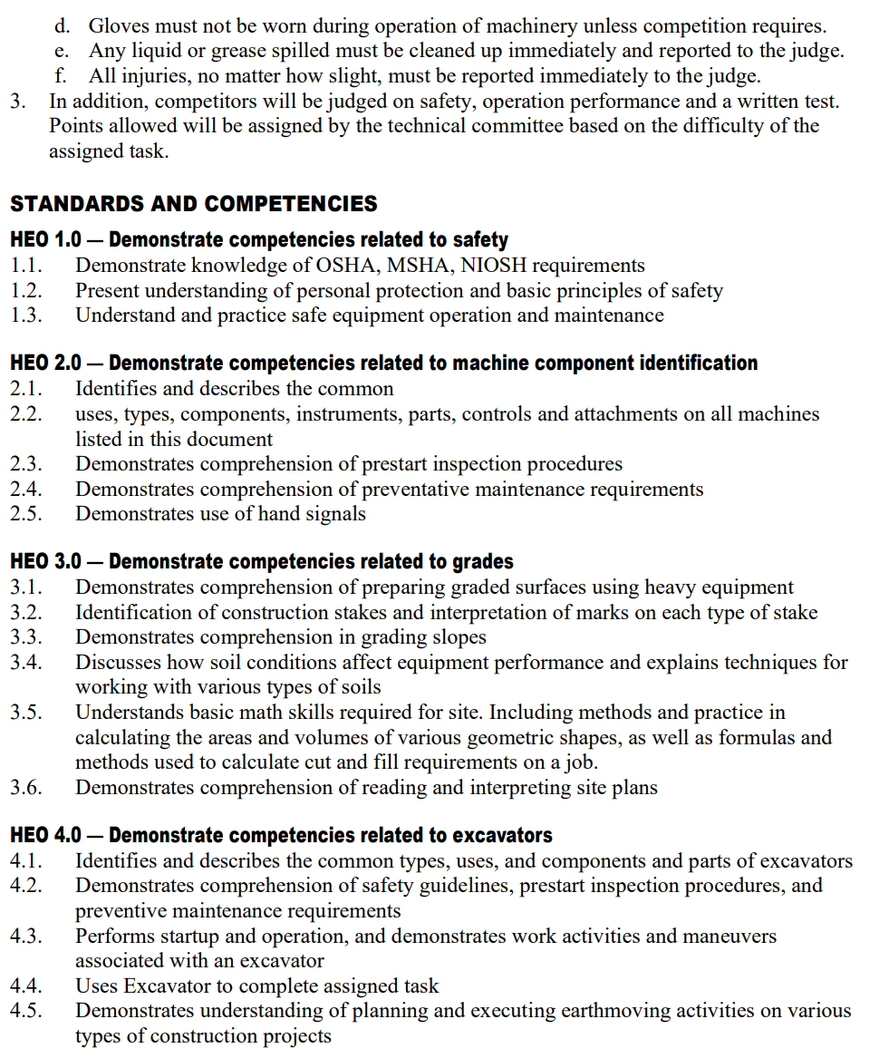
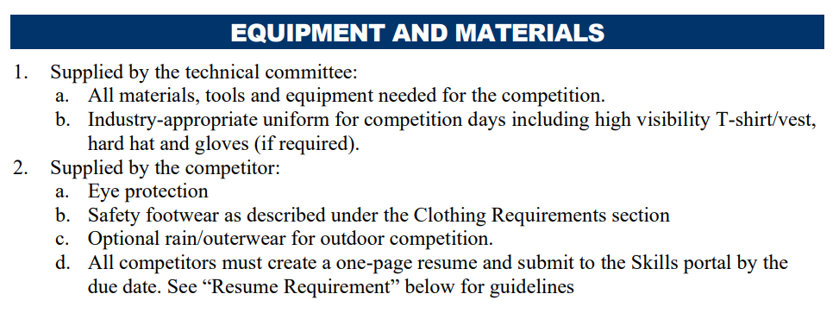
Aligning Curriculum with SkillsUSA Standards
OSPI Leadership Skills
SkillsUSA Framework

Slide 29
Embedding SkillsUSA Activities in Lesson Plans
Competition Embedded in Curriculum
SkillsUSA Curriculum
Extended Learning Activities
Technical Standards
Leadership Standards
Communication & Presentations
Extended Learning
Fundraising & Community Service
Verify against SkillsUSA standards and add to your Framework
Utilize Contests as Assessments
Verify against OSPI Leadership standards and add to your Framework
Utilize Contests as Assessments
Add to your Framework
Utilize SkillsUSA Curriculum (POWERRful) series
Add to your Framework
Add to your OSPI Program of Work
Utilize SkillsUSA Program of Work Toolkit
Add to your Framework
Add to your OSPI Program of Work
Utilize SkillsUSA Program of Work Toolkit
Leadership contests with Communication focus
Extemporaneous Speaking
Prepared Speech
Job Interview
Job Skills Demo A

Slide 30
Additional Curriculum
https://www.skillsusa.org/shop/
Team Building
Bellringers
Ice Breakers
Group Activities
Decision Making
SkillsUSA Framework
Communication
Conflict
Leadership
Critical Thinking
Presentations
Meetings
Parliamentary Procedure

Slide 31
Resource Canvas PCSC SkillsUSA Chapter
PCSC SkillsUSA Canvas Page
SkillsUSA Basics
Kahoots
Program of Work Activity Planner
Framework Integration
Resume Workshops
Job Interview Resources
Peer Interview Day
Employment Portfolio
POWERRful Speeches
Critical Thinking
Conflict Management in the Workplace
Difficult Conversations At Work
Customer Service Scenarios
SkillsUSA Independent Contests
Develop a school wide PLC
Ask for time on Professional Development days to work in your PLCs
As a school we have agreed that every class will do these activities
Different teachers worked together to customize SkillsUSA curriculum to our needs
Placed in Canvas Modules that each teacher can load into Class Canvas Pages

Slide 32
Integrating Curriculum
Identify what you are already doing well and label it SkillsUSA
Identify one or two pieces of curriculum to increase effectiveness of your program
Identify what contests you are willing\able to support
Empower students to explore SkillsUSA
Utilize contests as assessments in your classroom
Empower your Advisory Committees to take part in SkillsUSA activities and provide resources

Slide 33
Preparing for Competitions

Slide 34
Understanding Competition Levels
SkillsUSA Washington is divided into three Divisions
Middle School
High School
Post Secondary
Technical College
State College
University

Slide 35
Milestones
September
Identify areas of curriculum need
Connect with Regional Coordinator
Identification of contests your class can support
Attend the Fall Advisor Meetings
Recruit SkillsUSA members
Hold a Class\School SkillsUSA Leadership event
Have students identify contests of interest
Advisors announce interest for regional competitions
Host for regionals identified
Contest Preparation for students
Fundraising Activities to offset costs of Regional and State Events
Registration must be paid to compete in regionals
Regional competitions held
Must compete in regionals to qualify for State
October
November
December
January – February

Slide 36
Technical Standards
https://mycareeressentials.org/
https://www.skillsusa.org/competitions/skillsusa-championships/categories-and-descriptions/
Over 100 Technical, Leadership and Occupational contests
Comprehensive guidelines and criteria for competitions
Detailed descriptions of the competencies and skills required for each competition area
Ensure that students understand both the challenges of the competitions and the demands of their future careers
Aligned to Industry Certifications and Standards
Can be used to align to your course framework
Contest Descriptions can be found here (Link)

Slide 37
Tech Standards – What’s Included
CLOTHING REQUIREMENT
ELIGIBILITY
EQUIPMENT AND MATERIALS
Supplied by host
Supplied by contestant
SCOPE OF THE CONTEST
Knowledge Performance
Skill Performance
Contest Guidelines
Standards and Competencies

Slide 38
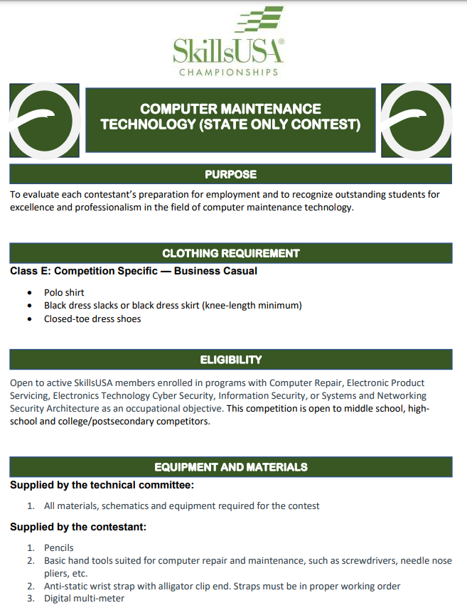
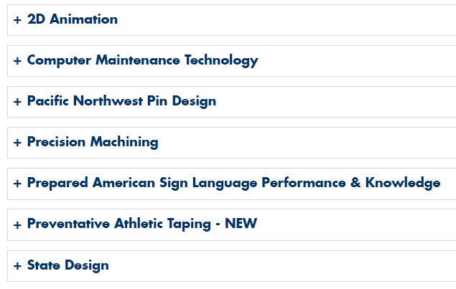
State Only Tech Standards
https://skillsusawashington.org/competitions/state-only/
Contests that are only offered in Washington State
There is no opportunity to compete at a National Level
Designed with the help of local industry and advisory
Can only be found on the SkillsUSA Washington website
https://skillsusawashington.org/competitions/state-only/

Slide 39
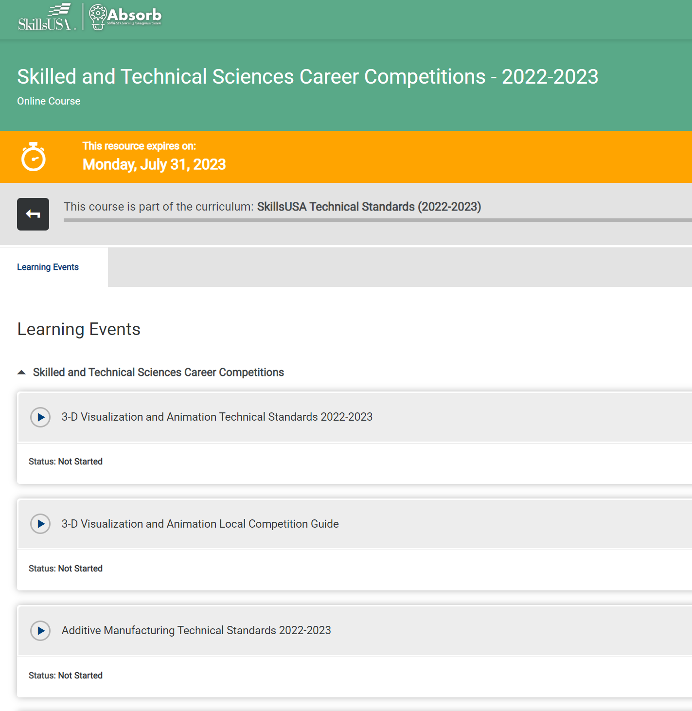
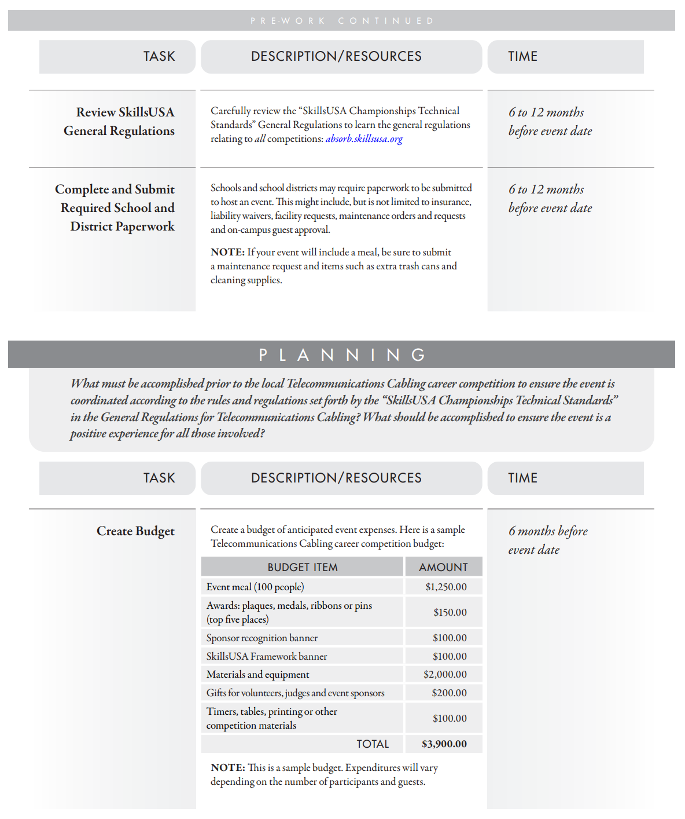
SkillsUSA Absorb
https://mycareeressentials.org/

Slide 40
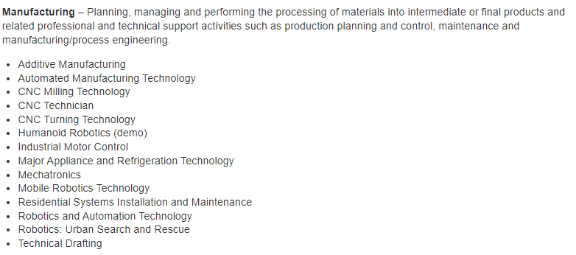
Competitions
100+ Nationally recognized competitions
16 Career Clusters
Each Career Cluster has multiple competitions

Slide 41
Integrating Curriculum Overview
Skills Competition as Assessments:
Framework Standards for Industry are built into the Technical Standards
Grade sheet \ assessments are already built
Supporting documents \ assessments for modules have been completed
Look at non-course contests
Job Skills Demo A
Job Interview
Audio Video Production

Slide 42
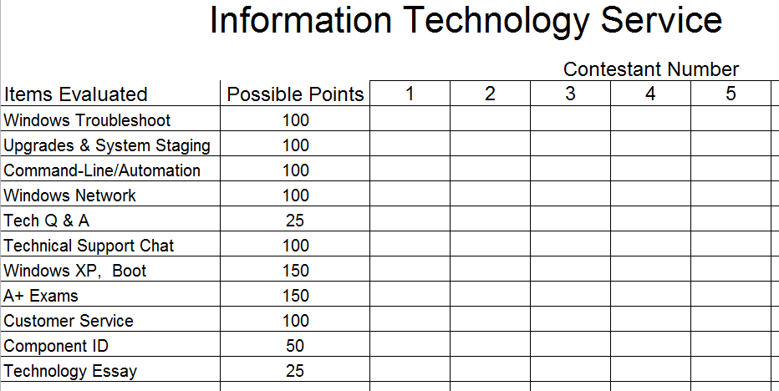
Grade Sheets

Slide 43
Use Materials Provided
Assessments for modules have been completed
Use Multiple stages of a contest to create multiple assessments
Information Technology Services - Customer Service Module

Slide 44
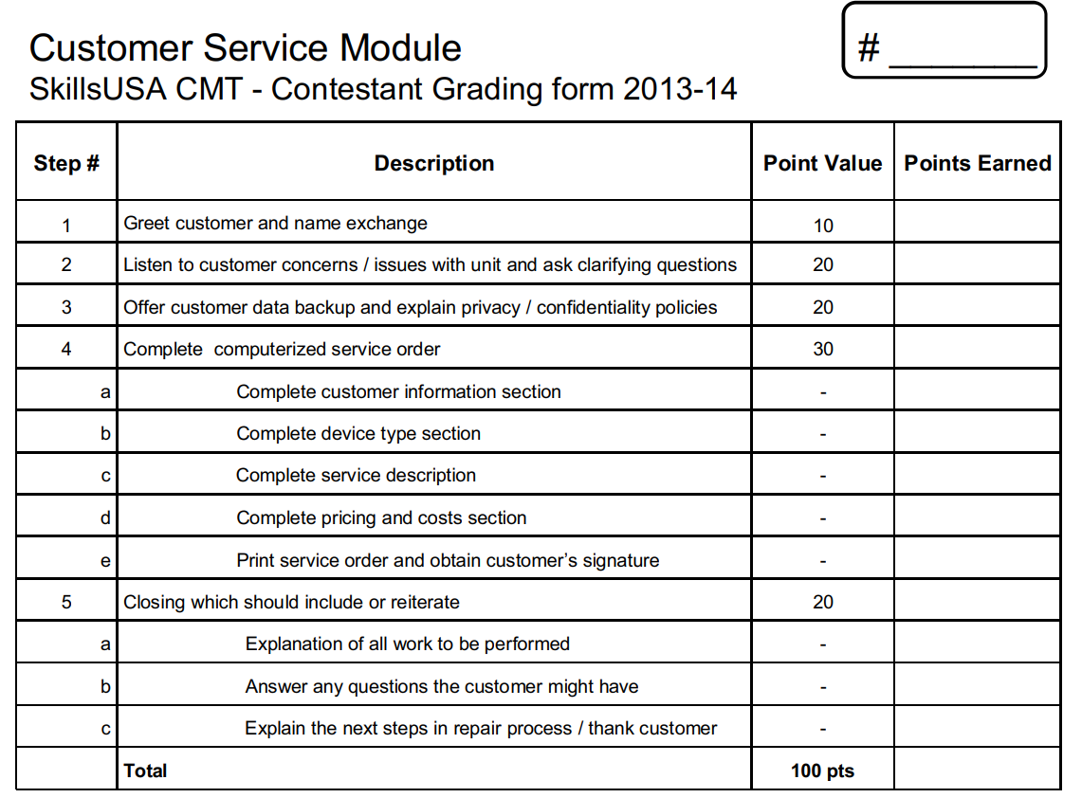
Information Technology Services Customer Service Module

Slide 45
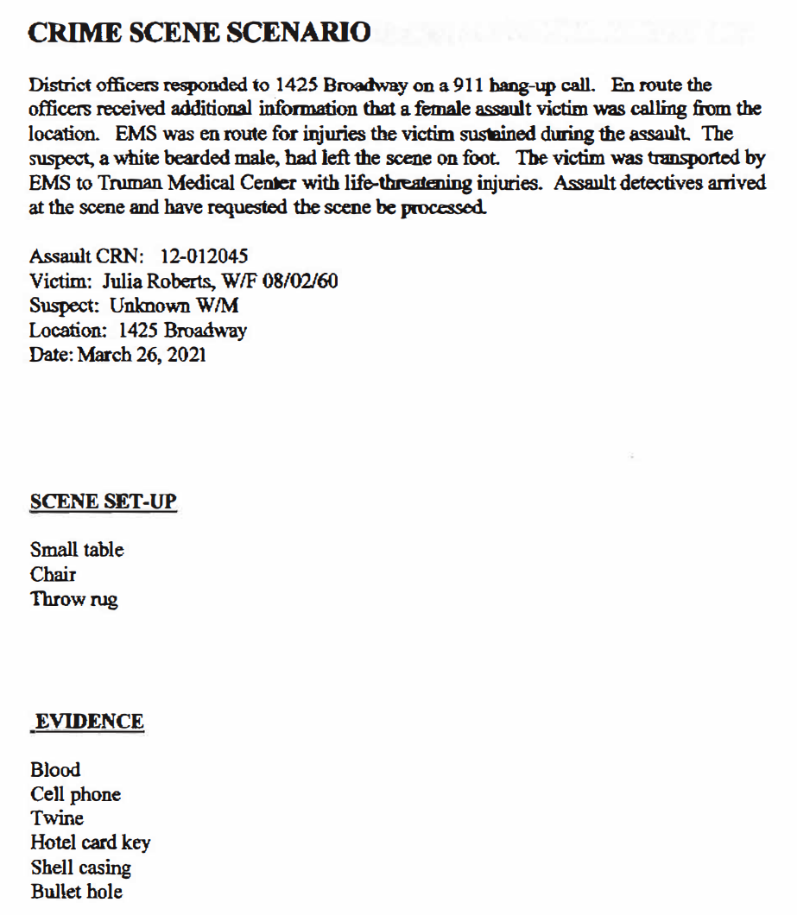
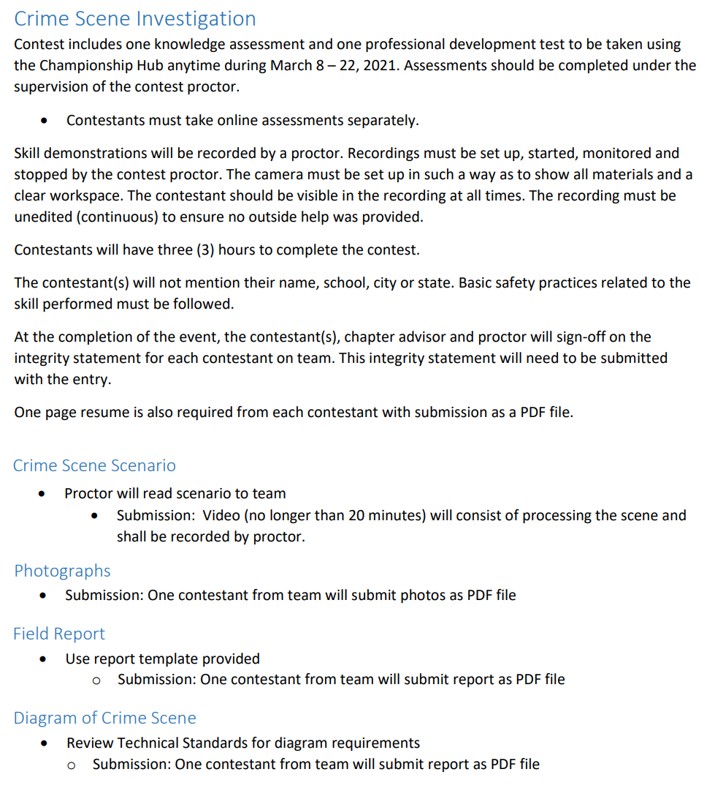
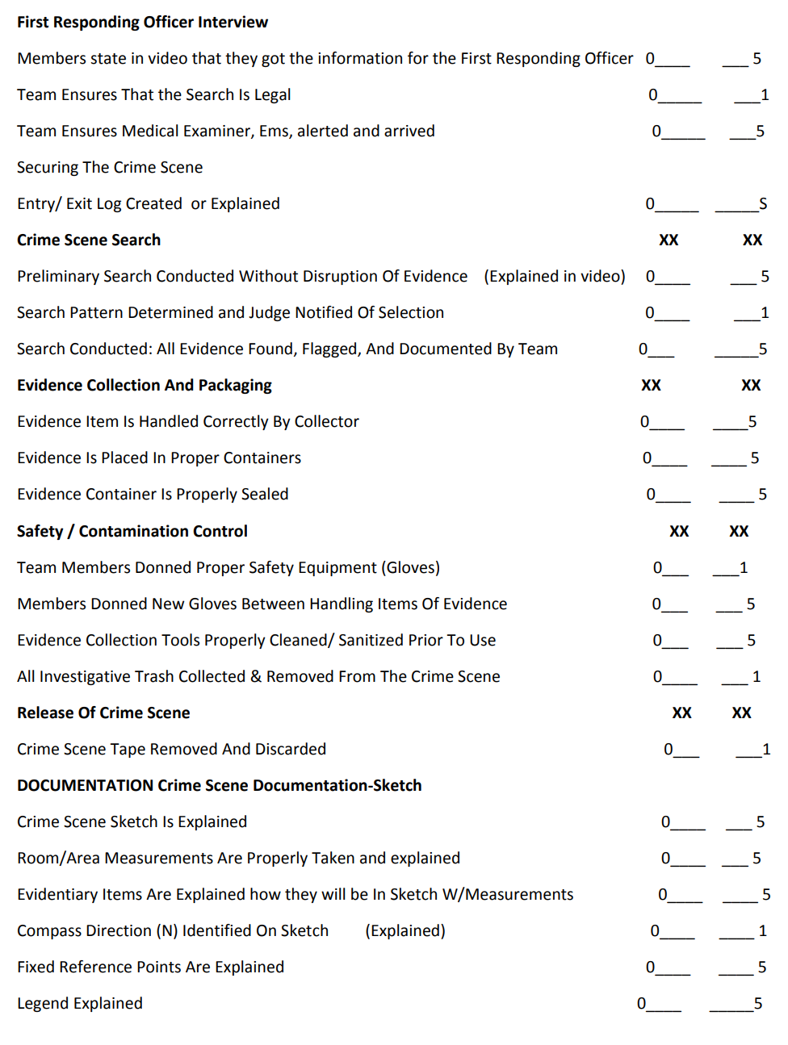
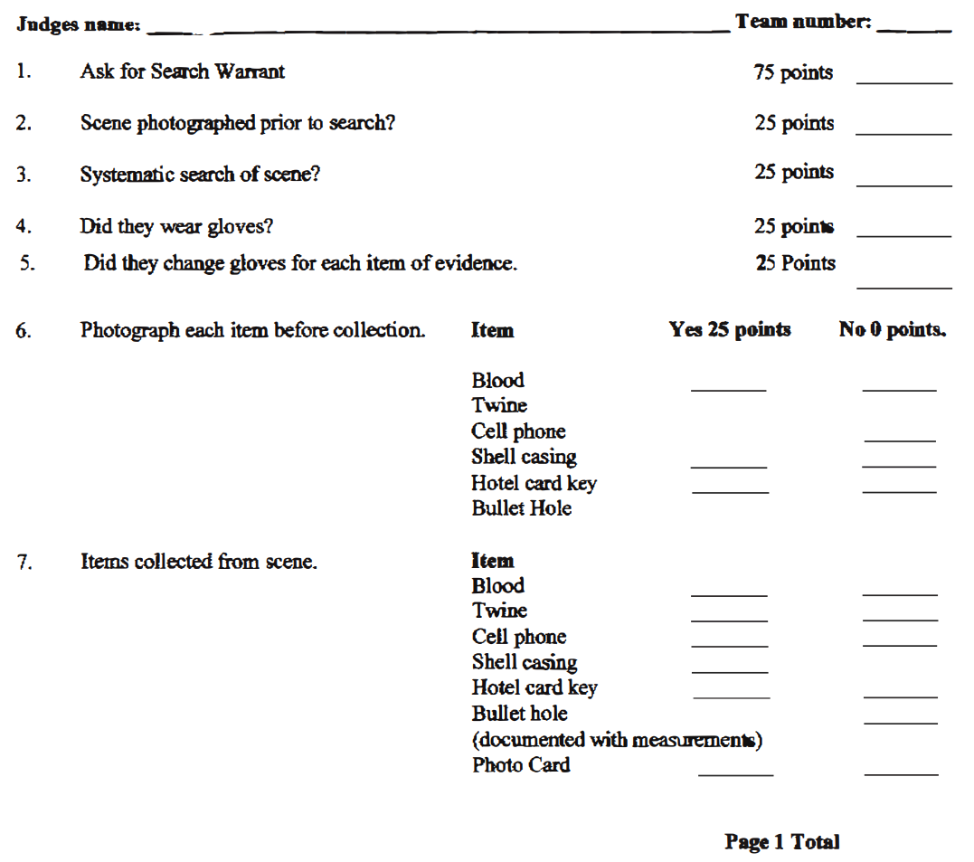
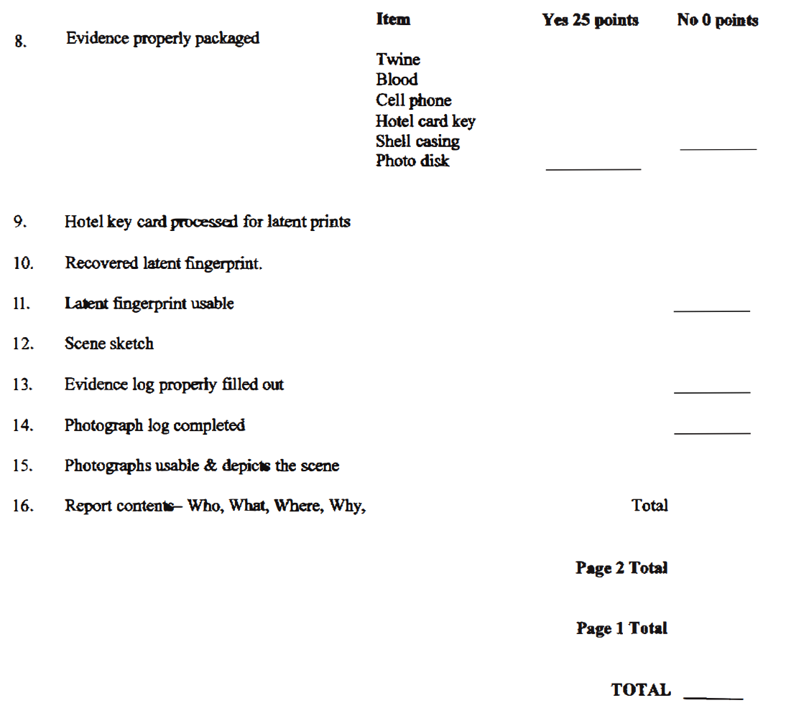
Existing Project (CSI)
Don’t reinvent the wheel
Contact your regional coordinator for example projects
Utilize National Rubric\scoresheets

Slide 46
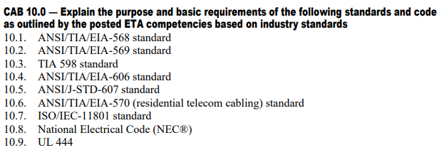
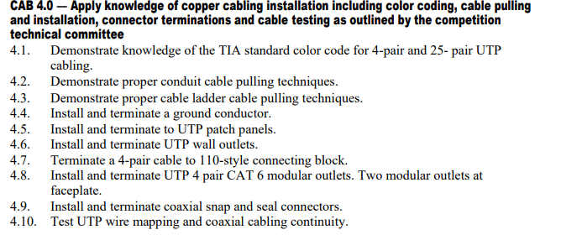
Integrating Curriculum (Telecom)
Add to Program Framework
Formative Assessments
Define hardware labels
Make Jumper Cables
Make Coaxial Cable
Punch down Assessment
Summative Assessments
Install serviceable connections between walls
Room Rewiring Project

Slide 47
Contests in Curriculum Example
Contests Supported by an IT class that are incorporated into the class curriculum
Occupational
Technical
Leadership
Career Pathways Showcase
Computer Maintenance
Extemporaneous Speaking
Related Technical Math
Community Service
Cybersecurity
Job Interview
T-Shirt Design
Customer Service
Information Technology Services
Job Skills Demo A
Other
Occupational Health and Safety
Internet of Things Smart Home Install
Pin Design
CareerSafe Video
Telecommunications Cabling
Prepared Speech
National Pin & T-Shirt Design
Quiz Bowl
Sate Pin & T-Shirt Design
* No Student has competed but is supported

Slide 48
Dress Code
For a Regional level Washington state believes in not setting barriers for students
Students should be dressed for an interview or in Industry appropriate clothing
For National competitions students must follow the dress code stated in the Technical Standards for the competition they are competing in
New or growing chapters contact Karmen or Adam for information on how to access grants to purchase SkillsUSA materials

Slide 49
Collaboration with Regional Teams

Slide 50
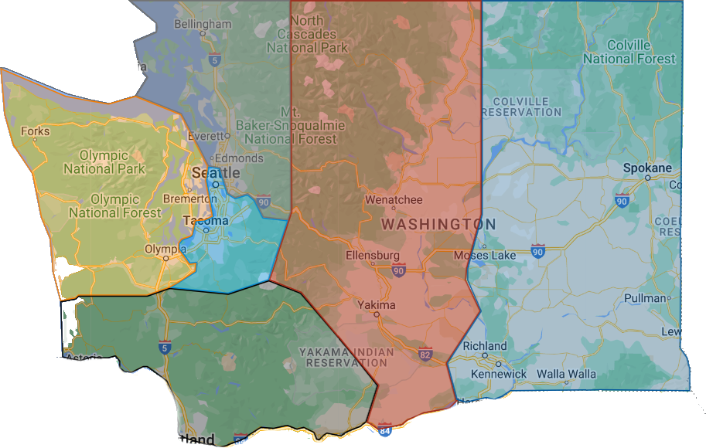
Region Coordinators
https://www.google.com/maps/d/viewer?mid=1pvPZ3YY9i_0Iiy7DmmC_qhGo73o8HWo&femb=1&ll=47.22111315185178%2C-120.5355055703125&z=7
Southwest
Nathan Younger
Ray Nelson
Olympic
Megan Ritchie
Tyler Renz
Puget Sound South
Gary Milbradt
Adam Scroggins
Central
Lauren Thomas
Todd Smith
Eastern
Dan Parker
Jessa Nocis
Terry Yeigh
Brandon McDaniel
Puget Sound North
Mary Rawlins
Teri Bravomejia
6
4
2
5
3
1
Email: “Region name”@Skillsusawashington.org
e.g. Pugetsoundsouth@skillsusawashington.org

Slide 51
Region Contacts
Central Region: Central@skillsusawashington.org
Eastern Region: Eastern@skillsusawashington.org
Olympic Region: Olympic@skillsusawashington.org
Southwest Region: Southwest@skillsusawashington.org
PS North Region: Pugetsoundnorth@skillsusawashington.org
PS South Region: Pugetsoundsouth@skillsusawashington.org
Karmen Warner: director@skillsusawashington.org
Courtney Burger: courtney@skillsusawashington.org
Nationals Customer Care: customercare@skillsusa.org

Slide 52
Leveraging Regional Resources
Don’t reinvent the wheel
Identify who has run the competition in the past and ask for advice
Contact neighboring regions
Ask how they are going to run the competition
Ask to attend\participate
Ask to observe
Utilize SkillsUSA provided Materials
Integrate competition modules as assessments in class
Flip the responsibility for SkillsUSA onto your student leadership team

Slide 53
Communication
September
Add yourself to the Mailing List
Attend Fall Advisors Meeting
October and November
Attend Advisor Training
Notify the Region Representative of your interest to compete
November
Solicit advice\support from other region advisers
Integrate the competitions in your classroom
December
Register to Compete
January – February
Compete In Regional Competitions

Slide 54
Enhancing Your SkillsUSA Programs

Slide 55
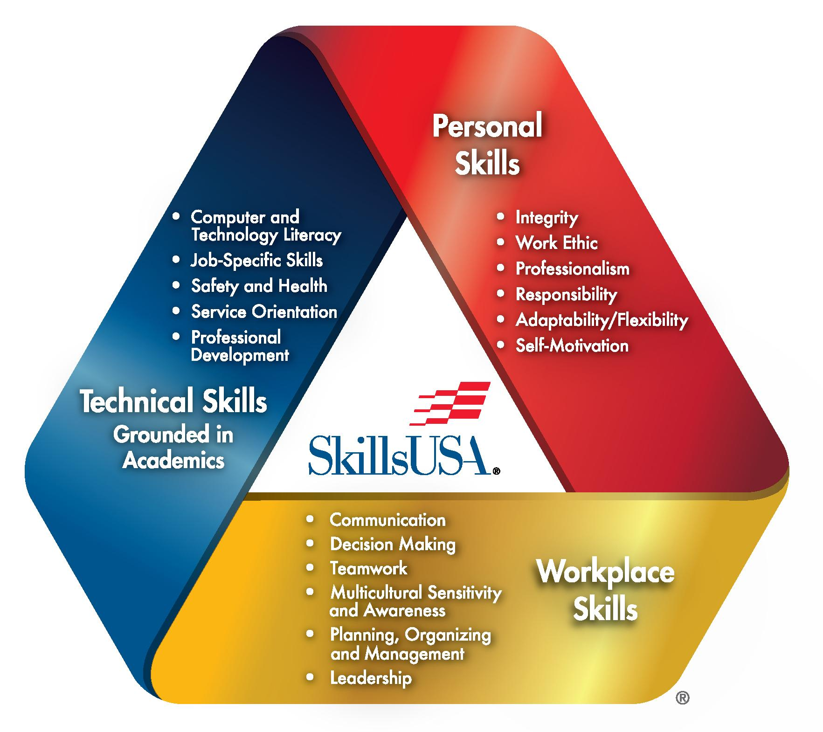
Evaluate Your Program
Evaluate areas you could use additional support
Identify resources that can help your program
Don’t reinvent the wheel
Work with your Regional Coordinators, State Office and State Trainers to find what works best in your program

Slide 56
Motivating and Inspiring Students
If your excited they are excited
Get your advisory involved and invite them to support students
Competition in curriculum exposes students to SkillsUSA
Invest in your student leaders then flip the classroom
Empowering messaging
“This is your program, take it as far as you want it to go”
“Sometimes it is the people no one can imagine anything of who do the things no one can imagine.” ― Alan Turing

Slide 57
Highlighting SkillsUSA Benefits to Students
https://www.youtube.com/watch?v=rz2vI1Zjn2k
Academic and career benefits
Enhanced Career Readiness
Improved Academic Performance
Networking and Career Opportunities
Personal and professional growth opportunities
Leadership Development
Professionalism and Ethics
Confidence and Public Speaking
Success stories and testimonials
https://www.youtube.com/watch?v=rz2vI1Zjn2k
Notes:
Enhanced Career Readiness: SkillsUSA prepares students for the workforce by equipping them with technical skills, leadership abilities, and professional attitudes that are highly valued by employers.
Improved Academic Performance: Participation in SkillsUSA activities and competitions helps students apply academic concepts in real-world scenarios, reinforcing their learning and often leading to better grades and higher levels of academic achievement.
Networking and Career Opportunities: SkillsUSA provides students with opportunities to network with industry professionals, potential employers, and peers from across the nation, opening doors to internships, job offers, and career advancements.

Slide 58
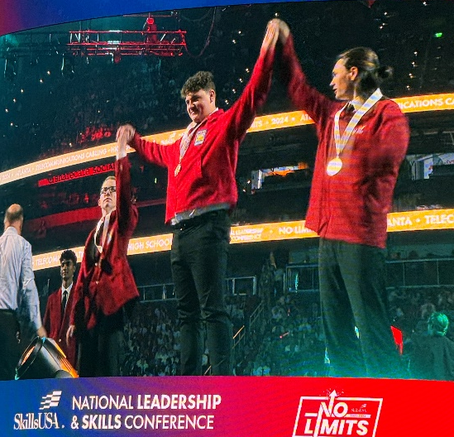
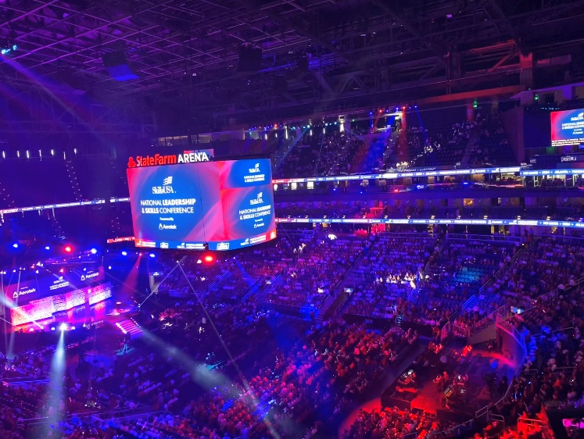
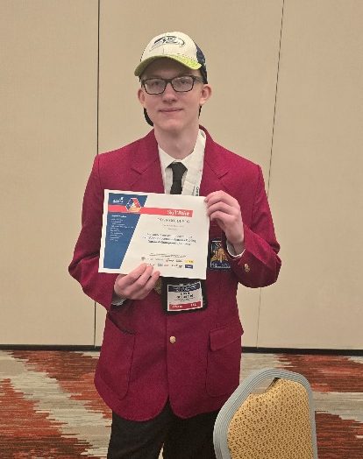
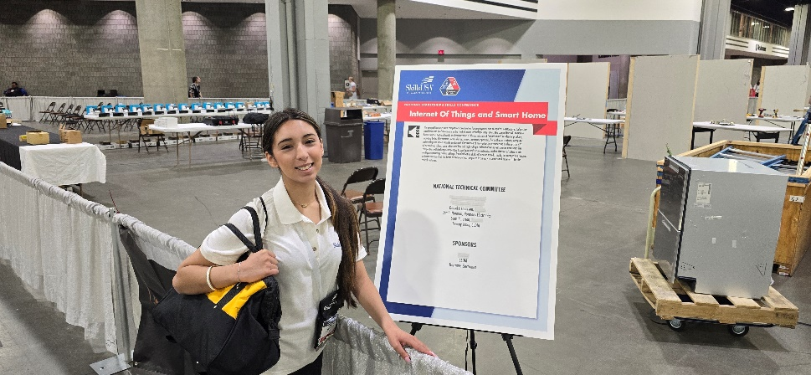
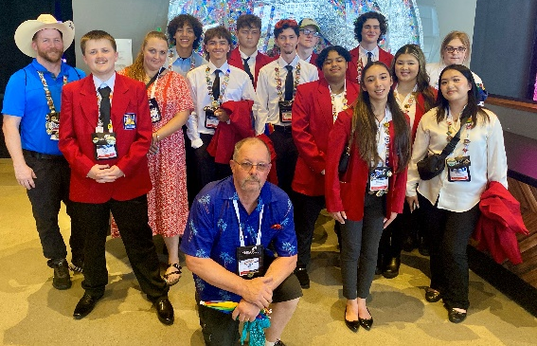
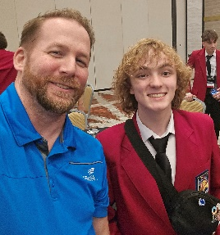
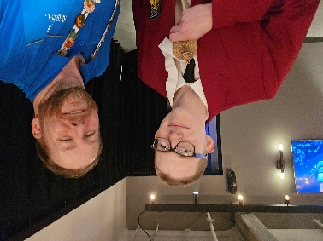
Recognizing and Celebrating Achievements
3rd
10th

Slide 59
Chapter of Excellence Program

Slide 60
Chapter of Excellence Program
2020 LinkedIn survey:
85% of employers reported wanting to hire individuals with leadership, written communication, verbal communication, flexibility and teamwork, as compared to field-specific skills.
Employers believe 11% of new employees have these skills
Education institutions believe 96% of graduates have these skills.

Slide 61
Chapter of Excellence Program
The Chapter of Excellence Program is designed to help students build these skills
Access to this tool is provided with your paid membership
Using this tool, students do 90% of the work planning activities (fundraisers, community service, etc.)
Helps ensure you are embedding your CTSO into your daily curriculum
Utilizes Measurables to evaluate activity success

Slide 62
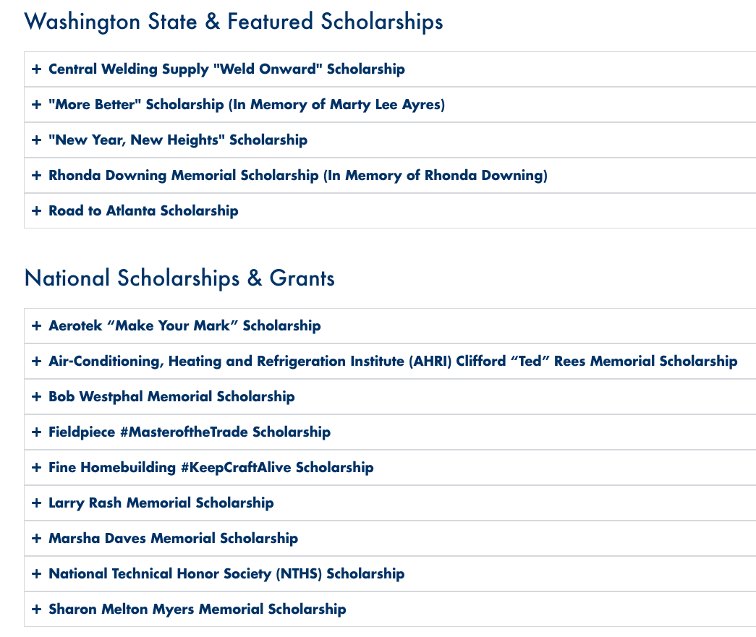
Scholarships
https://skillsusawashington.org/resources
After you have awarded 1st – 3rd place notify Advisors and competitors to check the SkillsUSA Washington website for Scholarship opportunities

Slide 63
Competition Schedule
October
Fall Advisor Meetings
Start of identification of regional contests
Advisors announce interest for regional competitions
Host for regionals identified
Registration must be paid to compete in regionals
Regional competitions held
Must compete in regionals to qualify for State
November
December
January – 1st week of February

Slide 64
A Word from the State Office

Slide 65
Costs
Support from the state
News

Slide 66
What Questions do you have?
Open Floor for Questions
Group Discussion and Sharing Experiences
Next Steps and Action Plans

Slide 67
Resources and Contacts
Contacts:
Karmen Warner: director@skillsusawashington.org
Courtney Burger: courtney@skillsusawashington.org
Central Region: Central@skillsusawashington.org
Eastern Region: Eastern@skillsusawashington.org
Olympic Region: Olympic@skillsusawashington.org
Southwest Region: Southwest@skillsusawashington.org
PS North Region: Pugetsoundnorth@skillsusawashington.org
PS South Region: Pugetsoundsouth@skillsusawashington.org
Nationals Customer Care: customercare@skillsusa.org
Documents:
Resources: https://skillsusawashington.org/resources/advisors/
12 Steps to Start the Year
Breaking down the Framework
2024-25 Program of Work
Membership Kit
Brand Portal
Membership Enrollment
Mailing List:
Sign up now
Social Media:
Social Media Links: https://linktr.ee/skillsusawashington
Instagram: skillsusawa
Linkedin: https://www.linkedin.com/company/skillsusa-washington/
Facebook: https://www.facebook.com/skillsusawa/
Scholarships:
https://skillsusawashington.org/resources/students/

Slide 68
Thank You
Join the Mailing List
Thank you for all you do for your students

