Slide 1
All Advisor Meeting
September 23, 2024

Slide 2
State Staff
Karmen Warner – Executive Director
Courtney Burger – Associate Director
David Barragan – Director of Student Development
Veronika Pohl – Director of Marketing
Adam Scroggins – Certified Trainer
Todd Smith – Certified Trainer

Slide 3
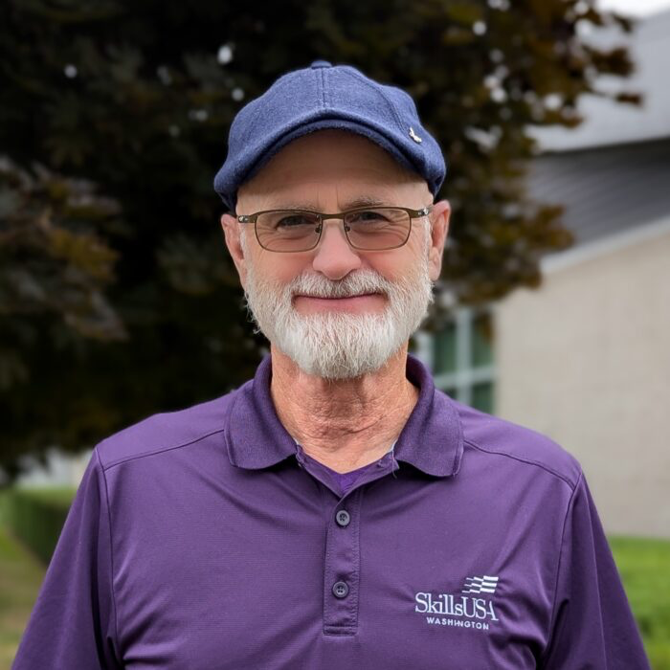
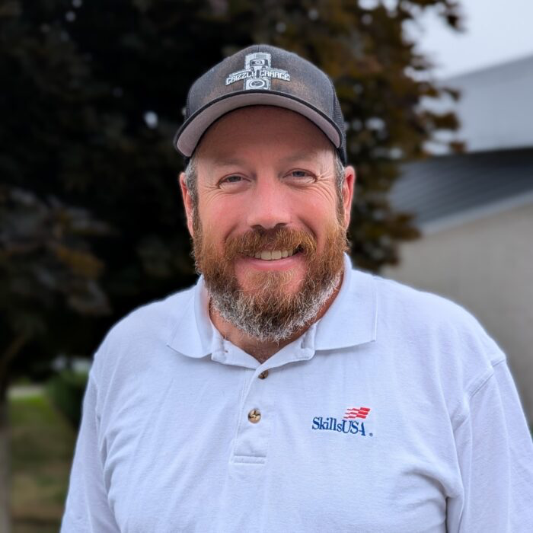
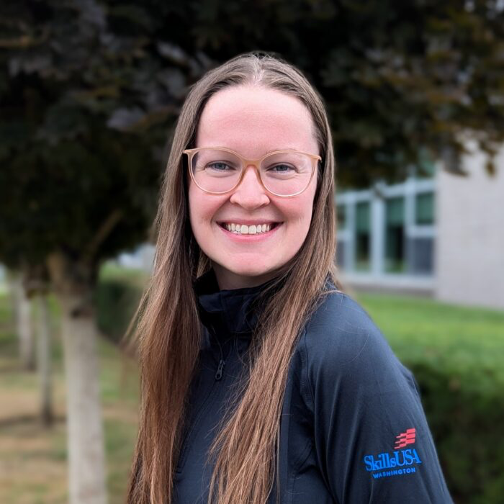
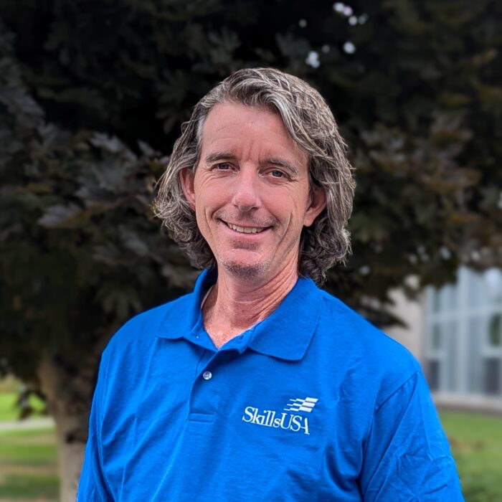
Eastern Region
eastern@skillsusawashington.org
Terry Yeigh
Rogers High School - Spokane
Brandon McDaniel
Newport High School
Jessa Nocis
Cheney High School
Dan Parker
Rogers High School - Spokane

Slide 4
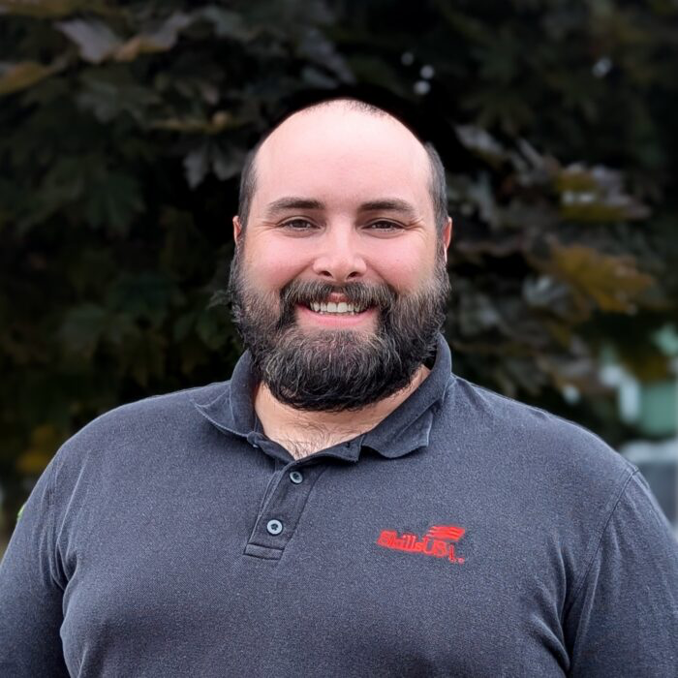
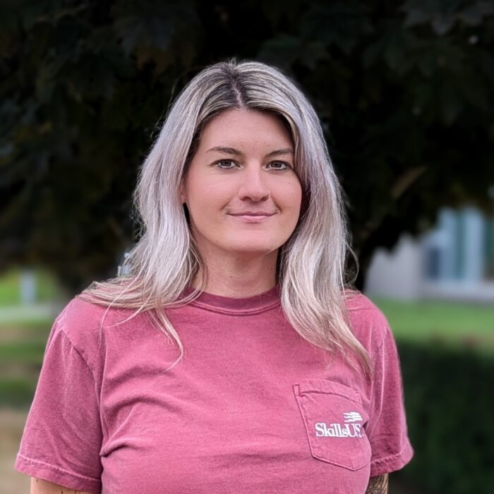
Olympic Region
olympic@skillsusawashington.org
Tyler Renz
Elma High School
Megan Ritchie
New Market Skills Center

Slide 5
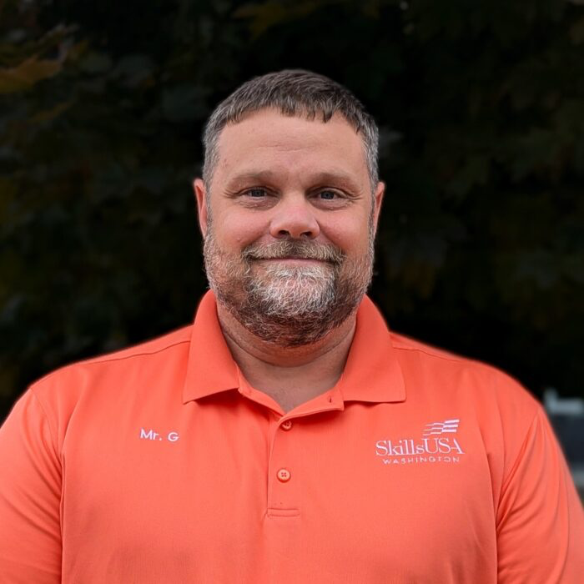
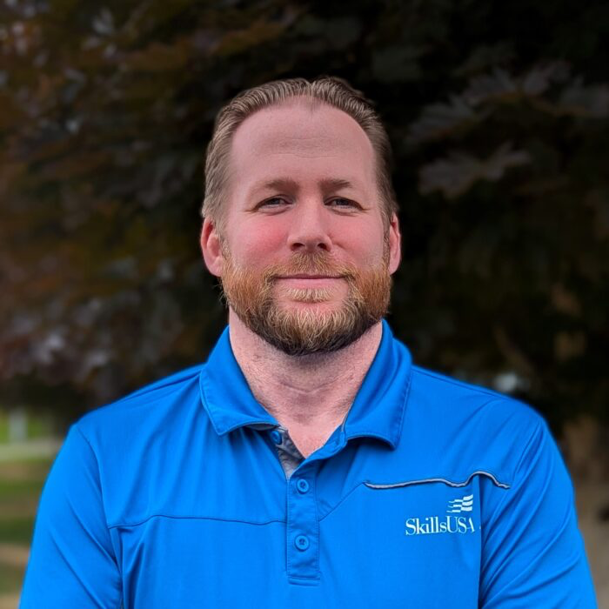
Puget Sound South Region
pugetsoundsouth@skillsusawashington.org
Gary Milbradt
Pierce County Skills Center
Adam Scroggins
Pierce County Skills Center

Slide 6
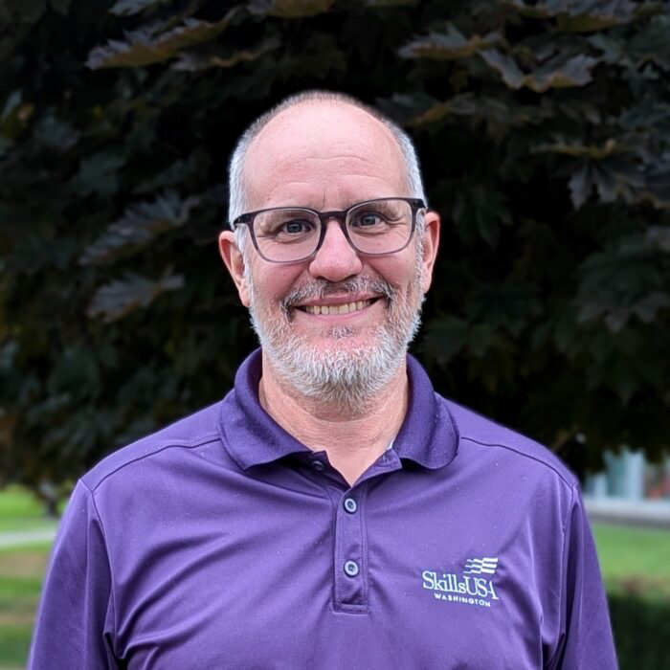
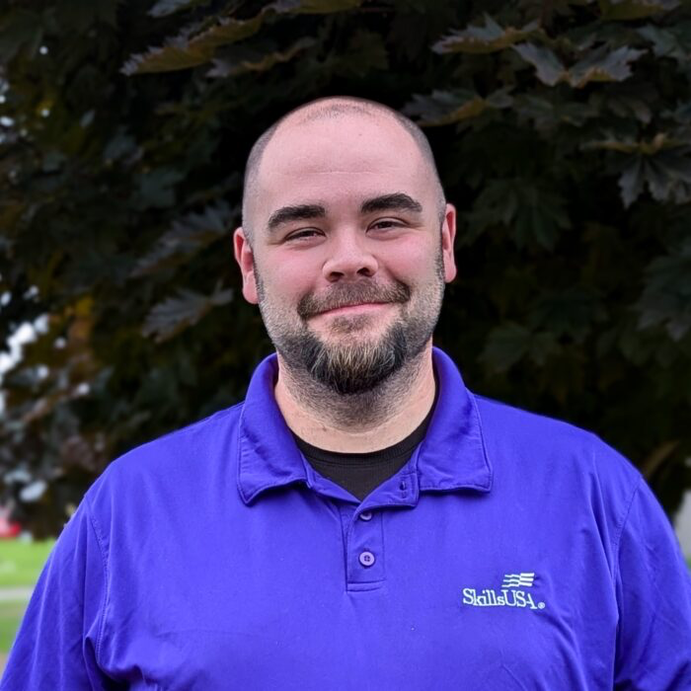
Southwest Region
southwest@skillsusawashington.org
Ray Nelson
Cascadia Tech Academy
Nathan Younger
Heritage High School

Slide 7
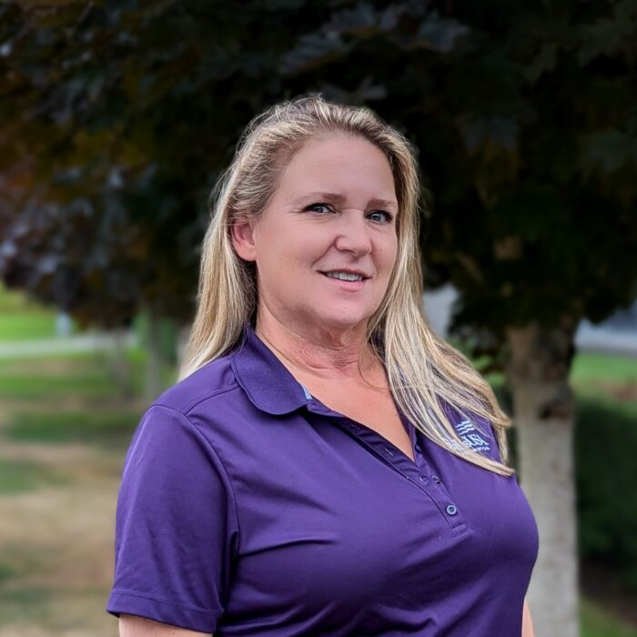
Puget Sound North Region
pugetsoundnorth@skillsusawashington.org
😃
Mary Rawlins
Northwest Career & Technical Academy
Teri Bravomejia
Arlington High School

Slide 8
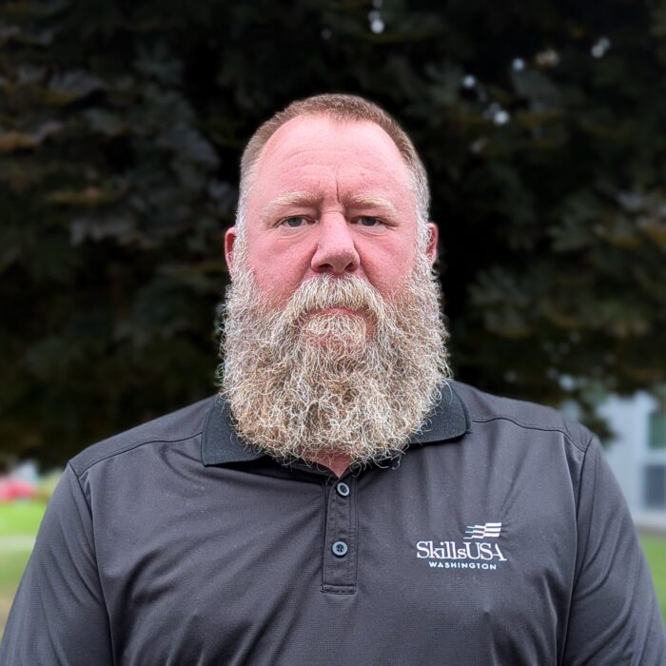
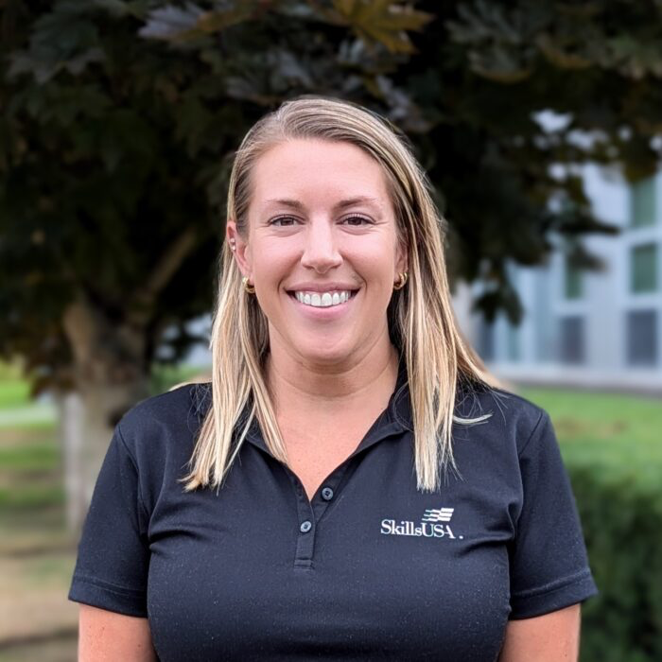
Central Region
central@skillsusawashington.org
Todd Smith
SEATech Skills Center
Lauren Thomas
Toppenish High School

Slide 9
Board of Directors
Adam Scroggins – President
Jessica Dempsey – Vice Chair
Jenna McDonald – Secretary
Nate Baker – Treasurer
Gary Milbradt – Puget Sound North
Mary Rawlins and Teri Bravomejia - Puget Sound North
Tyler Renz and Megan Ritchie – Olympic
Terry Yeigh- Eastern
Todd Smith and Lauren Thomas – Central
Ray Nelson and Nathan Younger – Southwest
Sarah Patterson, AGC Washington
Cheryl Stewart - AGC Inland NW
Stephanie Patterson - L&I apprenticeships
Kristina Young - The Boeing Company
Mark Wreath – WACTA Representative

Slide 10
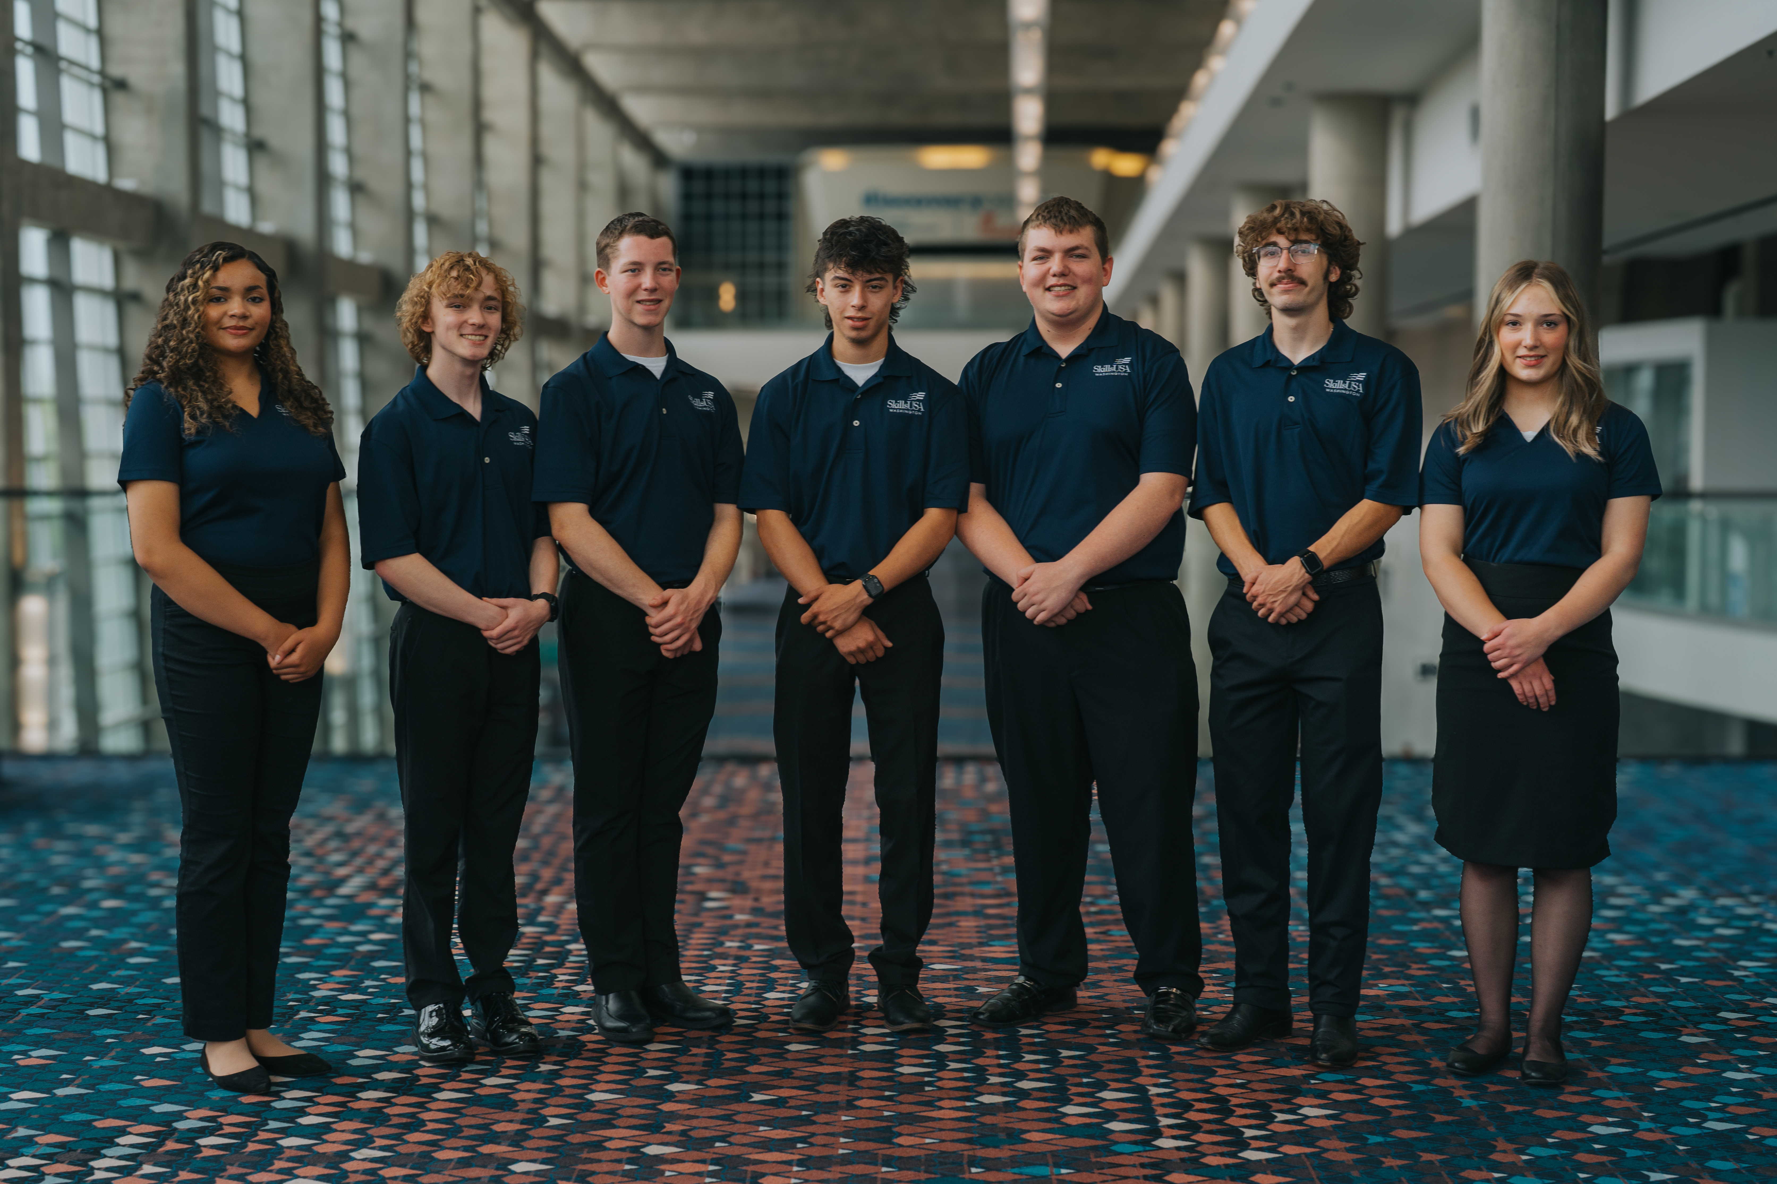
State Officer Team

Slide 11
Updates
NEW Website
App – Year-Round Updates
Boeing Assembler Competition
Registration System – All Conferences
New Payment Address
Welding Sculpture – Thank you Wagstaff
Achievements
Growth, Central Welding Supply, Boeing, SSE, NET, NTC
Vision of Organization
Great Events > Great Opportunities
Reminder: All invoicing will come via Quickbooks (No merchant fee)
New Payment Address:
SkillsUSA Washington 527 NW Elm Ave, Ste 3 #129 Redmond, OR 97756
Notes:
Gold + Largest membership growth, boeing, app work, central welding supply

Slide 12
Goals
Last years goals:
Training Center on website - Yes
Membership growth – Yes
Keep costs as LOW as possible for our students - Yes
Every contest led by industry – Almost
Increase scholarship opportunities to give back to our student members and their chapters. – Yes
Notes:
Gold + Largest membership growth, boeing, app work, central welding supply

Slide 13
SkillsUSA Washington Imperatives
Get industry involved and in front of our students.
Keeps cost low
Increases experience and opportunities for the students
Technical Standards are used
Unified regional championships
Ensures all SLC participants are properly equipped and prepared for the progressive nature of our championships
Must pay our invoices in a timely manner
Notes:
Gold + Largest membership growth, boeing, app work, central welding supply

Slide 14
October 25th - 26th
Black Diamond Camp
Registration Closes October 2nd
Registration NOW OPEN
Questions?
Courtney@skillsusawashington.org

Slide 15
Important Dates/Deadlines
Events
Advisor Training Series
Fall Leadership Camp Registration Closes | October 2nd 2024
Fall Leadership Camp | October 25th – 26th 2024
Regional Conference Registration Opens | Varies by region
Regional Conference | Reference your region’s webpage
State Membership Deadline | February 1st 2025
State Conference Draft / Registration Opens | February 6th 2025
State Leadership & Skills Conference | March 27th – 29th 2025
Assembler Competition | April 12th 2025
National Leadership & Skills Conference | June 23rd – 27th 2025
SkillsUSA 101 | Tuesday, October 1 @ 4-6 PM
Chapter Of Excellence | Thursday, October 3 @ 4-6 PM
Preparing Regional Championships | Tuesday, October 8 @ 4-6 PM
SkillsUSA Advanced – Teaching Tools | Thursday, October 10 @ 4-6 PM
Embracing DEI in the CTE Classroom | Tuesday, October 15 @ 4-6 PM
Integrating SkillsUSA into your Classroom Framework | Thursday, October 17 @ 4-6 PM
Round Table: Statewide Support for Advisors | Tuesday, October 21 @ 4-5 PM

Slide 16
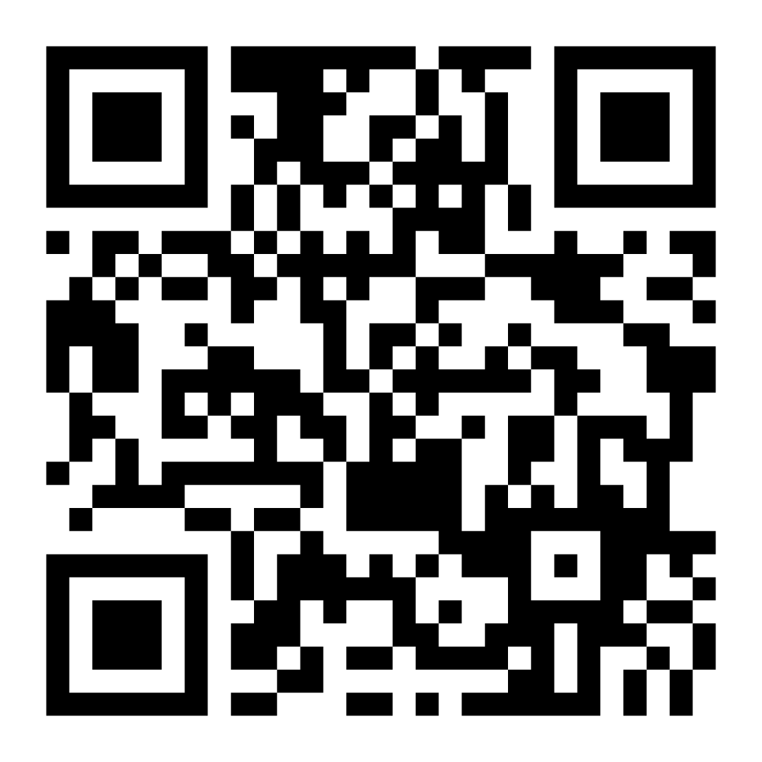
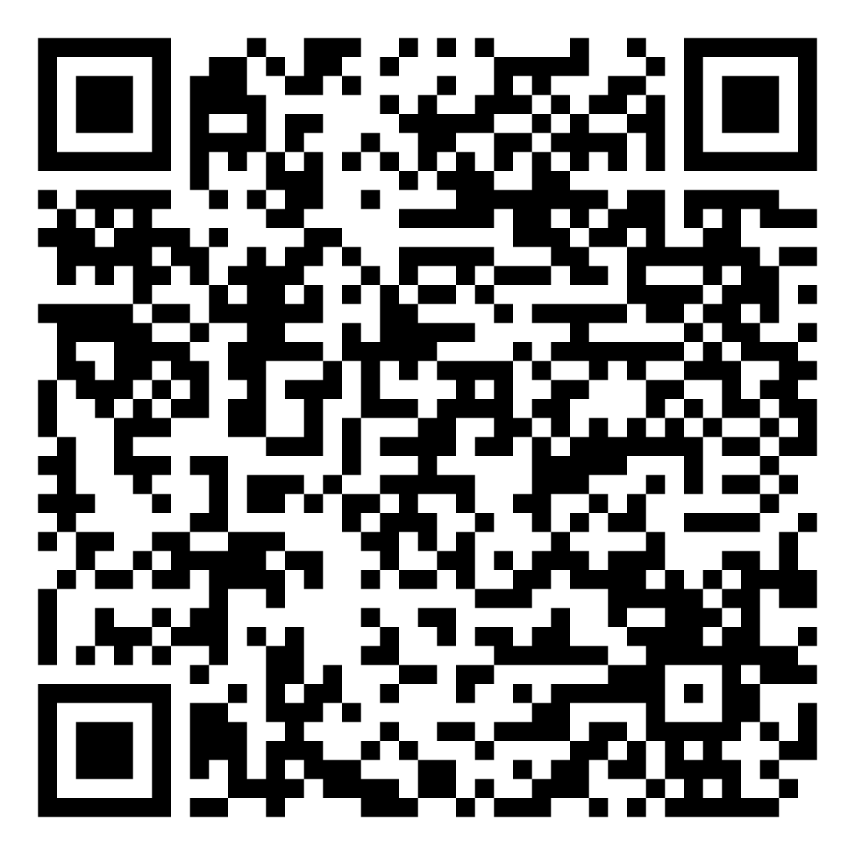
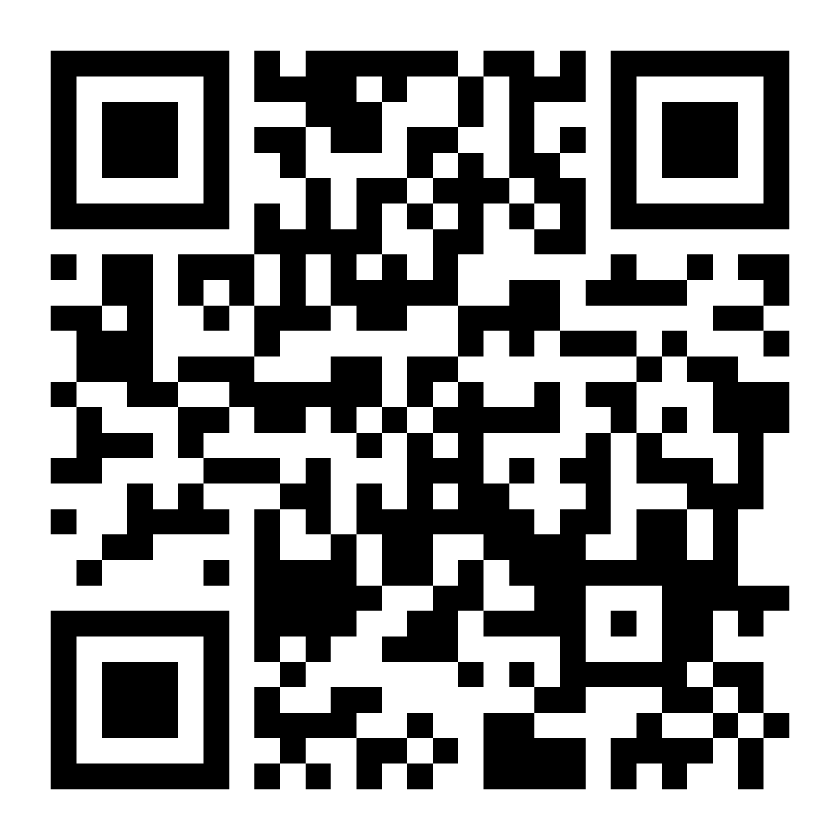
Communication is KEY
Website
Mailer
Washington App

Slide 17
Cost Breakdown
Membership Dues
Middle School: $12
High School & College/PS: $20
Professional: $30
Fall Leadership Camp
$225/registrant
Includes
Four Meals
Lodging
Camp Shirt + Swag
Advisor Summit / National Facilitation
Framework Creation
General and STEM Clock Hours
Regionals
One standard fee – Varies per region
State
$165/registrant
Nationals
Lowered this last year! ☺

Slide 19
Scholarships – Apply!
First Friday of the Month
Chapter Challenge
Friday Nov 1st
Central Welding Supply “Weld Onward” - $1,000.00
Friday December 6th
“More Better” - $1,000.00
Friday January 3rd
“New Year, New Heights” - $500.00 (4 recipients)
Friday February 7th
Rhonda Downing Memorial - Full SLSC Registration Cost
Friday April 4th
Road to Atlanta - $1,000.00 (2 recipients)
100% paid membership for up to 55 members ($1,000 value) X 5
The Chapter with the greatest overall engagement (likes, comments, shares, app downloads) wins!

Slide 20
Chapter Challenge Win paid membership for up to 55 members ($1,000 value) X 5 Deadline October 11th
Download the SkillsUSA Washington app
Follow our Instagram and Facebook pages
Share a post about your chapter on Instagram/Facebook tagging @SkillsUSAWashington and use the hashtag #SkillsUSAWAChapterChallenge
Example:
Share a post of your chapter in their SkillsUSA gear.
Caption: ”Excited for another great SkillsUSA year at GKHS! #SkillsUSAWAChapterChallenge”
Encourage your school and community to like, comment, and share your post
The chapter that generates the most likes, comments, and shares across both platforms(Facebook and Instagram) wins!
We will announce the winners on our Instagram account Monday Oct 14th

Slide 21
We are here to help!
State Staff
Karmen Warner – Executive Director
director@skillsusawashington.org
Courtney Burger – Associate Director
courtney@skillsusawashington.org
Adam Scroggins – Certified Trainer
pugetsoundsouth@skillsusawashington.org
Todd Smith – Certified Trainer
central@skillsusawashington.org
Regional Coordinators
Central Region – central@skillsusawashington.org
Todd Smith, Lauren Thomas
Eastern Region – eastern@skillsusawashington.org
Terry Yeigh, Jessa Nocis, Brandon McDaniel, Dan Parker
Olympic Region – olympic@skillsusawashington.org
Tyler Renz, Megan Ritchie
Puget Sound North Region – pugetsoundnorth@skillsusawashington.org
Mary Rawlins, Teri Bravomejia
Puget Sound South Region – pugetsoundsouth@skillsusawashington.org
Adam Scroggins, Gary Milbradt
Southwest Region – southwest@skillsusawashington.org
Ray Nelson, Nathan Younger

Slide 22
Questions?

Slide 23
Regional Meetings
Breakout Sessions

